Slide 1
EMPLOYABILITY CONFERENCE 2022
Employability: expanding the narrative for a rapidly changing world – continuing the conversation
Live Briefs - ARU’s approach to integrating real world professional experiences within the curriculum
Sarah Janes, Deputy Director of Student & Library Services &
Dr Marina Boz, Academic Employability Consultant (AEC)

Slide 2
Live Briefs - ARU’s approach to integrating real world professional experiences within the curriculum
Sarah Janes, Deputy Director of Student & Library Services
sarah.janes@aru.ac.uk
Dr Marina Boz, Academic Employability Consultant (AEC)
marina.boz@aru.ac.uk

Slide 3
Anglia Ruskin University (ARU)
Established 1858 as a school and as a university in 1992
35,515 students worldwide from more than 185 countries
Approx. 380 taught UG and PGT course - 215 UG & 164 PGT (incl CPD courses)
Campuses in Cambridge, Chelmsford, Peterborough and London
Majority of students fall at least into one group of disadvantage
Notes:
Key concept in HE- professional employment rate and provision
Central to TEF- DLHE data (DLHE was the old survey, it's now GOS)
Definitions of employability have shifted – now holistic view – graduate attributes, softer skills – in conjunction with specific subject knowledge and skills
HEA/Advance HE definition
What we offer to students – employer informed employability

Slide 4
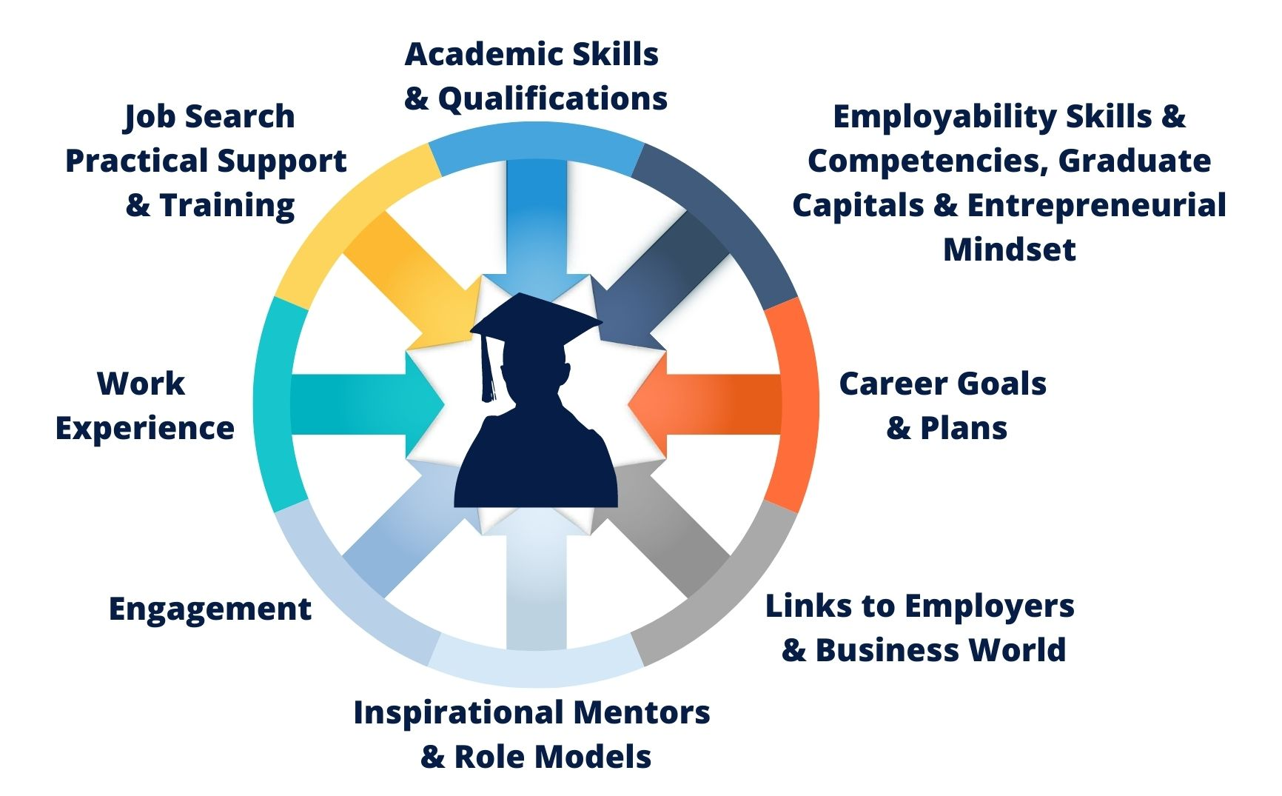
The ARU Student & Graduate
ARU is committed to education that:
Develops the ability of our students to gain, sustain and progress in graduate employment and to be successful in their next, and, future roles.¹
Engages, challenges and empowers students to reach their full potential.²
1. Designing our Future 2017-2026: https://aru.ac.uk/anglia-learning-and-teaching/about-us/our-strategy
2. Education Strategy 2018-2022: https://aru.ac.uk/anglia-learning-and-teaching/about-us/our-strategy
3. Active Curriculum Framework: https://aru.ac.uk/anglia-learning-and-teaching/about-us/our-strategy
​
Notes:
The ARU Education strategy - need to meet both student and employer expectations in preparing students for living and working in the 21st century
Commitment to ensuring ARU education enables students to be successful in their future careers, and reach their full potential.
Student-centred approach to employability with the provision – diagram
Active Curriculum Framework - to meet our Education Strategy’s commitment
Provides a holistic whole curriculum approach to our students’ development - personal capitals required to achieve successful outcomes

Slide 5
Employability Priorities
Four Major Strands
A whole curriculum approach – embedding employability into our curriculum and assessment strategies at all levels and from the start.
Significantly increase the number and breadth of real-world work opportunities available to our students.
Improving student engagement with employability and with their own career development from the start.
An institutional commitment to improving employability and enterprise in every subject.
Employability Strategy 2018-2023: https://aru.ac.uk/anglia-learning-and-teaching/about-us/our-strategy ​
Notes:
Examples of specific initiatives and actions we are taking to develop each of these strands: integrating employability into the curriculum is key to inclusivity, especially in making WIL available to all, no matter what the circumstances are of our students
# 1: E.g. Live Briefs, Employer Advisory Groups to inform curriculum content and development.
# 2: E.g. Dedicated Placements & Employer Engagement Team, the Anglia Ruskin Enterprise Academy (AREA), financial support including paid internship schemes and additional payment for certain groups of students.
# 3. E.g. Career Pulse, Personal & Career Development Plan, Aspirations monitoring, Student Employability Activators.
# 4. E.g.: Number of initiatives inlcuding: Chancellor's Leadership Award which encourages students to develop leadership and other employabiltiy skills via extra-curricular activities alongside study Students at the Heart of Knowledge Exchange (SHoKE) Project A project aiming to evidencing the benefits students can gain from knowledge exchange activities.
And Live Briefs within the curriculum, as well as other practice based subjects.

Slide 6
1 | KNOWLEDGE | knowledge, skills and future performance How can I develop graduate level knowledge and skills to become a confident well-rounded professional?
2 | SOCIAL CAPITAL | networks and social relations How can I develop my networks and social relations to enhance my knowledge of and access to targeted employment?
3 | CULTURAL CAPITAL | employability and cultural synergy How can I develop cultural appreciation of my sector and organisations so that I can present myself in a credible way?
4 | IDENTITY | self-concept and personal narratives How can I develop my understanding of the experiences, values and achievements to support the development of my professional profile? How can I develop strategies to accomplish my career goals?
5 | ADAPTABILITY | resilience and career adaptability How can I develop my capacity to move into and adapt to a fluid job market and to withstand the challenges and pressures I will encounter through life?
6 | THE WHOLE PERSON | employability as an outcome of lifewide learning How can I foster and evidence my creative and critical faculties in all that I do while at university so I am ready for graduate life and all that it brings?
The ARU Graduate Capitals
Active Curriculum Framework: https://aru.ac.uk/anglia-learning-and-teaching/about-us/our-strategy
Notes:
Capitals provide :
positive discourse to encourage students to optimise their personal qualities to enhance their employability
a framework for considering employability as an outcome of the learning experience.

Slide 7
A Whole Curriculum Approach: Embedding Employability
Focus on work-integrated learning (WIL) to increase employer engagement within the curriculum
WIL is the intentional integration of theory (i.e. what the student has learned) with the practice of work” (Dollinger and Brown, 2019, p. 90)
Live Briefs are purposefully designed to support the achievement of module learning outcomes
Notes:
“A Live Brief is a curriculum-based approach to engaging students and assessing their learning by using current, real-world activities devised and presented by professional partners in collaboration with academic staff”
It is inclusive for all,

Slide 8
Live Briefs: Definition
“A Live Brief is a curriculum-based approach to engaging students and assessing their learning by using current, real-world activities devised and presented by professional partners in collaboration with academic staff”.

Slide 9
Live Briefs: Critical Attributes
Activity
Currency
Outcomes-focused
Externality
Applied
Inclusivity
Productive
Impactful

Slide 10
Live Briefs: Programme Timeline
AY 2018/19: Employability Strategy
AY 2019/20: UG Portfolio Review supported by appointed Academic Leads for Employability
AY 2020/21: Phase 1 Live Brief Operational Delivery Starts
AY 2021/22: Phase 2 Live Brief Programme Scaling up
AY 2019/20: Phase 1 Live Brief Project Management Team
Notes:
Examples of specific initiatives and actions we are taking to develop each of these strands: integrating employability into the curriculum is key to inclusivity, especially in making WIL available to all, no matter what the circumstances are of our students
# 1: E.g. Live Briefs, Employer Advisory Groups to inform curriculum content and development.
# 2: E.g. Dedicated Placements & Employer Engagement Team, the Anglia Ruskin Enterprise Academy (AREA), financial support including paid internship schemes and additional payment for certain groups of students.
# 3. E.g. Career Pulse, Personal & Career Development Plan, Aspirations monitoring, Student Employability Activators.
# 4. E.g.: Number of initiatives inlcuding: Chancellor's Leadership Award which encourages students to develop leadership and other employabiltiy skills via extra-curricular activities alongside study Students at the Heart of Knowledge Exchange (SHoKE) Project A project aiming to evidencing the benefits students can gain from knowledge exchange activities.
And Live Briefs within the curriculum, as well as other practice based subjects.

Slide 11
Live Briefs: Year 1 Implementation Overview
72% of intended Live Briefs delivered
28 L4 and 1 L5 modules across 60 UG courses
31 partners
1,500 students approx.
MODULES BY FACULTY - DELIVERED 2020.2021
Arts, Humanities & Social Sciences | 13
Business & Law | 3
Science & Engineering | 9
Health, Education, Medicine & Social Care | 4
Total | 29

Slide 12
Live Briefs: Year 2 Scaling Up
86% of intended Live Briefs delivered
32 L4 and 46 L5 modules across 80 UG courses
69 partners
4,304 students
MODULES BY FACULTY - ONGOING 2021.2022
Arts, Humanities & Social Sciences | 33
Business & Law | 9
Science & Engineering | 27
Health, Education, Medicine & Social Care | 9
Total | 78

Slide 13
Conclusion: Key Take-Aways
Institutional initiative, key senior stakeholders
Project Management Group (ALT, RIDO, Student & Library Services)
Academic, pedagogic positioning
Inclusive, student-centred
Clear impact measures and accountability process
Long-term commitment to build on and move beyond Live Briefs to continue to develop an employment-focused curriculum

Slide 14
Thank you
Sarah Janes, Deputy Director of Student & Library Services
sarah.janes@aru.ac.uk
Twitter: @SarahJanesARU; @ARemployability
LinkedIn: https://www.linkedin.com/in/sarahclaydon
Dr Marina Boz, Academic Employability Consultant (AEC)
marina.boz@aru.ac.uk
Twitter: @MarinaBoz
LinkedIn: linkedin.com/in/marina-boz-7a76b9aa

Slide 15
THANK YOU

