Slide 1
EMPLOYABILITY CONFERENCE 2022
Employability: expanding the narrative for a rapidly changing world – continuing the conversation
Using visual methods to enhance our understanding of international student employability
Dr Xin Zhao, Lecturer, Information School & Dr Emma Parry,
Careers & Employability Consultant, Careers Service
The University of Sheffield

Slide 2
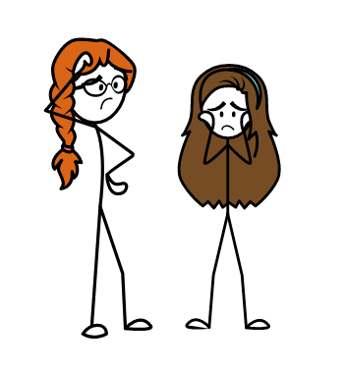
Using visual methods to enhance our understanding of international student employability
A practical workshop on using drawing in your research/practice

Slide 3
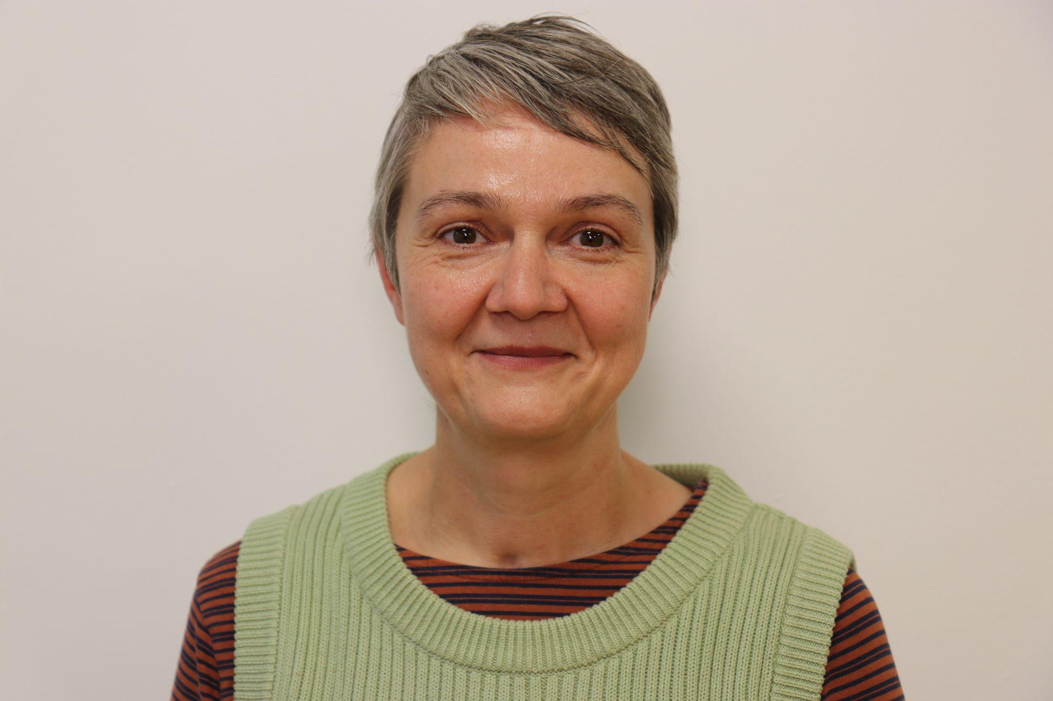
Introductions to speakers
Dr Xin Zhao
Lecturer, Information School
(xin.zhao@sheffield.ac.uk)
Dr Emma Parry
Careers & Employability Consultant, Careers Service
(e.parry@sheffield.ac.uk)

Slide 4
Outline of the session
2:00pm - 2:10pm | Introduction to using visual methods
2:10pm - 2:15pm | Introduction to drawing task
2:15pm - 2:30pm | Drawing task
2:30pm - 2:45pm | Sharing feedback/reflections from the drawing task and general Q and A Upload drawings to jamboards Share reflections on jamboards

Slide 5
Visual methods
3 main types of visual material:
2D pictures - drawings, cartoons, storyboards, maps, photographs, paintings etc.
3D objects - lego sculptures, clay sculptures etc.
Moving or electronic images - TV, videos, websites etc.
Material objects - toys, buildings, neighbourhoods etc.
Visual methods can be stand-alone methods or complementary to other methods as data gathering opportunities e.g. interviews
Visual methods can be stand-alone for analysis or combined with other modes of analysis e.g. I used critical discourse analysis to interpret talk alongside the drawings
Becoming more used within employability research but lack of visual methods used to explore international students and employability

Slide 6
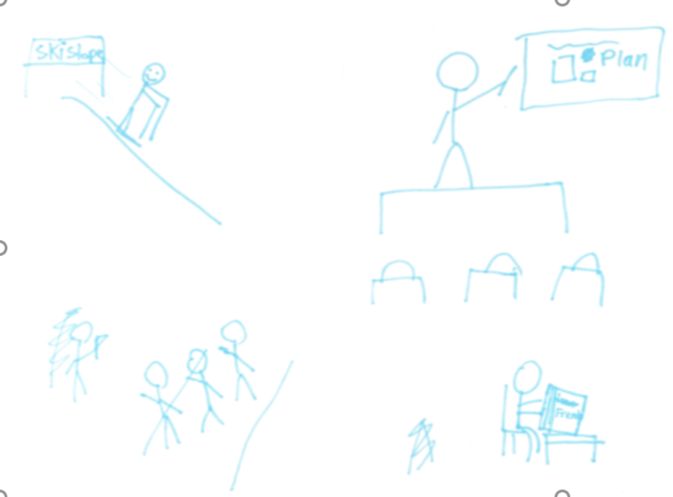
How I used drawings in my research: Drawings and talk combined
Mike talked me through his drawing and I asked him what his parents would say; what his friends would say and what his teachers would say…

Slide 7
Using your drawings data in different ways

Slide 8
Benefits and challenges of using drawings
Benefits | Challenges
Enables richer conversations (useful when talking with young people or people who are not native English speakers, for example) | Can make people feel judged
Useful way for people to ‘distance’ themselves when talking about difficult topics | Can make people feel anxious
Gives great data for research reports | Can be more time consuming in research (production time and analysis)
Gives a useful structure to talk about with the person who produced the drawing - helps them to organise ideas more easily | Produces a lot of data! Especially if you combine with other methods
Enables people to reflect more easily on complex topics - easier than words alone | Potential misinterpretation of the drawing by researchers

Slide 9
International Students’ employability
UK HE is heavily reliant on international students (20% of all students) (UKCISA, 2020)
Employability of graduates is a key purpose of HE and one of the main reasons for international students to study in the UK.
Research suggests UK higher education institutions have largely been UK-centric and that there is a lack of focus on the employability needs of international students (Goodwin & Mbah, 2019; Huang & Turner 2018).
A number of studies have since attempted to address the above issue by exploring the perspectives of international students on their employability needs (Zhao & Cox, 2022; ).
There remains a large gap in the literature to examine the perspectives of practitioners who support international students and employers who recruit international employees.

Slide 10
Using visual methods to investigate international employability
Current research tends to rely on traditional methods such as interviews and questionnaires on international student employability.
There remains a lack of innovative approaches to advance research in the field of international student employability.

Slide 11
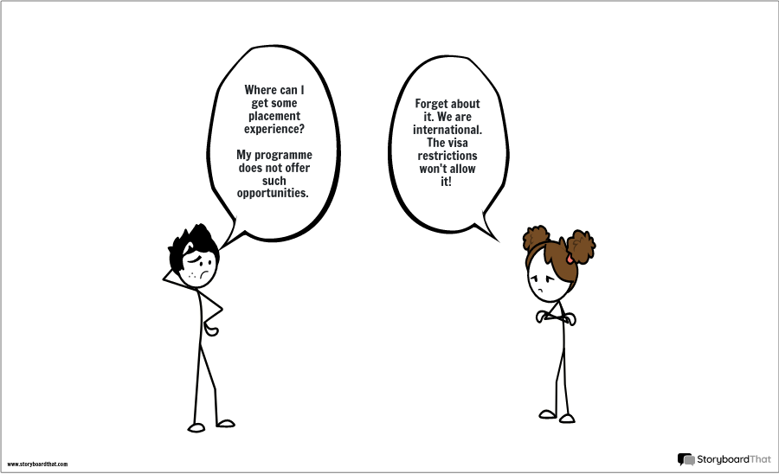
A digital storyboard created by an international student

Slide 12
Introducing the drawing task
Use pen and paper or StoryboardThat to create a drawing/storyboard. Please upload it to the Jamboard (see the link via Chat) or email your photo to Skye to upload (xin.zhao@sheffield.ac.uk)
For practitioners:
Draw a picture that represents your support for international students’ employability
For researchers:
What barriers exist for international students in the literature? Draw a picture to represent your ideas/experiences.
For employers:
Working with/recruiting international students/graduates - draw a picture to represent your ideas/experiences.

Slide 13
Plenary discussion and Q&A

Slide 14
THANK YOU

