Slide 1
EMPLOYABILITY CONFERENCE 2022
Employability: expanding the narrative for a rapidly changing world – continuing the conversation
Pinning Down Employability: Digital badging on an undergraduate module at The Open University Business School
Terry O’Sullivan, Senior Lecturer in Management
The Open University Business School

Slide 2
Pinning down employability: digital badging on an undergraduate module at The Open University Business School.
Employability Conference 2022: expanding the narrative continuing the conversation 22 March 2022
Terry O’Sullivan, Senior Lecturer in Management, The Open University Business School
Image with thanks to Scott Gustavson

Slide 3
What are digital badges?
The original ‘microcredential’
Graphic computer files which have information ‘baked into’ them
WHO (award holder)
WHAT (exactly what the had to do in order to be able to earn the badge.
the detail they can contain can recognise specialised achievements
WHENCE (provenance)
Stackable, combinable, machine-readable…
Used by some major organisations as recognition devices for internal training/development
Motivational for co-curricular activities (Coleman, 2018) and especially employability skill development (Law, et al., 2015)
Image by Gordon Johnson from Pixabay

Slide 4
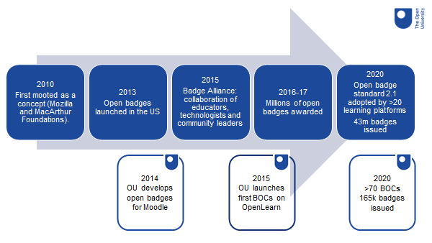
A brief history of Digital Badges at the Open University
Slide created by Dr Patrina Law, OpenLearn

Slide 5
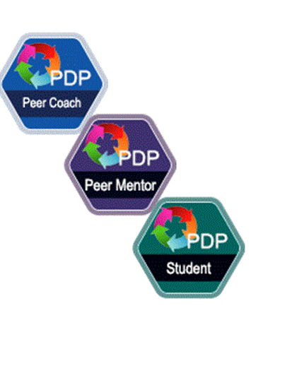
Using badges at the open university
Open Learn Badged Open Courses (BOCs)
Badged Open Courses, many focusing on employability skills, launched 2015
By 2022 172k badges had been issued by OpenLearn.
Ad-hoc use within credit-bearing modules to recognise specific (co-curricular) achievements including:
peer mentoring (WELS)
Journaling club, laboratory skills, online summer school (STEM)
B206 badging employability pilot

Slide 6
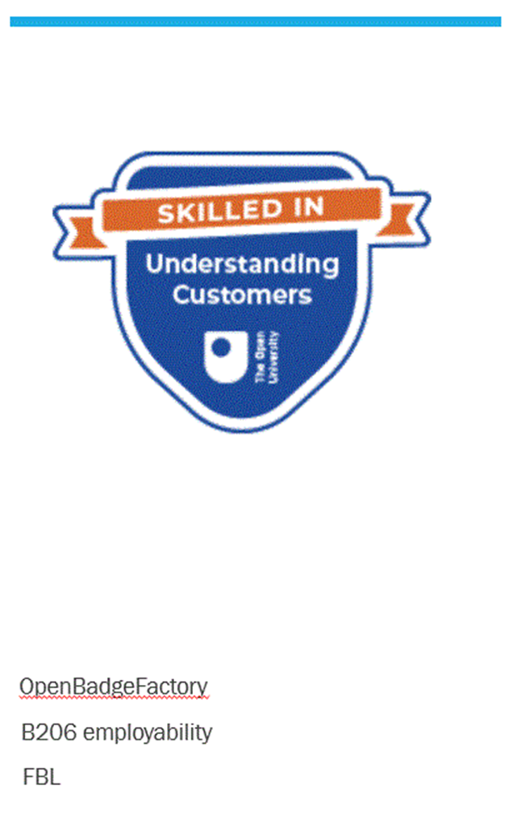
B206 – 60 credit online module on customer behaviour at OU Level 2. Activity-based pedagogy
Problem: uneven engagement with learning activities to promote employability
Opportunity: reflection on employability skills development using enhanced FutureYOU page
Solution: Digital badge as incentive to do more and be recognised for it
Credit MicroSoft image

Slide 7
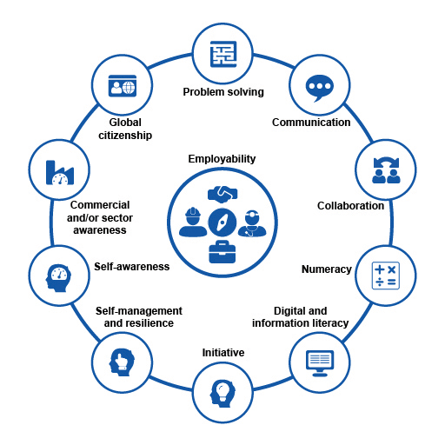
Write five reflections on module learning activities related to five employability elements
Submit all five together from the FutureYOU B206 Badge Track page
Verification and authorisation
Pick up your badge (from Open Badge Factory)
The Open University (2018)

Slide 8
Show the world that you are
with a digital badge

Slide 9
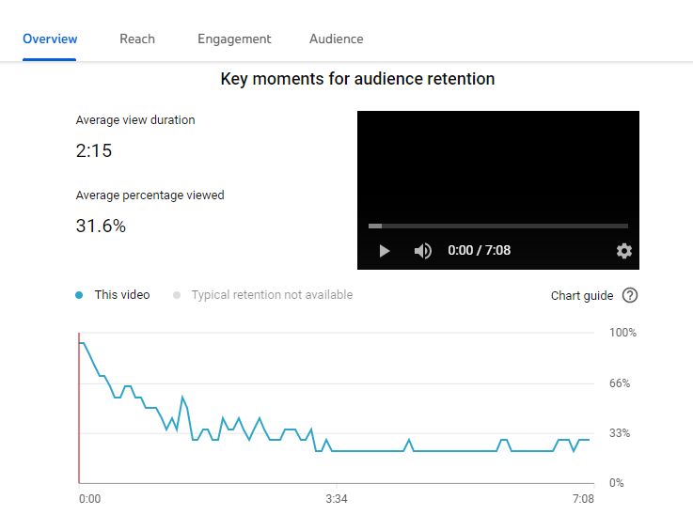

Slide 10
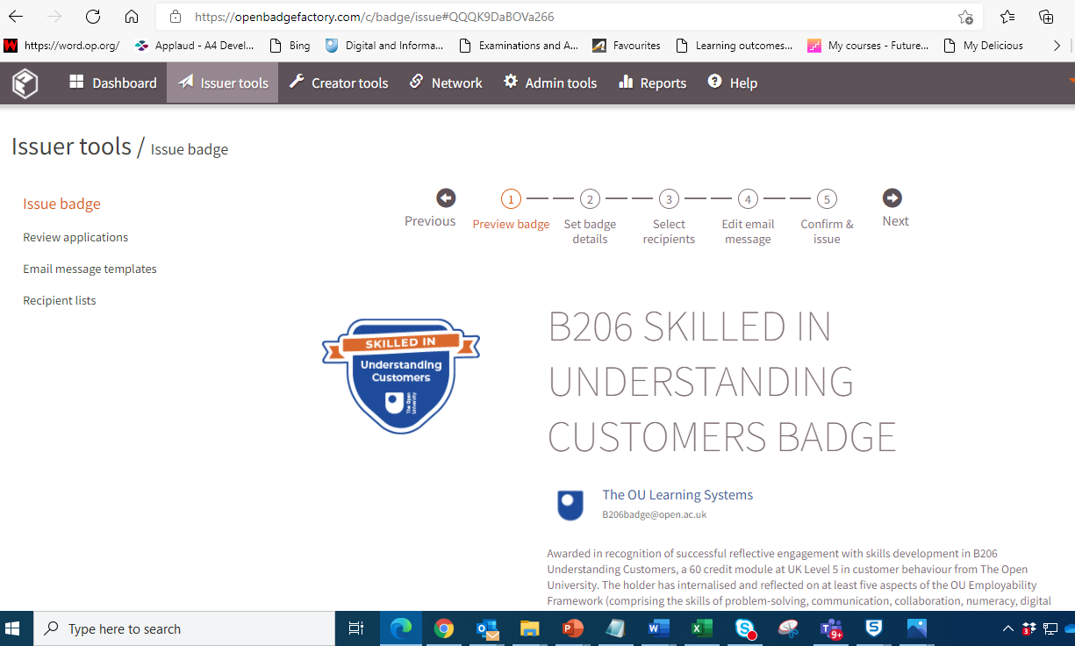

Slide 11
Top line results from survey
(October 2021)
70% of respondents were unaware of the offer
6% of respondents earned a badge from the offer
22% felt that badges were not relevant to them
8% already held at least one digital badge at the time of the offer
63% would like to earn badges in future as part of OU study
50% would like to earn badges for activities such as volunteering with the OU
Imange: National Cancer Institute UNSPLASH

Slide 12
THE FUTURE OF DIGITAL BADGING ON B206 UNDERSTANDING CUSTOMERS
‘Automatically-generated badges within the Virtual Learning Environment for completion of selected learning activities?
Light-touch monitoring for quality
Potential for badges at stage or qualification level
Emergence of coherent strategy on badging with regard to credit bearing as well as non-credit bearing learning at OU
Image: Stevepb on Pixabay

Slide 13
Next steps: The beaupeep project. Badging employability and user perceptions evidence from examples of practice
Newsletter
Survey and evidence café invitations currently open
Please email BEAUPEEp@open.ac.uk
Image with thanks to Scott Gustavson

Slide 14
REFERENCES
Coleman, Jonathan D. (2018) 'Engaging undergraduate students in a co-curricular digital badging platform', Education and information technologies, Vol.23 No. 1, pp.211-224
Law, Patrina ; Perryman, Leigh-Anne and Law, Andrew (2015). Badging and employability at The Open University. European Journal of Open, Distance and e-Learning, Best of EDEN 2013-2014, article no. 704. Open Research Online - a research publication from The Open University
The Open University (2018) The Employability Framework – final version 29/10/18 Available at: https://learn3.open.ac.uk/pluginfile.php/171985/mod_resource/content/2/The%20Employability%20Framework%20-%20final%20291018.pdf (Accessed 1st March 2022)

Slide 15
THANK YOU

Slide 16
THANK YOU

