Slide 1
EMPLOYABILITY CONFERENCE 2022
Employability: expanding the narrative for a rapidly changing world – continuing the conversation
Beyond the classroom: A new model to demonstrate how experiential learning can develop soft skills and aid employability
Dr Rod Brazier

Slide 2
Beyond the classroom: A new model to demonstrate how experiential learning can develop soft skills and aid employability
Dr. Rod Brazier

Slide 3
Experiential Education Literature
Kolb, 1984 – Learning Cycle Theory

Slide 4
Experiential Education Literature
CEWIL WIL Definitions, (updated 2020)

Slide 5
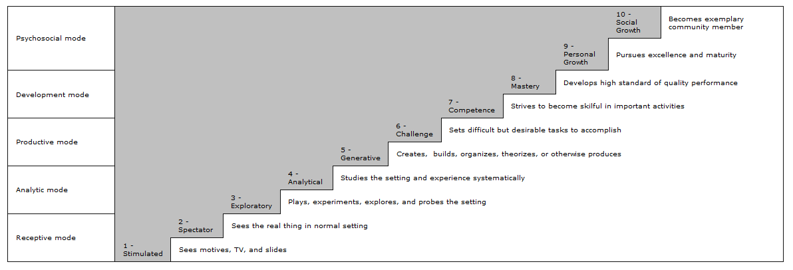
Experiential Education Literature
Gibbons and Hopkins (1980) - scale of experientiality

Slide 6
Literature Review: Experiential Education and Business Management
Moon (2004) – reflection and autonomy
Johnston & Sator (2017) – experiential teaching models have high impact outcomes
Levant et al (2016) – active learning within business simulations can aid soft skill development
Carolis & Litzky (2019) – Experiential education gives entrepreneurship students range of opportunities

Slide 7
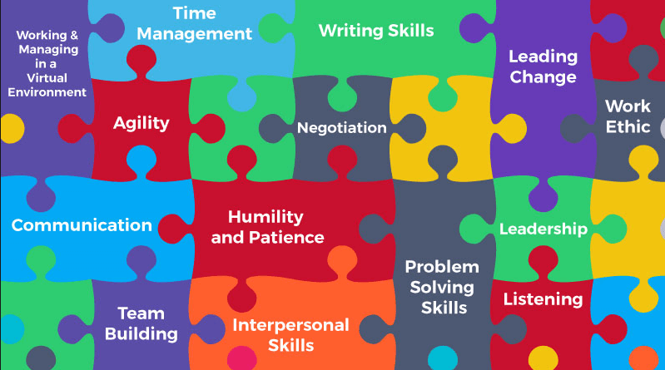
Literature Review: Degree Apprenticeships and Soft Skill Development
Billet (2016) – (i) Centrality of experiences can aide students within design of degree apprenticeship schemes & (ii) questioned whether education should move away from measurement and towards prioritising learner needs and employability
Noone (2009) – Professional thinking styles should be encouraged through real-world, authentic experiences
Coonan & Pratt-Adams (2018) – (i) Career-readiness will continue to grow in importance as skills shortgage exists & (ii) culture change necessary
Chang & Rieple (2013) – Variety of skills demonstrated by students in experiential projects

Slide 8
Research Problem
Gaps in literature
Lack of studies into effect of experiential education within Business Management programmes
Research often focused on theory rather than detailed, practical, wide-ranging solutions
No existing detailed exploration of the link between experiential education and the extensive potential for soft skills development within Business Management in UK HE context
No study which considers this across undergraduate and degree apprentice programmes

Slide 9
Research statement and sub-questions
Research Statement:
An exploration of the nature of students’ soft skills development in the context of experiential education in contrasting business management undergraduate courses (RS1)
Sub-questions:
In what ways do students who are taught using experiential learning activities participate within their learning activities both inside and outside of the classroom? (RQ1)
In what ways are experiential learning activities supported by teachers? (RQ2)
What soft skills are developed in the context of experiential learning activities both inside and outside of the classroom? (RQ3)
What are the relationships between experiential learning activities and soft skill development in the context of different course routes? (RQ4)

Slide 10
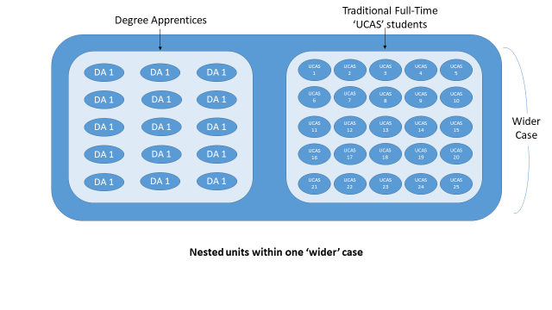
Methodology
Nested case study
Epistemology – Constructionism – reality is socially, collaboratively constructed
Naturalistic – a study of the spontaneous with a directed flow
Emergent – reality and meaning emerged from data
Theoretical perspective - Symbolic Interactionism – society is constructed through human interaction
Theoretical analysis – used theory from the literature as a narrative to shape the study
Thematic analysis – themes emerged from me constantly moving back and forth between the data making subjective meanings

Slide 11
Methods
Student Reflective Journals
Preliminary Field Notes
Researcher Observations
Semi-structured Focus Group Interviews
Artefacts (documents, student work)

Slide 12
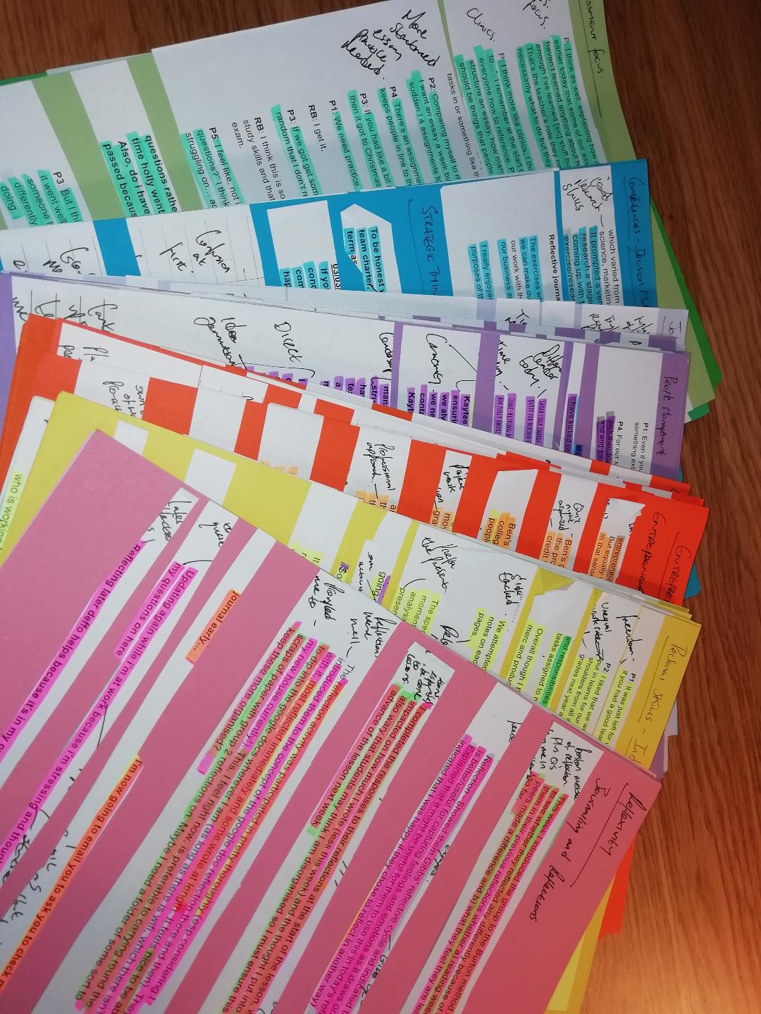
Findings
Range of soft skills were developed by students who participated within experiential project
11 themes and 39 sub-themes of soft skill
Experiential activities facilitated soft skill development
Nature of teacher facilitation affected soft skill development
Soft skills developed both within and externally to the classroom setting
Reflexivity, student-led learning and autonomy affected students’ soft skill development

Slide 13
Conclusions
Students who are taught using experiential learning approaches participate within their learning activities in a variety of ways both inside and outside the classroom (Addressing RQ1)
Experiential learning is supported by teachers who are pro-active, brave and who encourage students to learn autonomously through student-led learning (RQ2)
Range of soft skills are developed through experiential education both inside and outside the classroom. These skills are advanced when facilitated through autonomous, student-led learning (RQ3)
Experiential learning can lead to soft skill development for students in the context of different course routes (RQ4)

Slide 14
Contributions to the field
A synthesis of different ideas, brought together into a single model - ExpEd Framework (major contribution of study):
ExpEd = (IntEx + ExpAct + SLL = SSD)
Integrated Experiential Education Approach Wheel - IntEx wheel (sub-contribution)
Taxonomy of Experiential Activity - ExpAct (sub-contribution)
Relationship between Student-led learning and soft skill development – SLL (sub-contribution)
An offering of practical guidance through a proof of concept on how experiential education can foster soft skill development (practical contribution)

Slide 15
Learning designer is responsible for:
Teacher is responsible for:
Student is responsible for:
Outcome generated:
IntEx
ExpAct
SLL
SSD
+
+
=
The Experiential Approach Framework formula: IntEx + ExpAct + SLL = SSD

Slide 16
Learning designer is responsible for:
Teacher is responsible for:
Student is responsible for:
Outcome generated:
Integrated Experiential Approach
(IntEx)
Experiential Activity
(ExpAct)
Student-Led Learning
(SLL)
Soft Skill Development
(SSD)
+
+
=
Experiential Approach Framework - ExpEd

Slide 17
A range of interchangeable Experiential approaches are available for learning designers…
Which are then developed through a variety of experiential classroom activities…
To be undertaken by students in a variety of ways
The combination of experiential approach, classroom activities and the method and degree of student engagement culminates in the development of a range of soft skills
Core Soft Skills are Developed
Directed. Teacher-Led Activities (TLA)
Traditional UCAS
Students
Less Student-Led Learning (SLL)
Directed and/or Ambiguous roles = Less SSD
Low reflexivity
Inside Classroom
Assessment Focus
1. Active Learning
3. Collaborative Learning
5. Service Learning
4. Co-Operative Learning
2. Work-based Learning
6. Problem-based Learning
7. Authentic Learning
+
+
Student-Led Learning
Individual Roles Impact Upon SSD
Reflexivity is a Cause and Effect on and of SSD
Soft Skill Development
Task
Location
Cohort
Focus
=
Less Directed TLA.
Student-Led Learning
Outside Classroom
Degree Apprentices
Project
Focus
More Student-Led Learning (SLL)
Actively negotiated & well-defined roles = More SSD
High reflexivity
Advanced Soft Skills are Developed

Slide 18
A range of interchangeable Experiential approaches are available for learning designers…
Core Soft Skills are Developed
Directed. Teacher-Led Activities (TLA)
Traditional UCAS
Students
Less Student-Led Learning (SLL)
Directed and/or Ambiguous roles = Less SSD
Low reflexivity
Inside Classroom
Assessment Focus
1. Active Learning
3. Collaborative Learning
5. Service Learning
4. Co-Operative Learning
2. Work-based Learning
6. Problem-based Learning
7. Authentic Learning
+
+
Student-Led Learning
Individual Roles Impact Upon SSD
Reflexivity is a Cause and Effect on and of SSD
Soft Skill Development
Task
Location
Cohort
Focus
=
Less Directed TLA.
Student-Led Learning
Outside Classroom
Degree Apprentices
Project
Focus
More Student-Led Learning (SLL)
Actively negotiated & well-defined roles = More SSD
High reflexivity
Advanced Soft Skills are Developed

Slide 19
A range of interchangeable Experiential approaches are available for learning designers…
Which are then developed through a variety of experiential classroom activities…
To be undertaken by students in a variety of ways
The combination of experiential approach, classroom activities and the method and degree of student engagement culminates in the development of a range of soft skills
Core Soft Skills are Developed
Directed. Teacher-Led Activities (TLA)
Traditional UCAS
Students
Less Student-Led Learning (SLL)
Directed and/or Ambiguous roles = Less SSD
Low reflexivity
Inside Classroom
Assessment Focus
1. Active Learning
3. Collaborative Learning
5. Service Learning
4. Co-Operative Learning
2. Work-based Learning
6. Problem-based Learning
7. Authentic Learning
+
+
Student-Led Learning
Individual Roles Impact Upon SSD
Reflexivity is a Cause and Effect on and of SSD
Soft Skill Development
Task
Location
Cohort
Focus
=
Less Directed TLA.
Student-Led Learning
Outside Classroom
Degree Apprentices
Project
Focus
More Student-Led Learning (SLL)
Actively negotiated & well-defined roles = More SSD
High reflexivity
Advanced Soft Skills are Developed

Slide 20
A range of interchangeable Experiential approaches are available for learning designers…
Which are then developed through a variety of experiential classroom activities…
To be undertaken by students in a variety of ways
The combination of experiential approach, classroom activities and the method and degree of student engagement culminates in the development of a range of soft skills
Core Soft Skills are Developed
Directed. Teacher-Led Activities (TLA)
Traditional UCAS
Students
Less Student-Led Learning (SLL)
Directed and/or Ambiguous roles = Less SSD
Low reflexivity
Inside Classroom
Assessment Focus
1. Active Learning
3. Collaborative Learning
5. Service Learning
4. Co-Operative Learning
2. Work-based Learning
6. Problem-based Learning
7. Authentic Learning
+
+
Student-Led Learning
Individual Roles Impact Upon SSD
Reflexivity is a Cause and Effect on and of SSD
Soft Skill Development
Task
Location
Cohort
Focus
=
Less Directed TLA.
Student-Led Learning
Outside Classroom
Degree Apprentices
Project
Focus
More Student-Led Learning (SLL)
Actively negotiated & well-defined roles = More SSD
High reflexivity
Advanced Soft Skills are Developed

Slide 21
A range of interchangeable Experiential approaches are available for learning designers…
Which are then developed through a variety of experiential classroom activities…
To be undertaken by students in a variety of ways
The combination of experiential approach, classroom activities and the method and degree of student engagement culminates in the development of a range of soft skills
Core Soft Skills are Developed
Directed. Teacher-Led Activities (TLA)
Traditional UCAS
Students
Less Student-Led Learning (SLL)
Directed and/or Ambiguous roles = Less SSD
Low reflexivity
Inside Classroom
Assessment Focus
1. Active Learning
3. Collaborative Learning
5. Service Learning
4. Co-Operative Learning
2. Work-based Learning
6. Problem-based Learning
7. Authentic Learning
+
+
Student-Led Learning
Individual Roles Impact Upon SSD
Reflexivity is a Cause and Effect on and of SSD
Soft Skill Development
Task
Location
Cohort
Focus
=
Less Directed TLA.
Student-Led Learning
Outside Classroom
Degree Apprentices
Project
Focus
More Student-Led Learning (SLL)
Actively negotiated & well-defined roles = More SSD
High reflexivity
Advanced Soft Skills are Developed

Slide 22
Learning designer is responsible for:
Teacher is responsible for:
Student is responsible for:
Outcome generated:
Experiential Pedagogic Approach
Effective Experiential Teaching
Active, Autonomous Learning
Soft Skill Development
+
+
=
The ExpEd Guide

Slide 23
Learning designer is responsible for:
Teacher is responsible for:
Student is responsible for:
Outcome generated:
ExpEd Framework could be set up like this…
Activities could include this…
Practical ways in which students could lead their own learning include…
Soft skills which are developed
(from basic to advanced)
+
+
=
The ExpEd Tool

Slide 24
THANK YOU

