Slide 1
EMPLOYABILITY CONFERENCE 2022
Employability: expanding the narrative for a rapidly changing world – continuing the conversation
Optimising the Employability of our Students through Co-Design
Lauren Moriarty, Course Director of BA Product Design and MA 3D Design and PhD Candidate
Leeds School of Arts, Leeds Beckett University

Slide 2
Optimising the Employability of our Students through Co-Design
Lauren Moriarty
Course Director of BA Product Design and MA 3D Design and PhD Candidate

Slide 3
PhD title:
Co-Designing Graduates
How can a higher education experience be optimised to align most effectively with the product design industry?
Notes:
Timeline

Slide 4
The co-design approach focuses on designing with students, not for them.
“Not only is a community far more likely to adopt a practice or service that it helped create, but you’ll also gain valuable insight into all facets of your solution.”
(IDEO, 2017)

Slide 5
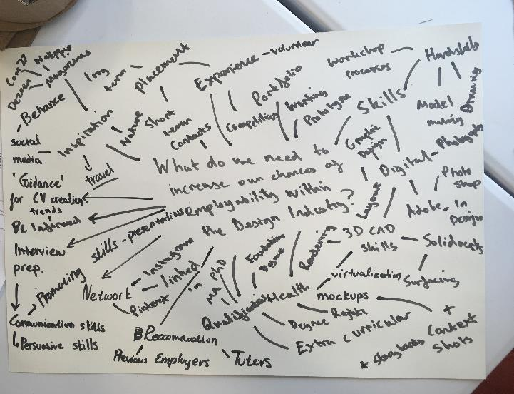
Student co-design sessions
Student employability brainstorming, Image credit: Lauren Moriarty
Notes:
Two images

Slide 6
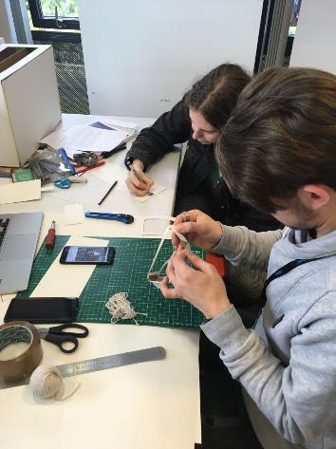
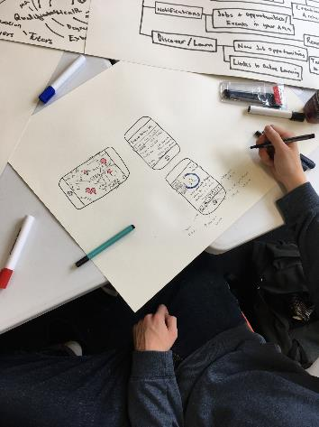
Student co-design sessions
Student co-design session
Image credit: Lauren Moriarty
Student co-design session
Image credit: Lauren Moriarty
Notes:
Two images

Slide 7
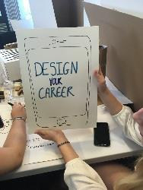
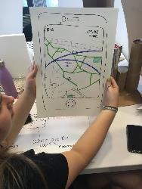
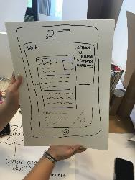
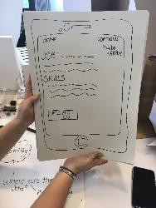
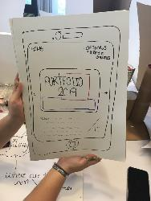
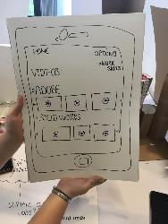
Student co-design sessions
Student co-design session. Image credit: Lauren Moriarty
Notes:
Two images

Slide 8
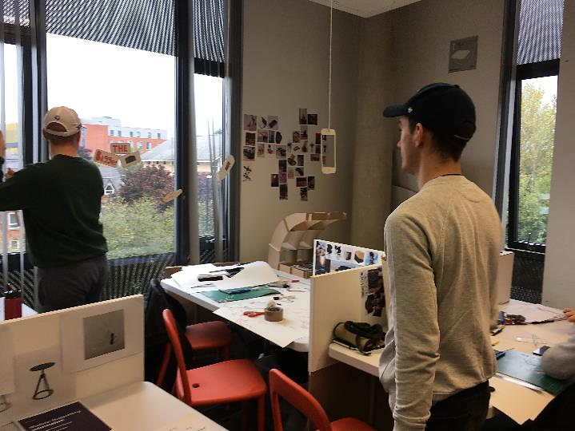
Student co-design sessions
Student co-design session
Image credit: Lauren Moriarty
Notes:
Two images

Slide 9
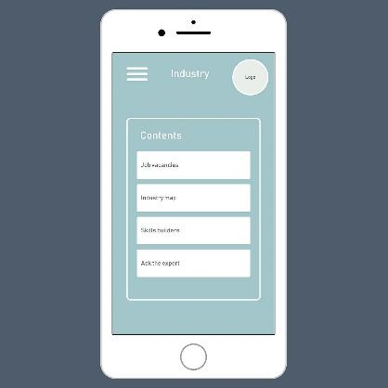
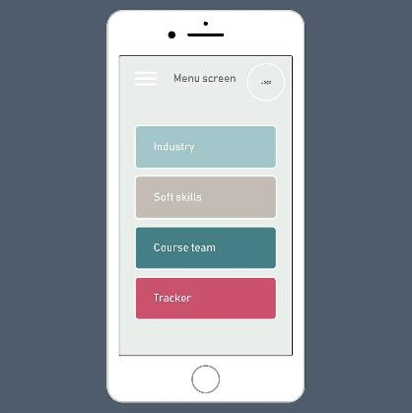
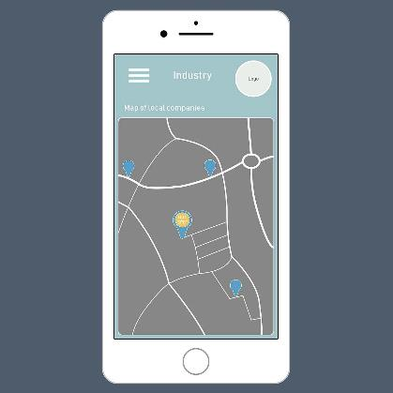
Development of the app
App development, based upon co-design activities. Lauren Moriarty 2021
Notes:
Two images

Slide 10
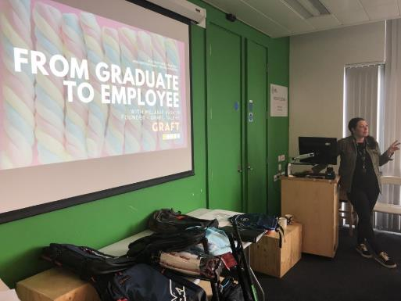
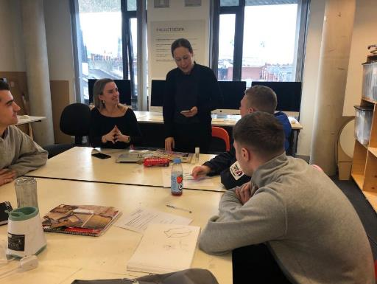
Course conference and co-design session
Product Design Futures Conference 2020 Leeds Beckett University
Image credit: Lauren Moriarty
Product Design Futures Conference 2020 Leeds Beckett University
Image credit: Lauren Moriarty
Notes:
Two images

Slide 11
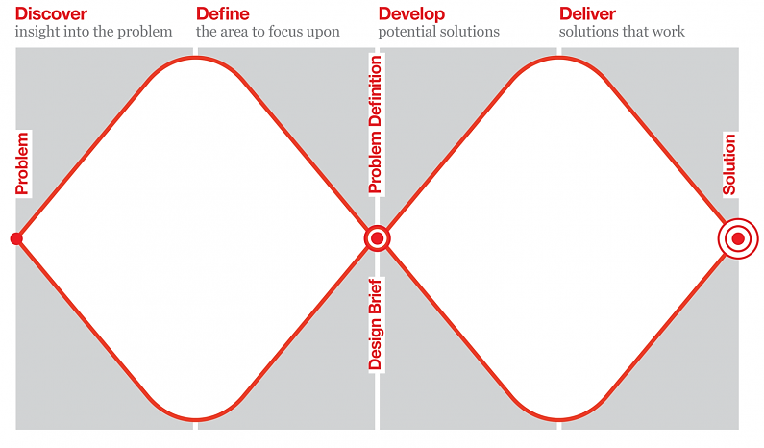
Co-design Methodology
The Design Council: The Double Diamond

Slide 12
Co-designing with students involves ongoing reinvention based upon their changing needs.

Slide 13
For students to be involved in the co-creation of their curriculum has implications for how they see themselves. It allows students to have ownership of their work and ‘creates new rules of design derived of networks, not hierarchies’ (Sanders 1999).

Slide 14
Final thoughts and going forward…
Co-design: A method of fundamentally understanding the needs of a user group
Challenging assumptions
Fostering the testing and iteration of ideas in a collaborative environment
Fun and engagement

Slide 15
References:
Design Council (2019) Framework for Innovation [Online] London: Design Council. Available from: < https://www.designcouncil.org.uk/sites/default/files/asset/document/Double%20Diamond%20Model%202019.pdf > Accessed 1st December 2020).
IDEO (2017) Design Kit [Online] London: IDEO. Available from: < https://www.designkit.org/methods/co-creation-session> Accessed 25th November 2020.
Sanders, E. B. N. (1999) Postdesign and participatory culture. Paper presented at Useful and Critical: The Position of Research in Design, University of Art and Design Helsinki, Tuusula, Finland, 9–11 September 1999.

Slide 16
THANK YOU

