Slide 1
EMPLOYABILITY CONFERENCE 2022
Employability: expanding the narrative for a rapidly changing world – continuing the conversation
Work-ready graduates: building employability skills for a hybrid world
Liz Spratt & Matt Swarbrick, Chartered Management Institute

Slide 2
WORK-READY GRADUATES
BUILDING EMPLOYABILITY SKILLS FOR A HYBRID WORLD

Slide 3
UNCERTAIN CLIMATES
x10
Competition
Expectations
COVID-19
Increased competition
Maintain reputation
Enhanced offering
Government Reforms & targets
Student satisfaction
Graduate employability
Quality of teaching
New normal; blended learning
Building for the future
Learner success
Job-ready students

Slide 4
OUR RESEARCH APPROACH

Slide 5
OUR RESEARCH
How did we conduct our research?
Rapid review of existing literature around employability skills
17 HEI senior representatives in universities across the UK
Conducted 16 interviews and polled 528 UK HR decision-makers
6 focus groups with undergraduate students and polled 600 students (300 CMI undergrad business students, 300 undergrads not on CMI-accredited courses)
Analysis of the 2018/2019 Graduate Outcomes survey to examine employment and salary outcomes
What did we want to understand?
Whether there have been changes to employability skills within the context of the pandemic.
How employers can help shape employability programmes in Higher Education Institutions (HEIs)
The shape of employability programmes offered by HEIs in future.

Slide 6
WHAT WE LEARNT

Slide 7
MANAGERS AND LEADERS IMPORTANT TO BUILDING BACK POST COVID AND LEADING REMOTE WORK
Organisations locations as reported by managers, Sept 2021
12%
83%
5%
17%
UK productivity was around 17% below the US and France.
96%
managers felt that M&L roles are important for shaping the UK’s economic recovery in 2021.
Data on managers location is taken from our latest Managers Voice Polling (Sept 2021),
Productivity data is taken from House of Commons Library: https://commonslibrary.parliament.uk/research-briefings/sn02791/,
Data on the importance of M&L for Building Back Better taken from our joint research with IoD Post Pandemic Prosperity: https://www.managers.org.uk/wp-content/uploads/2021/02/Management-and-leadership-driving-post-pandemic-prosperity-Feb-21-final.pdf

Slide 8
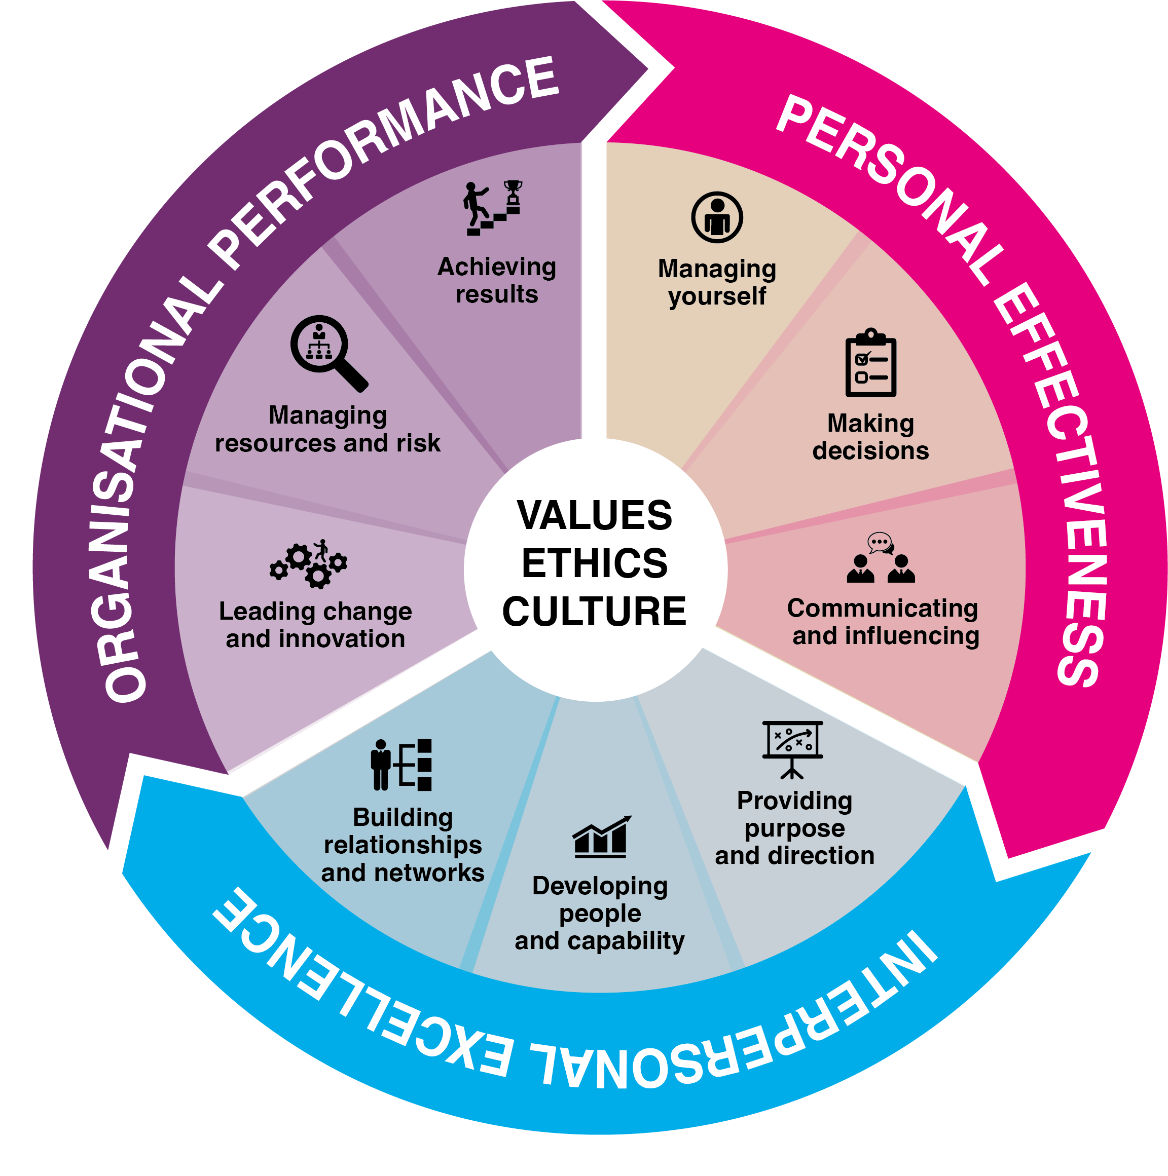
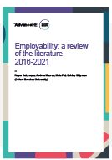
UNDERSTANDING EMPLOYABILITY
CMI’s professional standards
Advanced HE Employability literature review
21st Century Leaders CMI
A students perspective
Polling HE learners on our dual accredited degree

Slide 9
EMPLOYERS STILL REPORT M&L SKILLS GAPS, WITH COMMUNICATION SKILLS INCREASING IN IMPORTANCE
72%
57%
Of all skills gaps were identified as self management skills gaps e.g managing time, team working etc
Of skills gaps were identified as management and leadership skills gaps e.g managing others, persuading and influencing, setting objectives
EmployerOur 12 skills for managers are taken from our major thought leadership from 2020 “Management Transformed”: https://www.managers.org.uk/knowledge-and-insights/research-thought-leadership/management-transformed/
s skills survey 2020: https://assets.publishing.service.gov.uk/government/uploads/system/uploads/attachment_data/file/925744/Employer_Skills_Survey_2019_research_report.pdf

Slide 10
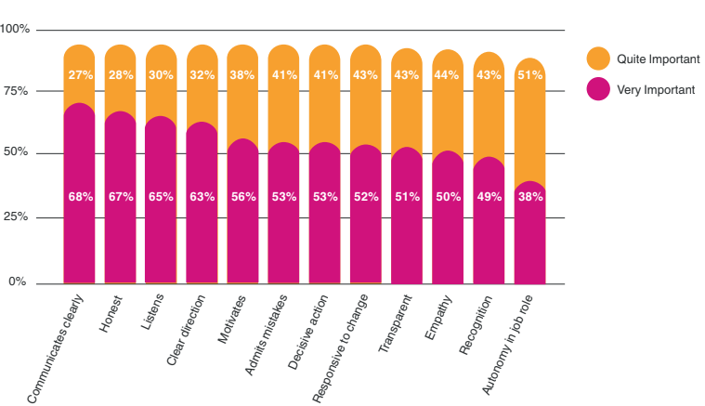
EMPLOYERS STILL REPORT M&L SKILLS GAPS, WITH COMMUNICATION SKILLS INCREASING IN IMPORTANCE
Most important managerial traits
Employers skills survey 2020: https://assets.publishing.service.gov.uk/government/uploads/system/uploads/attachment_data/file/925744/Employer_Skills_Survey_2019_research_report.pdf
Our 12 skills for managers are taken from our major thought leadership from 2020 “Management Transformed”: https://www.managers.org.uk/knowledge-and-insights/research-thought-leadership/management-transformed/

Slide 11
GRADUATES NOT ARRIVING IN THE WORKPLACE WITH THE SKILLS EMPLOYERS EXPECT
Employers believe graduates do not arrive in the workplace fully equipped with the skills they need to be work-ready.
only
Students are completely confident they can demonstrate employability skills.
78%
1 in 4
Employers believe students need training in:
team working (58%)
problem-solving (54%)
communication (52%)
But also cite skills for the remote workplace:
Self-management, motivation, digital communication, creating a digital personal brand/profile, and networking effectively in a digital world are in demand.
Findings taken from our Sept 20201 thought leadership on Work Ready Graduates: https://www.managers.org.uk/wp-content/uploads/2021/09/employability-skills-research_work-ready-graduates.pdf

Slide 12
EMBEDDING EMPLOYABILITY SKILLS IN UNDERGRADUATE DEGREES PROGRAMMES IS KEY
employers want training programmes to ensure graduates are work-ready
95%
Students on CMI accredited courses are more employable and have improved salary outcomes
students wanted to take – or find out more - about employability bootcamps
89%
7%
8%
more likely to be in highly skilled roles
salary boost equating to an extra £2,000 a year
employers want completion of an accredited training course or qualification
55%
Findings taken from our Sept 20201 thought leadership on Work Ready Graduates: https://www.managers.org.uk/wp-content/uploads/2021/09/employability-skills-research_work-ready-graduates.pdf
CMI graduate outcomes statistics taken from: https://www.managers.org.uk/wp-content/uploads/2020/04/Better-Together.pdf

Slide 13
RECOMMENDATIONS
Embed accredited employability skills in course modules where possible, or ensure all students have access to accredited standalone employability modules.
Take a whole-university approach to employability from the outset of courses. All students need access to employability skills regardless of degree course.
Make sure students are aware of their employability skills and are able to measure and track their employability skills gain.
Support students to articulate and convey their skills and be able to demonstrate they are work-ready in an increasingly digital workplace.
Use existing and emerging national and regional networks to connect with employers to better understand the skills needed for the workplace.
Create networking opportunities for students to connect with local employers to provide real-life work-based assignments, mentoring opportunities and career pathways.

Slide 14
EMPLOYABILITY DIAGNOSTIC AND BOOTCAMP

Slide 15
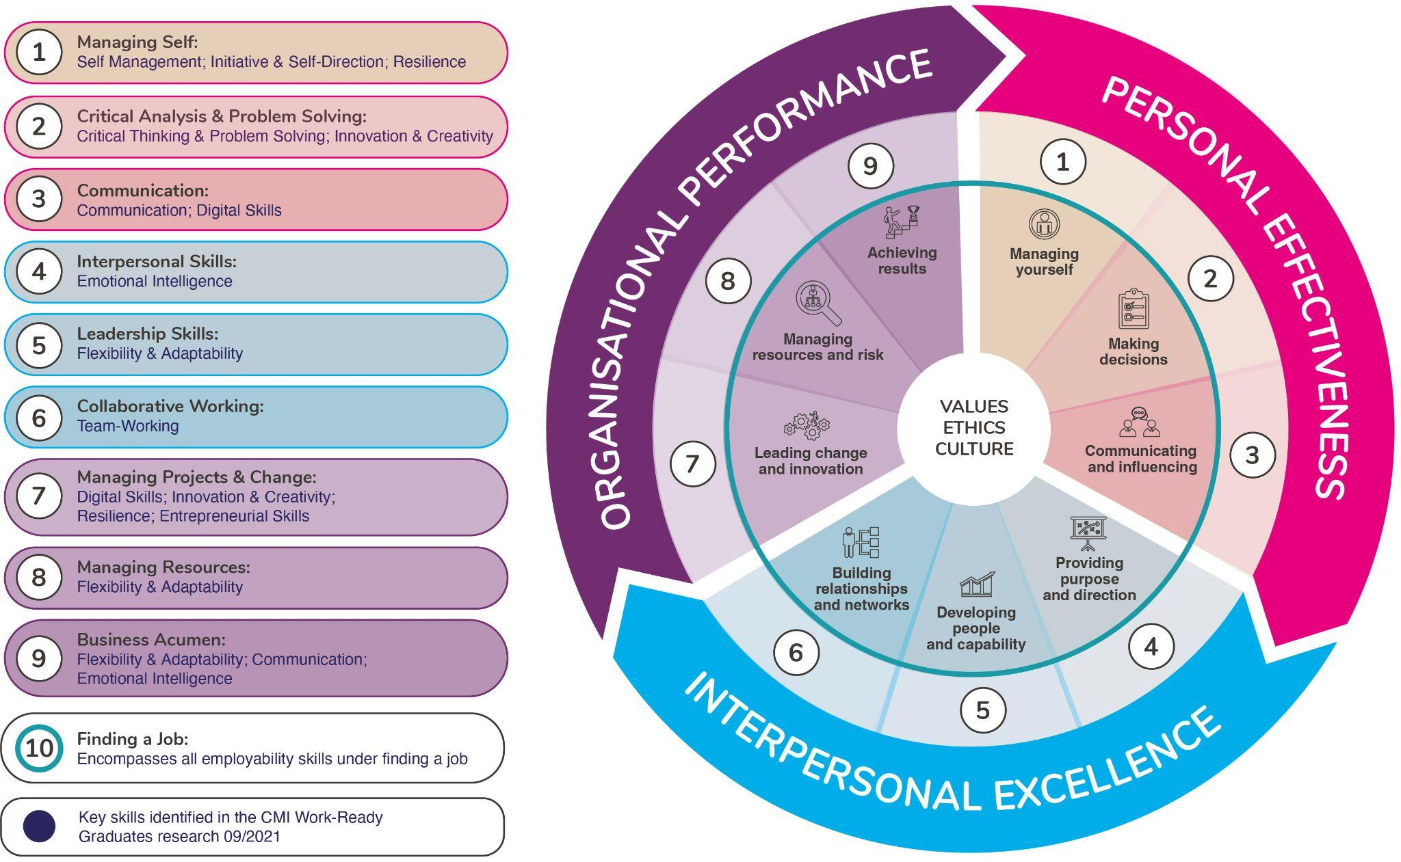
EMPLOYABILITY SKILLS FRAMEWORK

Slide 16
PROPOSED SOLUTION
Introducing Employability Bootcamps
Diagnostic
Development tool for core employability skills
Aligned to Employability Skills Framework
Self-diagnostic + e-learning programmes
Aimed at students across university faculties
Certification & Digital Badging
Career skills
Employability Bootcamps
Report
e-Learning

Slide 17
SKILLS & E-LEARNING STRUCTURES
Employability Bootcamp Series
Personal Effectiveness
Interpersonal Excellence
Organisational Performance
Career Management
Managing Self
Interpersonal Skills
Managing Change
CV Writing
Critical Analysis & Problem Solving
Leadership Skills
Managing Resources
Finding a Job
Communication
Collaborative Working
Business Acumen
Interview Skills

Slide 18
ANY QUESTIONS?
matt.swarbrick@managers.org.uk
liz.spratt@managers.org.uk

Slide 19
THANK YOU

