Slide 1
Sanctuary Scholarships
at The Open University
Undergraduate degrees at no cost
Study part-time or full-time
Study at home and online, at times that suit you
Take a course to prepare for university study

Slide 2
What is The Open University?
The Open University (OU) is the biggest university in the UK.
Students study at home with support online.
Most students work part-time during their studies.
OU courses are designed to be accessible to everyone.
UED | Profile

Slide 3
Studying at home
Students at the OU study at home, this is called distance learning.
You will have study materials, an online study portal, a tutor, student forums, learning events, and more.
You will need an internet connection to be able to study.

Slide 4
Studying part-time or full-time
You have the option to study part-time or full-time.
Most students study part-time, which means you can continue working or volunteering while earning a qualification.
You can study at your own pace.

Slide 5
What are the OU offering?
x12 Sanctuary Scholarships
x50 Access Module Fee Waivers

Slide 6
To apply, you must:
1
Be a forced migrant
3
Live in the UK
Be a person displaced from their homeland or place of residence for political, economic, ethnic, environmental, or human rights pressures.
Be ordinarily resident in the UK
2
Earn no more than £25,000 a year
4
Haven't studied at a University in the UK before
Have a personal annual income of no more than £25,000 or be in receipt of a qualifying benefit.
Hold no existing higher education qualification attained in the UK

Slide 7
To apply, you must:
5
Be a new student to The OU
7
Want to study for at least 30 credits per year
Be a new student to The Open University in the academic year 2022/23.
Be studying at a minimum intensity of 25% (30 credits) per academic year
6
Want to enrol in 2022/23
8
Have proof of your immigration status and annual income
Be intending to enrol for an undergraduate OU module commencing in the 2022/23 academic year. If you are applying for an Access Module Fee Waiver you must be intending to study an Access module.
You will need your Home Office immigration status, and evidence of your annual personal income (or qualifying benefit).

Slide 8
What are credits?
Sanctuary Scholarships
£0
A Sanctuary Scholarship will cover the cost of 360 credits of undergraduate study (a full degree).
There are 12 Sanctuary Scholarships available, which will pay the full tuition cost and provide support for 12 students.
Students will be allocated a named contact who will assist them through their degree.
UED | Profile

Slide 9
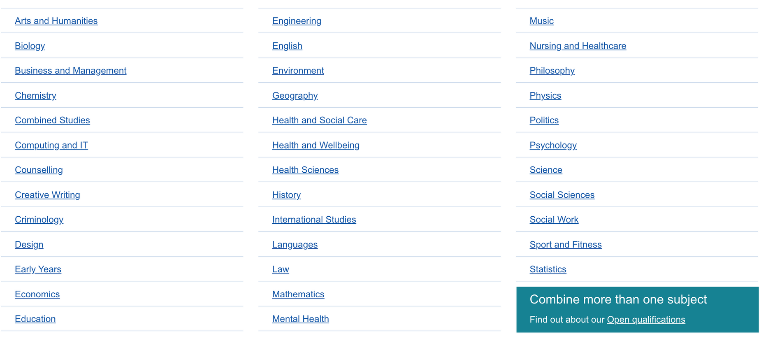
Sanctuary Scholarships
What degree can you do?
View all courses online
There are lots to choose from!

Slide 10
Sanctuary Scholarships
Paid for you by the OU!
What are credits?
"The Sanctuary Scholarship covers the cost of 360 credits" - What does that mean?
1 credit represents about 10 hours of study.
Students must achieve 360 credits to complete an undergraduate degree.
The Scholarship offers to cover the cost of the study. So, your degree will be completely free.
360 credits =

Slide 11
Sanctuary Scholarships
How long will it take?
The number of hours you'll need to put into studying will depend on how many credits you’re taking.
Per week, that would look like:
Full time (120 credits) = around 32 to 36 hours per week.
Part time (60 credits) = around 16 to 18 hours per week.
Part time (30 credits) = around 8 to 9 hours per week.

Slide 12
Sanctuary Scholarships
How long will it take?
Undergraduate degree: 360 credits total
Full-time (120 credits per year)
3 years
Part-time (60 credits per year)
6 years
Part-time (30 credits per year)
12 years

Slide 13
Sanctuary Scholarships
How long will it take?
Most students choose to start part-time, and then work their way up to full-time study, which would not take them 12 years to complete.
For example:
Year 1
Year 2
Year 3
Year 4
Year 5
5 years of study
+
+
+
+
=
30 credits
30 credits
60 credits
120 credits
120 credits
360 credits

Slide 14
Sanctuary Scholarship
£0
Study for free
Study from home
Study at your own pace
Study with support

Slide 15
Access Module Fee Waivers
Access Modules are online classes that introduce you to distance learning and studying at The Open University.
The OU is offering 50 people a fee waiver for these classes, which means 50 people will access the course for free.
UED | Profile

Slide 16
Access Module Fee Waivers
What is an Access Module?
Access Modules are designed to help you refresh your skills and help prepare you to study at The Open University.
You get an overview of the subject that interests you.
You can build self-confidence.
The modules are 30 weeks long, with no final exam.
There are three different types of Access Modules....

Slide 17
Access Module Fee Waivers
There are 3 different Access Modules:
1
Arts and languages
2
People, work and society
3
Science, technology and maths

Slide 18
Access Module Fee Waivers
What is a fee waiver?
A 'fee waiver' means that you don't have to pay for the modules.
Access Modules are usually £753, but this cost will be covered, so, will be completely free for 50 students.
Wave 'goodbye'
to fees!

Slide 19
Access Module Fee Waivers
£0
Study for free
Study from home
Developyour skills
Prepare for a degree
UED | Profile

Slide 20
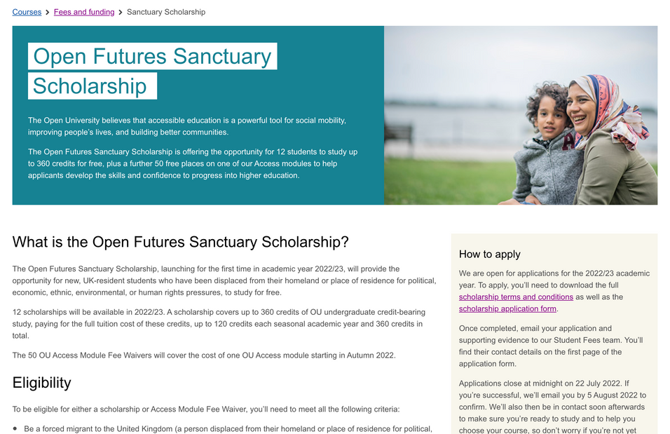
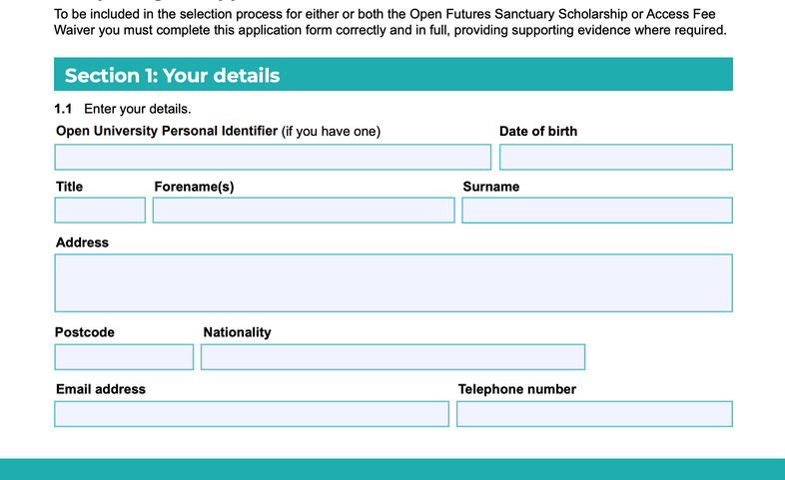
How to apply
Visit the website
https://www.open.ac.uk/courses/fees-and-funding/sanctuary-scholarship
Download and fill in the application form
Send your application to the Student Fees team
Here, you can access the full terms and conditions for applying to either the Scholarship or the Fee Waiver
Presentations are communication tools that can be demonstrations, lectures, speeches, reports, and more.
Once you have filled it in, email your application to: studentfees@open.ac.uk

Slide 21
Further information about applying
There is only one application, you can tick to apply for:
The Sanctuary Scholarship only
The Access Module Fee Waiver only
Both the Sanctuary Scholarship and Access Module – this will mean that if your application for the Sanctuary Scholarship is unsuccessful, you will then be considered for an Access Module Fee Waiver.
You must only apply once.
You must only apply for yourself.
Eligible applicants will be chosen at random.
Successful applicants will be notified by email on or before 5th August 2022.

Slide 22
Deadline:
12 July
2023
Courses start:
October
2023

Slide 23
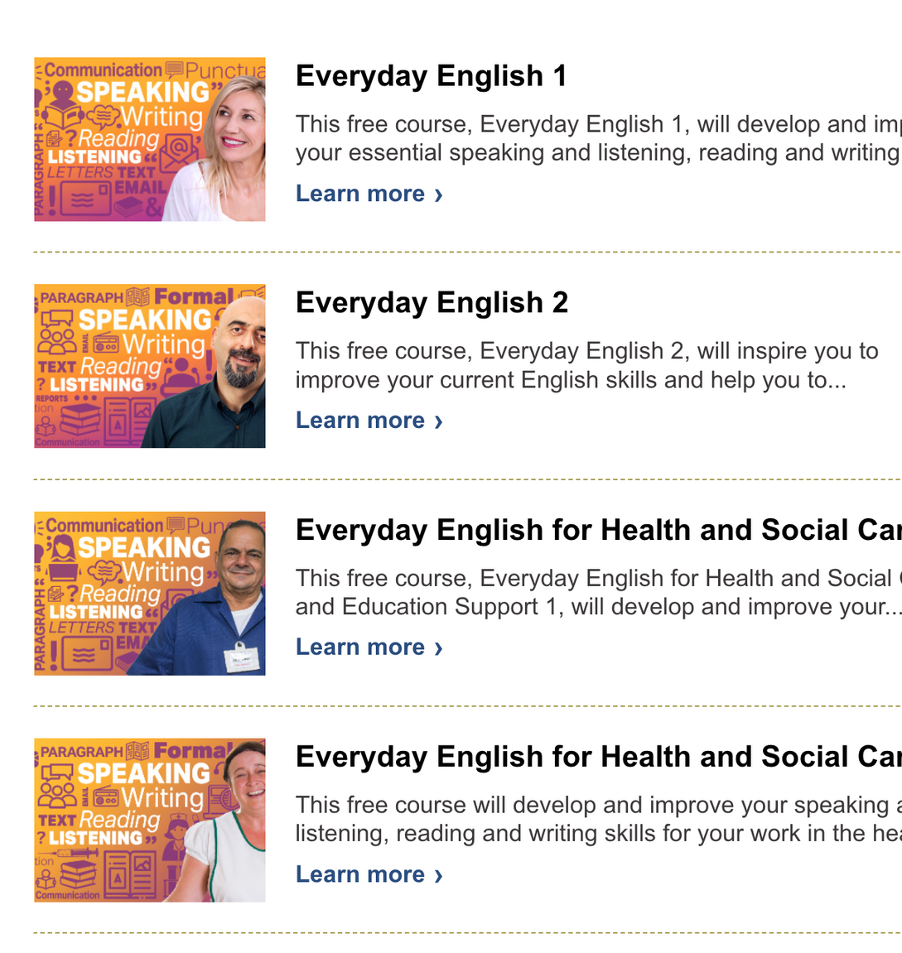
Do you want to improve your English before you study?
The Open University also offer FREE online English classes for refugees
These classes help you to develop your English skills, which can help you prepare for higher education.

Slide 24
Sanctuary Scholarships
at The Open University
For more information
Website: https://www.open.ac.uk/courses/fees-and-funding/sanctuary-scholarship
Phone: 0300 303 5303

