Slide 1
Bereavement and Loss:
Supporting People with Profound and Multiple Learning Disabilities and their Family Carers
Notes:
PAMIS is an voluntary organization that supports people with profound and multiple learning disabilities and their family carers. The bereavement and loss research project was carried out as a result of family carers telling us over the years that they struggled when trying to support their sons or daughters through bereavement and family carers whose son or daughter died also told us that they felt that they were not well supported with their grief. We held a number of focus groups and collected qualitative data

Slide 2
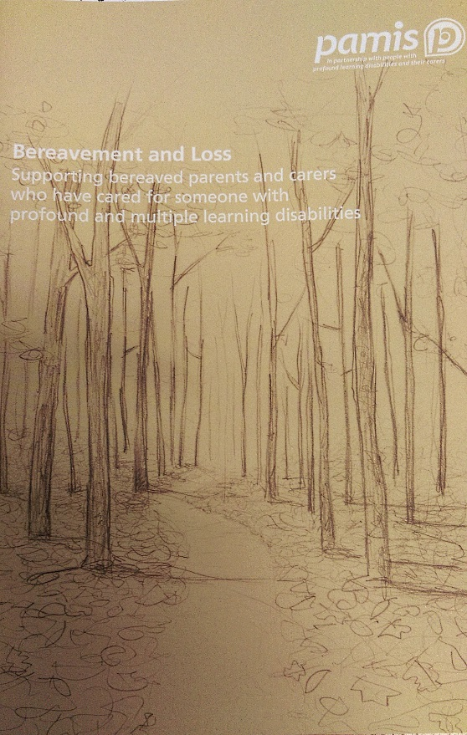
The Learning Resource Pack
developed from experiences of parents and carers
describe the experience of bereavement and loss
understand the effects
suggest ways of supporting
adaptable.

Slide 3
Sections of the Resource Pack A
Introduction:
Understanding Bereavement:
how to use the resource
definition of bereavement and loss
work of PAMIS.
experiencing bereavement and loss
reactions to bereavement and loss
changes that Make Grieving Difficult.
Support
Additional Materials:
our own emotions
concerns about exploring loss
planning for change
suggestions for support
using multi-sensory resources
rituals and practices.
additional reading list
DVD will be included in the pack.

Slide 4
Sections of the Resource Pack B
Introduction:
how to use the resource
definition of bereavement and loss
work of PAMIS.
Understanding living with a person with profound and multiple learning disabilities:
caring for someone with profound and multiple learning disabilities
diagnosis and the caring role
caring and the family
views of society
chronic sorrow.
Understanding the family’s and paid carers experience of bereavement:
experience of end of life care
recognising differences in grieving process
additional challenges
cultural differences and norms.
Additional Materials:
additional reading list
DVD is included in the pack.

Slide 5
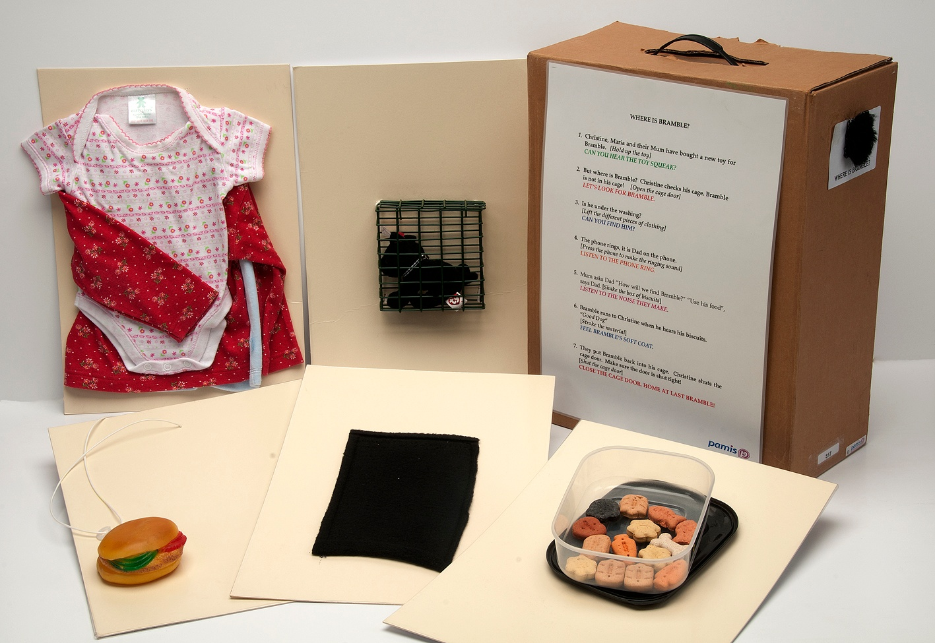
Multi-Sensory Approaches
Using tactile symbols
Notes:
Could the significant objects within the story be documented to add significance. The resource pack has a multi-sensory story template that can be adapted. Having short narrative with the object also allows future care staff to keep memories alive.

Slide 6
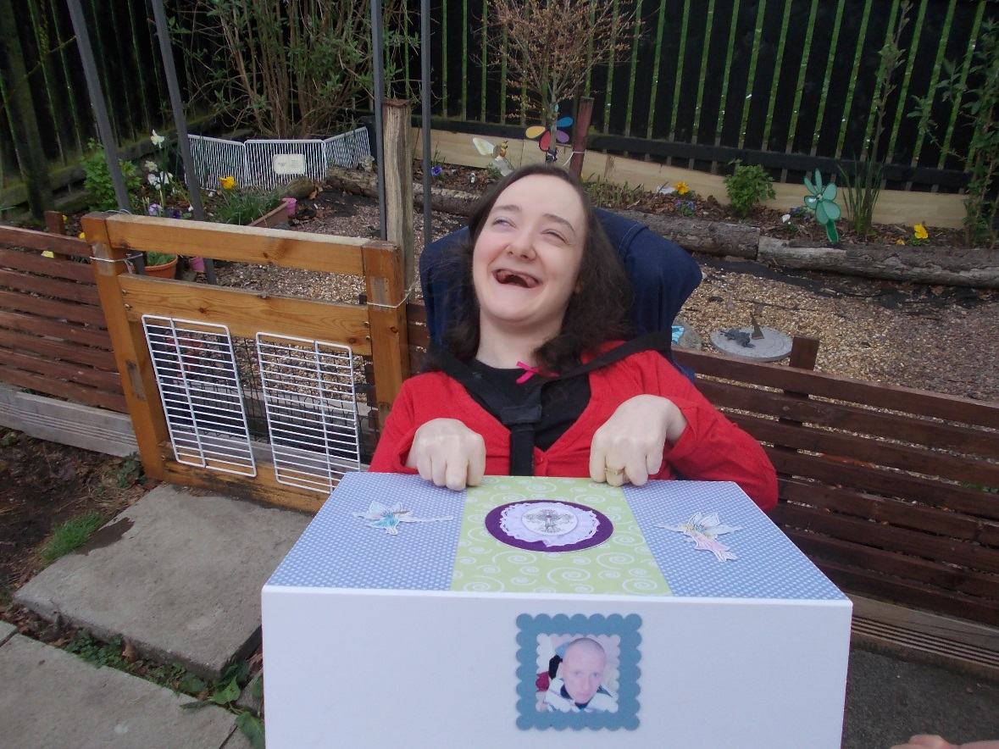
Multi-Sensory Approaches
memory boxes,what might be included?
sensory stories, would a story about the person help
what narrative could be attached to some of the items
within either the memory box or the story?
Notes:
Memory boxes what might be included in a memory box and again is there a narrative that could be documented about each item and its significance
Documenting the story that may be associated with items in stories or memory boxes allows future carers to continue to share important memories with the person

Slide 7
Complimentary therapies and activities
dance
drama
drumming
music
tactile activities, such as massage
aromatherapy, using scents to trigger memories
sensory garden.

Slide 8
Understanding Chronic Sorrow
The term “chronic sorrow” has been used to describe the experience of individuals and their long term carers who have experienced recurrent loss associated with illness and disability throughout their lives.
“A “living loss” because it doesn’t go away, chronic sorrow may stay in the background while the family does their best to incorporate the child’s care into their usual routine. If a medical crisis or event occurs which magnifies the loss and disparity between reality and the life once dreamed of, it can trigger a return of the profound sadness.”
www.chronicsorrow.org
Notes:
Susan Roos speaks about A living Loss to Chronic Sorrow: A Living Loss, Susan Roos This website has useful information for families and professionals on coping with living with chronic sorrow.
At its core, chronic sorrow is a normal grief response that is associated with an ongoing living loss. It is the emotion-filled chasm between “what is” versus the parents’ view of “what should have been.”
Many parents will relate to the experience of chronic sorrow because of the many losses often associated with having and caring for a child with profound and multiple learning disabilities.
Parents experience cumulative losses such as their child not reaching expected developmental
milestones, for example walking, talking and becoming involved in all the expected childhood activities.
Therefore, parent’s emotional experiences of sadness, guilt, helplessness and at times anger are experienced as loss as the dreams, hopes and wishes they had for their son or daughter are not realised. These losses are not only experienced in relation to the physical, emotional and social abilities that nondisabled children usually attain but continue and involve the natural expectations that parents have for their child later in life. Examples of this are in relation to the expectations that their child will grow up, get married, have a family and become independent members of society. It is helpful if parents have been supported while caring for their son or daughter and enabled to share their sorrow.
It is also important that parents know that this reaction to their profound sense of loss is a normal parental reaction to their emotional and
challenging role of caring for their disabled child.
In summary, parents experience deep sorrow when faced with their child's inability to meet normal developmental milestones. This sorrow can be increased with the realisation that future long-term expectations will not be met and what should or could have been, is unattainable.
The experience of chronic sorrow is often overlooked by those outwith the family which can further isolate bereaved parents not only when their child is alive but also in their experience of bereavement when their child dies.
We need to remember and acknowledge that chronic sorrow will be intertwined within the caring experience.

Slide 9
Family Carers’
Specific Experiences of bereavement
unexpected death
caring
loss of role
returning equipment
physical feelings
Experience of each family member
social support gone
searching for information
disenfranchised grief
revisiting

Slide 10
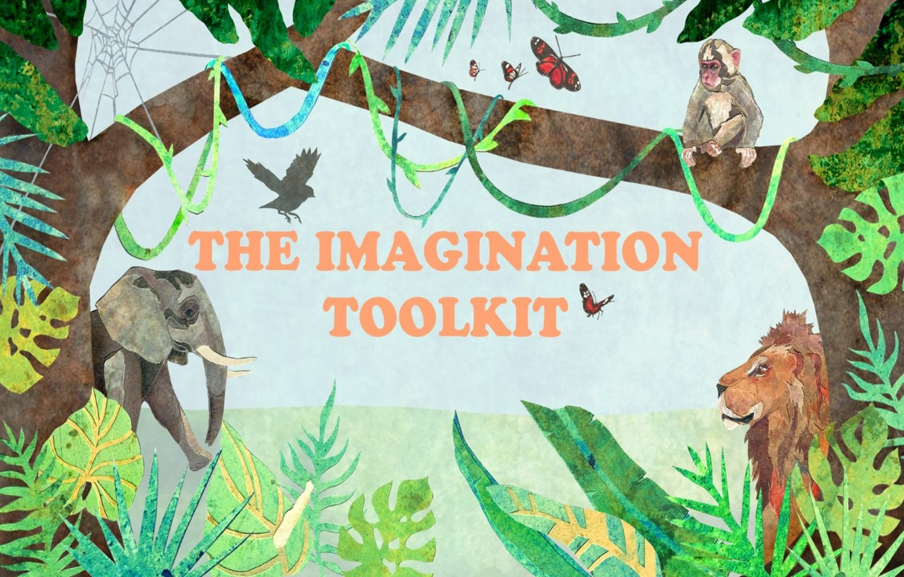
Additional resources
The Imagination Toolkit- a multi-sensory story resource for challenging times

Slide 11
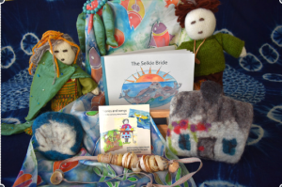
Spirit of stories
Real Lives-Real Stories
Creating individual stories about events in someone’s life helps them share their life experience with others and also helps with understanding difficult topics.

Slide 12
Useful links
PAMIS website: pamis.org.uk/
Chronic Sorrow www.chronicsorrow.org
Bereavement and Loss: pamis.org.uk/resources/bereavement-and-loss/
Learning Resource Pack Order Form
pamis.org.uk/resources/bereavement-and-loss/
PAMIS creative arts: pamis.org.uk/creative-arts/
Multisensory stories: pamis.org.uk/services/multi-sensory-storytelling
Virtual Activity Programme: pamis.org.uk/services/virtual-activity-programme/

Slide 13
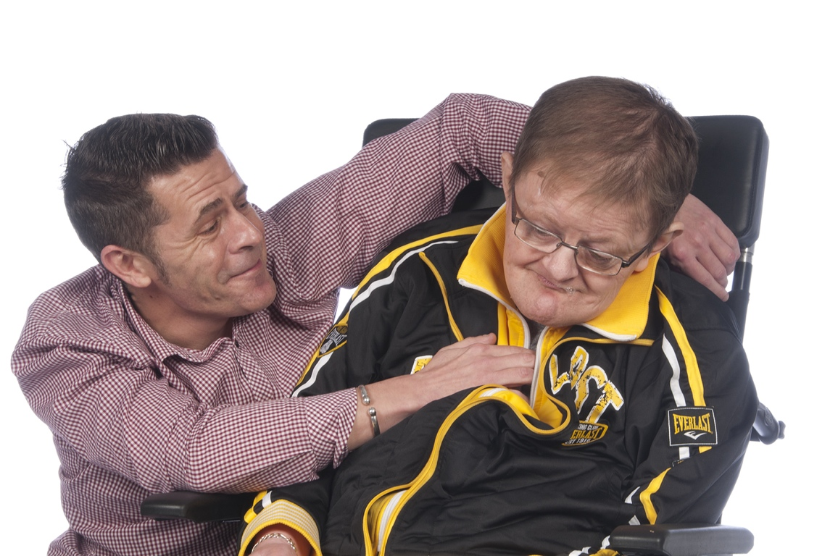
Sometimes the best resources are within ourselves...
Thank you
Notes:
Today I have shared some of the pack contents to

