Slide 1
What the Dickens!
How wealth and social status impacted on the lives of children and young people with intellectual disabilities in mid nineteenth century England
David S Stewart OBE D.Litt.h.c. DL
Head Teacher , Oak Field School, Nottingham
Copyright David S Stewart 2016

Slide 2
Mrs Alexander 1848
The rich man in his castle, The poor man at his gate, God made them high and lowly, And ordered their estate.

Slide 3
Dickens – Household Words 4th June 1853
But, a closer study of the subject has now demonstrated that the cultivation of such senses will, besides frequently developing others that are latent within him but obscured, so brighten those glimmering lights, as immensely to improve his condition, both with reference to himself and to society. Consequently there is no greater justification for abandoning him, in his degree, than for abandoning any other human creature.

Slide 4
Georgina Cuff 1838-1901

Slide 5
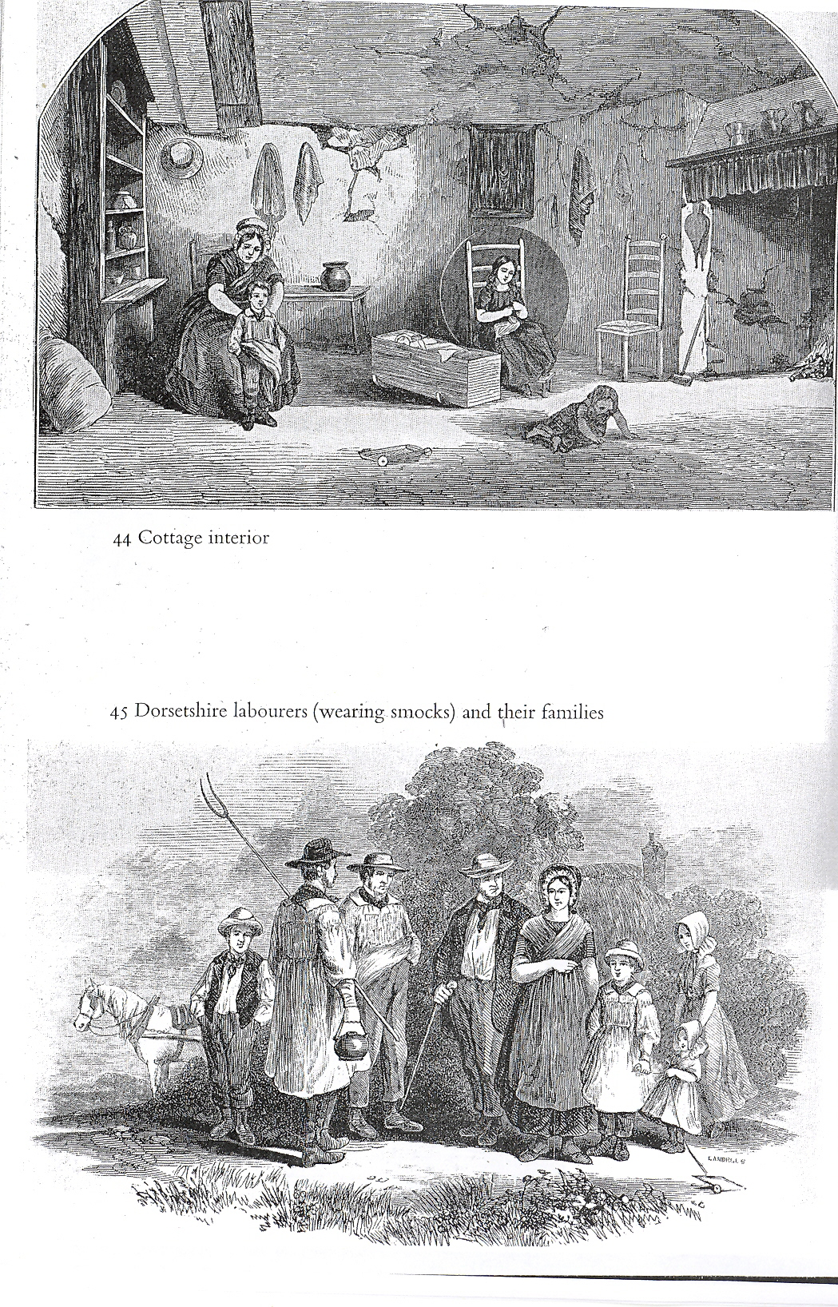

Slide 6
Blandford Crosswheel Button

Slide 7
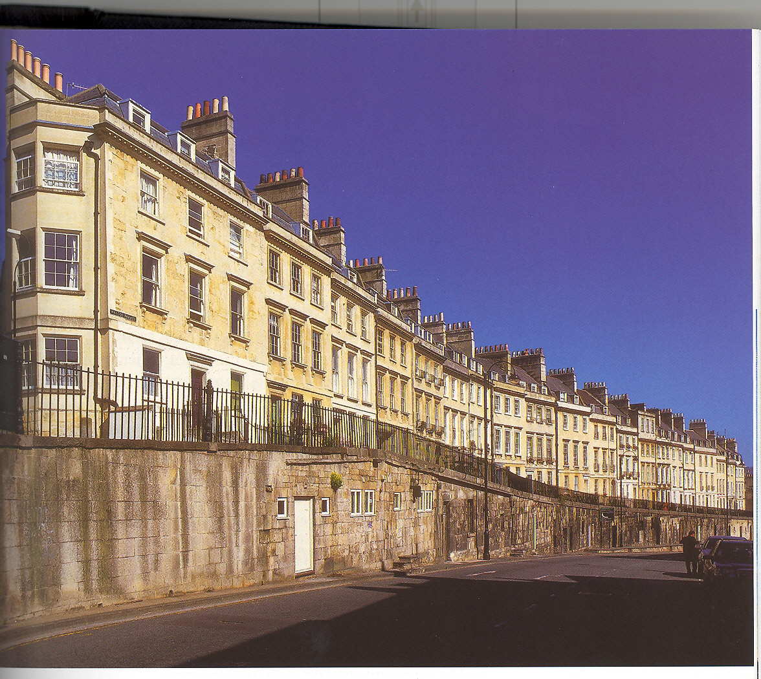
Bath Institution – 5 Walcot Parade

Slide 8
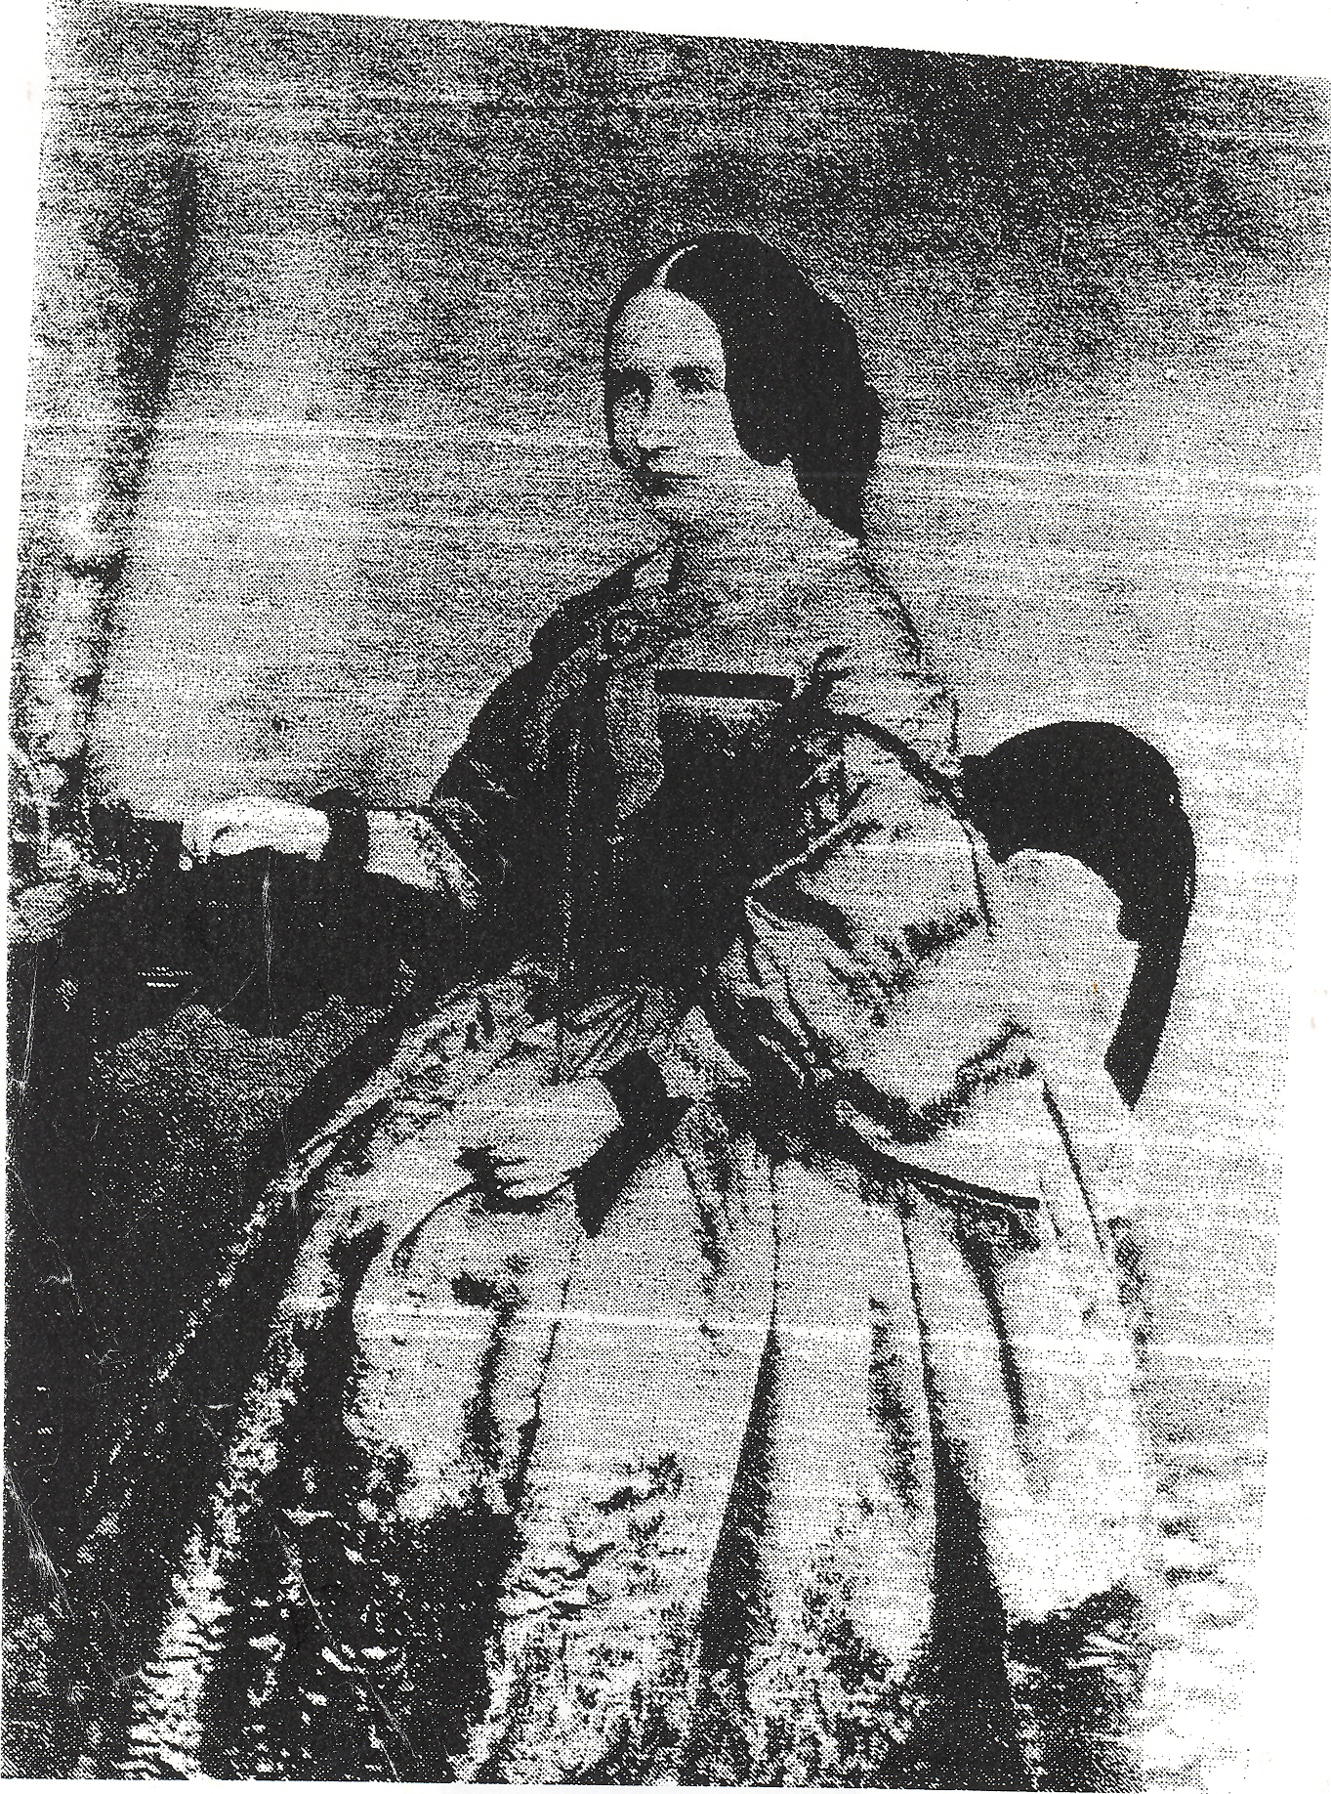
Charlotte Smoult White 1820-1878

Slide 9
Georgina Cuff 1838-1901
Bath Institution
April 1848 Admitted at the age of 9. An orphan, brought from the workhouse. In good health, but extremely unruly. She has often been tied to the table to keep her out of mischief, when she would persist in moving about, dragging the table after her. She is utterly ignorant.

Slide 10
Georgina Cuff
Nov 1853 She is still here in the Institution, and will probably be retained as a servant. A most satisfactory change is apparent in her. Subdued by kindness, her energies find vent in useful employments. She assists in housework and in dressing the younger children of whom she is extremely fond.

Slide 11
Georgina Cuff
Being once reproved for laughing with A J
(Alfred Jiggens) during the Scripture lessons, she, after class, took the little fellow – a dumb child – by the hand, and leading him away, made him spell on his fingers a simple prayer that God would forgive their naughty laughing, and make them good.

Slide 12
Guggenbuhl visited the Institution in Bath whilst Georgina was there

Slide 13
Blandford Workhouse – Georgina came here after Bath

Slide 14
Fisherton House – she was moved here – mother here as well

Slide 15
Laundry Work
avoid the purchase and “use in the washing-house of all machinery which diminished the amount of labour.”
(report of Commissioners for Scotland)
In France laundry work was divided into categories
“the delirious washed, the imbeciles carried the linen to dry, the melancholy ironed it, and the monomaniacs folded it and put it away.”
(Francis Scott 1879)

Slide 16
Dorset County Asylum – Georgina ended her days here

Slide 17
Andrew Reed Plumbe 1838-1881

Slide 18
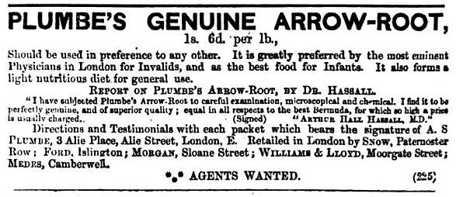
Mrs. Anna Serena Plumbe Samuel Plumbe with first wife with two brothers in 1881 and son Rolls

Slide 19
Rowland Plumbe, brother designed the theatre at Normansfield

Slide 20
Park House
The Board….. earnestly hope that their Asylum may become both a School and a refuge, where the more hopeful may find beneficial training, and the hopeless and forlorn a quiet and grateful place of rest.

Slide 21
Park House, Highgate Andrew admitted May 1848

Slide 22
Essex Hall Andrew admitted May 1854

Slide 23
Dickens – Household Words 1853
The funds of the society who maintain Park House and Essex Hall, are devoted in aid of the maintenance and education of idiots, for whom the parents pay a certain annual sum. This is an admirable means of helping those who help themselves, and who, as the subjects of a peculiar misfortune, have a pressing claim on such aid. But we hope, through the instrumentality of these establishments, to see the day, before long, when the pauper idiot will be similarly provided for, at the public expense.."

Slide 24
Earlswood Asylum Andrew admitted February 1857

Slide 25
Charles George Brandreth 1844-1891

Slide 27
Colville House
“the mere sound of idiot is repugnant to delicate ears – and the men of wealth, or ample means, would gladly seek for his imbecile child a place where such objections to not exist.”
Provision of a ‘nursery explicitly devoted to the circumstances of their condition.’

Slide 28
Lunacy Commissioner’s report on Colville House 1852
Describing George William Brandreth
“the male seemed rather to be of very slow and deficient intellect than to be idiotic.” Said to be “manifestly improved and improving as well in point of physical strength and mental powers as in general habits and behaviour. They spend much of their time out of doors in riding about on a donkey, in strolling about the grounds and in common sports.’

Slide 29
Royal Albert Asylum, Lancaster

Slide 30
Dr George Edward Shuttleworth

Slide 31
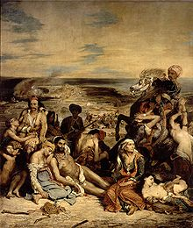
The Scaramanga family

Slide 32
Julia Scaramanga

Slide 33
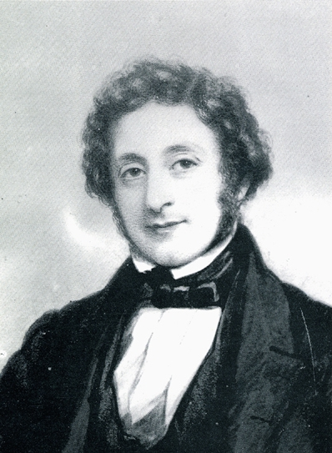
The Ralli Grandparents

Slide 34
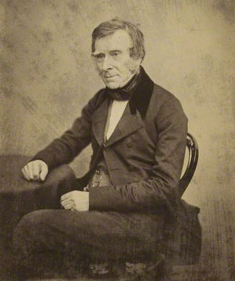
Dr John Snow Sir Benjamin Brodie Operated on Peter Scaramanga in 1854

Slide 35
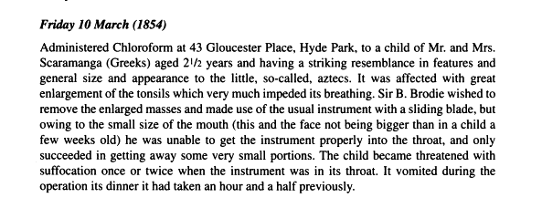
From Diary of Dr John Snow Visit to Peter Scaramanga

Slide 36
Young man with microcephaly

Slide 37
Hyde Park Gardens

Slide 38
Normansfield – Mimina admitted here in 1875 and died within a month

Slide 39
Dr John Haydon Langdon Down

Slide 40
Mary Langdon Down

Slide 41
Shanklin seashore

Slide 42
Memorial at Greek Orthodox Cemetery West Norwood

Slide 43
Conclusion
The need for greater analysis of individuals’ lives – need to build up a picture of whole family
Factors of wealth and poverty
How do we view these early attempts at provision in the wider context of revisionist history?
Each child has its own identity and family.
Need to rescue from obscurity

