Slide 1

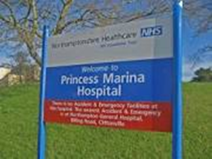
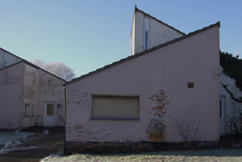
Staff Memories of Princess Marina Hospital 1972-1995

Slide 2
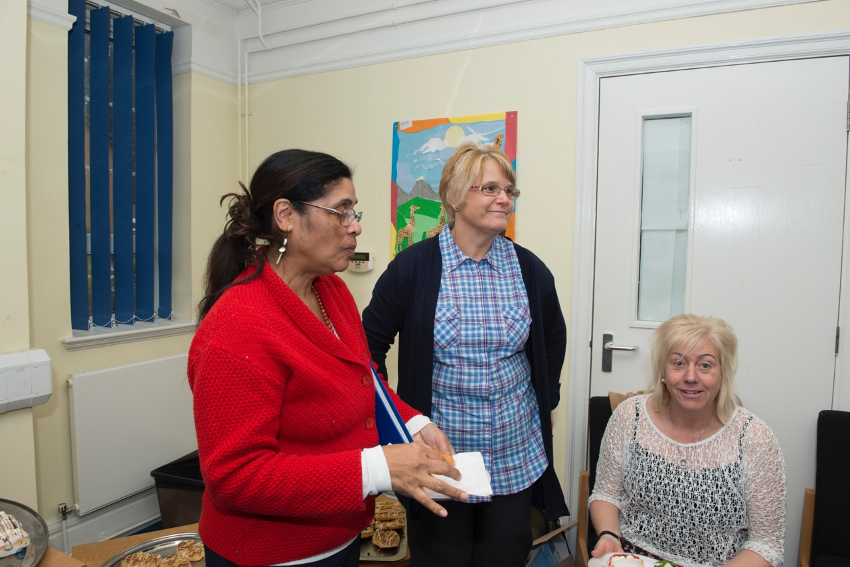
How it started

Slide 3
What we did
Focus groups with staff and one to one interviews
We asked them questions
Jan recorded everything
Then we had a coffee morning
Staff and people who used to live in the hospital came
They added what they remembered

Slide 4
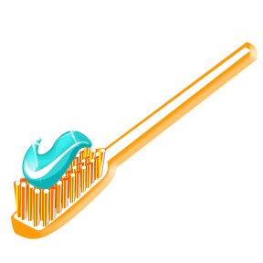
Examples of the questions
Clothes, health, washing
Did everyone have their own toothbrush?
Did everyone have their own clothes?
What was personal hygiene like? Did people have baths or showers? How often?
Were the toilets clean?
Who looked after residents’ teeth?
What was health care like?
When people were ill did they go to the General Hospital?
Did people have to consent to medication?

Slide 5
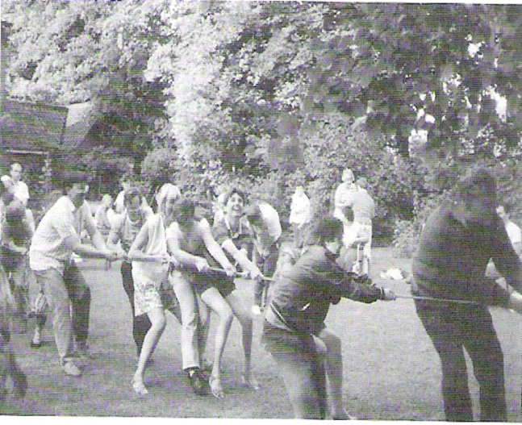
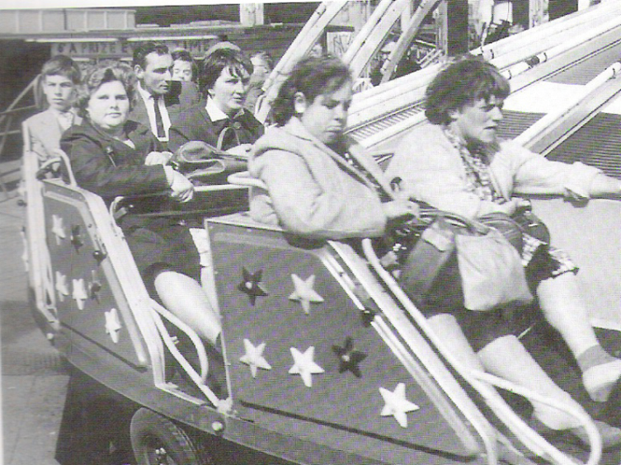

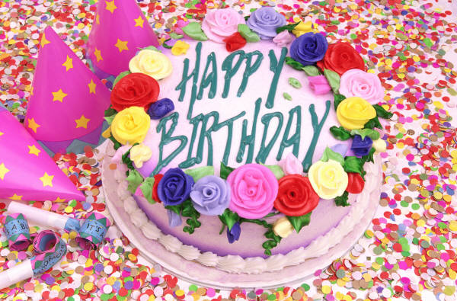
Another example
Having fun
What did residents do for fun?
Holidays?
What happened at Christmas?
How did residents celebrate birthdays?

Slide 6
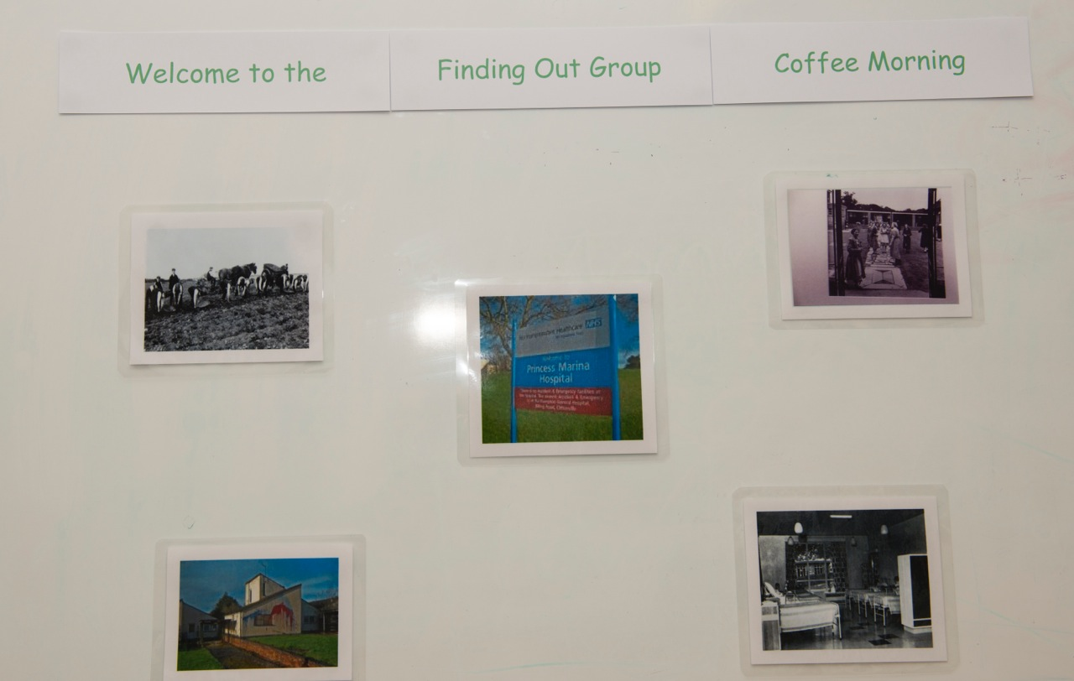
Coffee morning

Slide 7
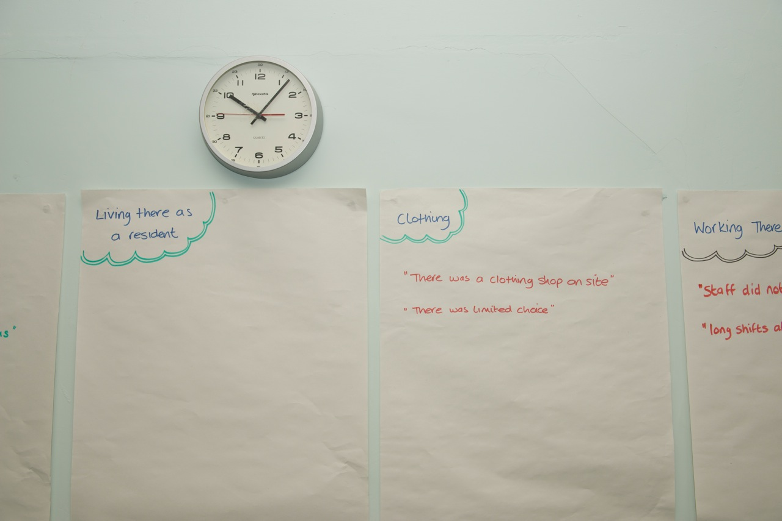

Slide 8
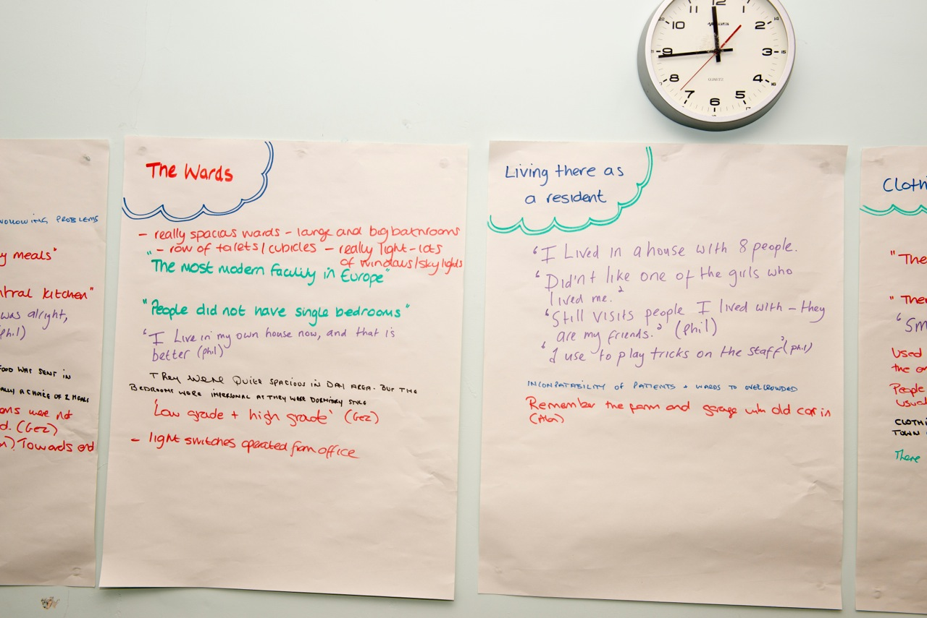

Slide 9
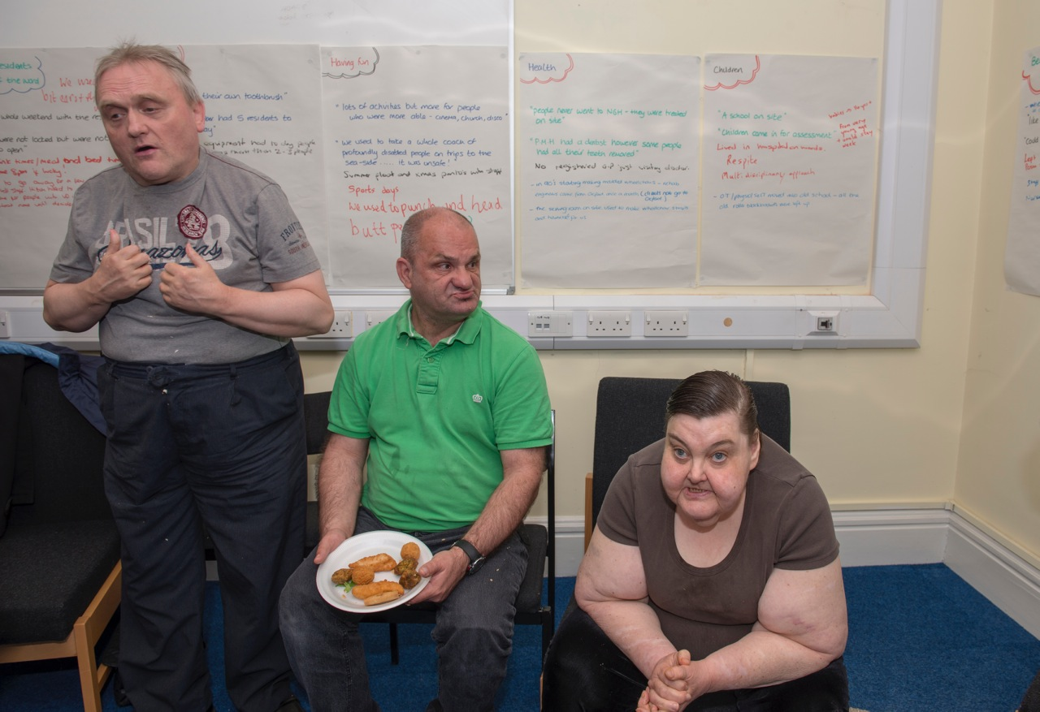

Slide 10
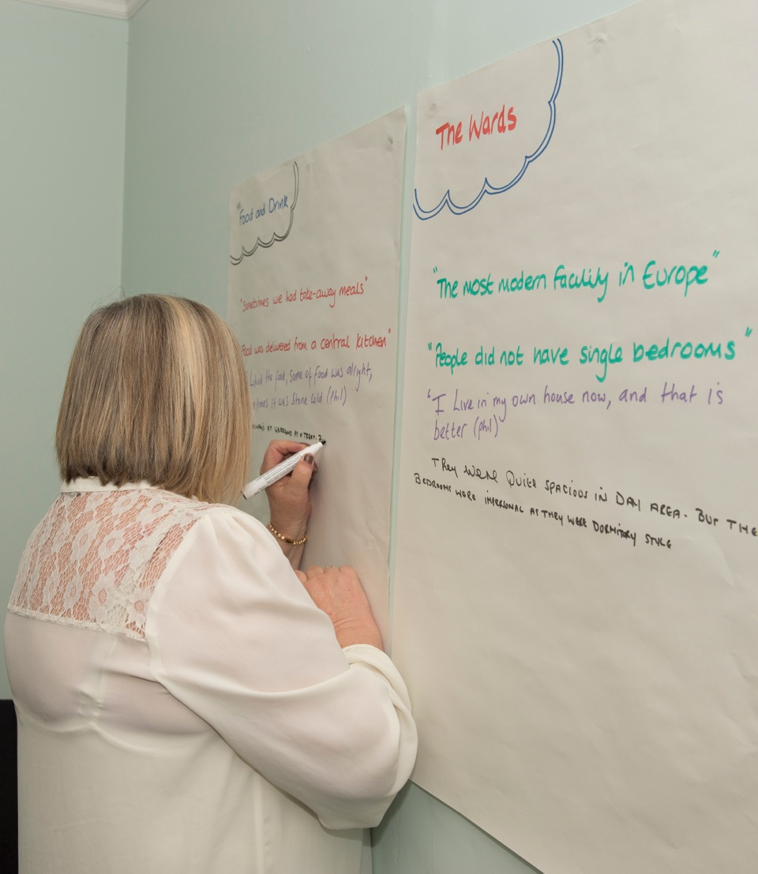

Slide 11
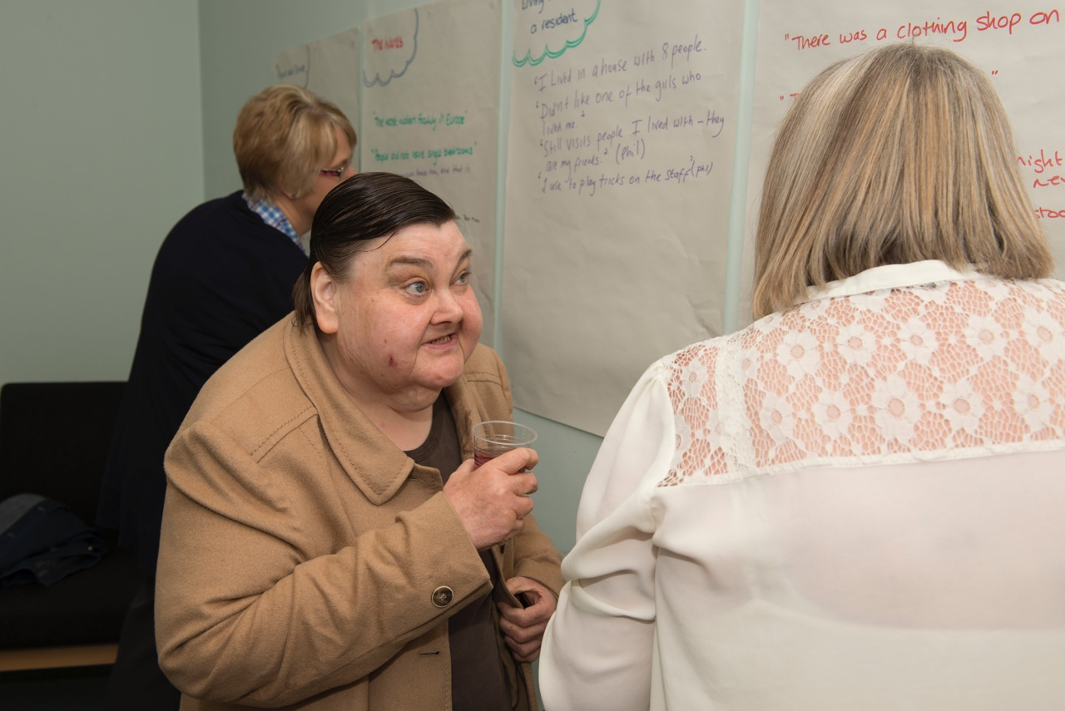

Slide 12
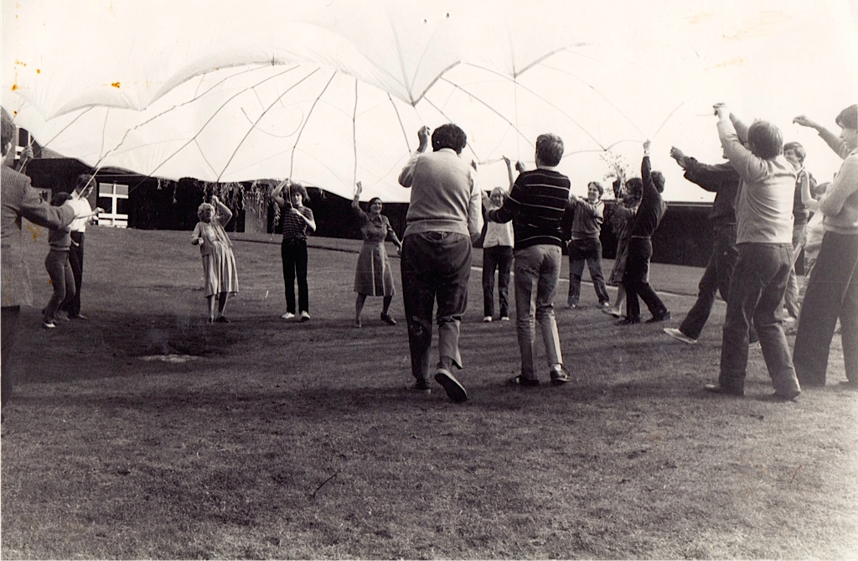
What we found out about good practice
Find good staff and things will take off

Slide 13
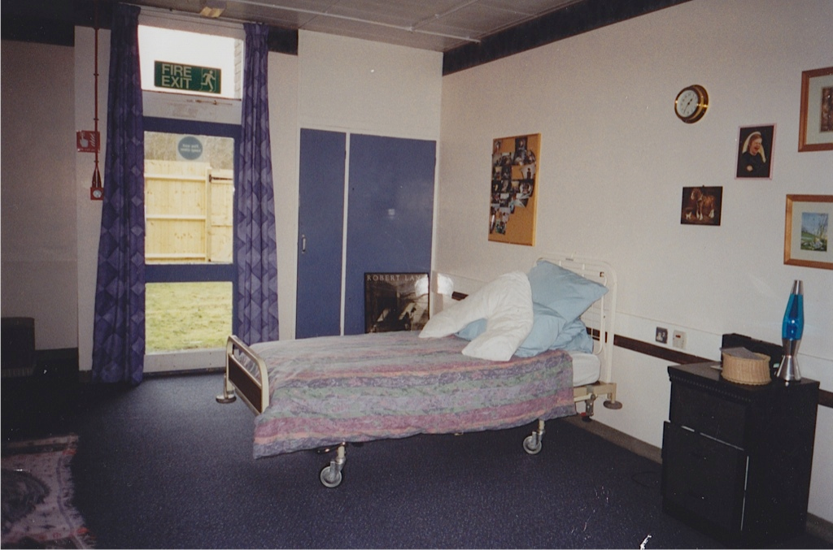
Princess Marina better than other hospitals
It was the most modern facility in the whole of Europe, attracting people from all over the world. Architecturally and in terms of facilities it was light years ahead, it never got overfilled.

Slide 14
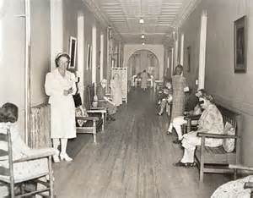
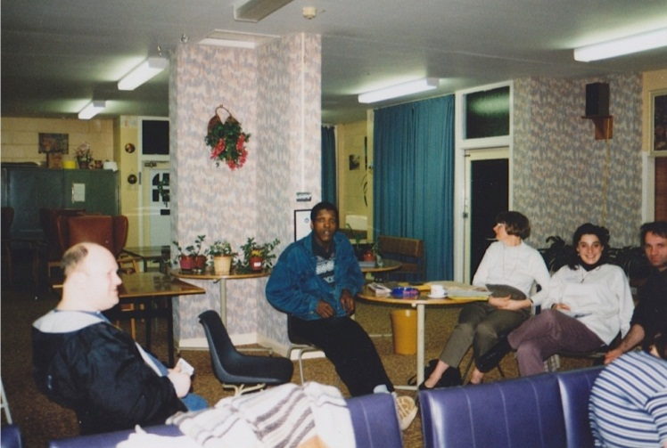
A better hospital?
Some hospitals had wards that catered for 40 – 60 people, cared for by 3 or 4 staff, and assisted by patients. PMH wards were designed for 20, with 4 to 5 staff.
Working conditions were better than anywhere in the country.
It’s difficult to appreciate
the difference.

Slide 15
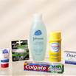

Individualised care
One thing that struck me, working on the wards people had a blue J cloth for their face and pink one for their bottom, I remember that as being so individual, and individual toiletries as well.
I came from somewhere where they boiled the flannels, 40 of them in soapflakes, they would boil 40 flannels, then you would pick any flannel up, so having each person having flannels for themselves for face and bottoms was a big difference.

Slide 16
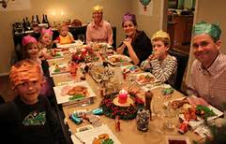
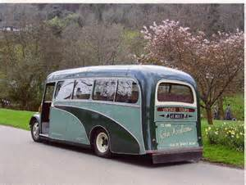
Taking risks
Those times were more relaxed and fun, less bureaucracy like health and safety.
We did everything we could to get people out. Whole ward would get in a big coach, lay some people across the seats, change them on the seat, alternative was they just didn’t go. Contrast to nowadays
At Christmas you used to take people home with you who did not have family, staff felt for them. Some areas would close for Christmas because those few who did not go home would go home with staff. This does not happen now.

Slide 17
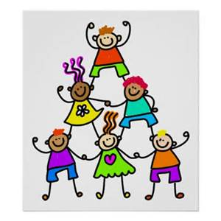
Team work
You would think very carefully before
going off sick because you would
leave colleagues struggling or people would
would not get their needs met so you supported one another and cared about one another, staff teams on the ward.
I used to hear staff saying this is my 2nd home because I spend so much time here, and it’s like having a 2nd family because I spend so much time with the staff group

Slide 18

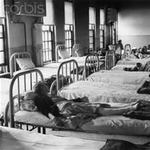
Bad experiences?
There was nothing like safeguarding and you thought seriously about whether you mentioned bad experiences or not because, depending what wards you were on and who the managers were because life could be made very difficult for you if you challenged.
If you spoke out, you sometimes got moved to wards where practice was not very good
and staff were institutionalised, a
dumping ground for troublesome staff.

Slide 19
Our conclusions
Life is better now
But some staff worked hard to make things as good as they could be
In some ways staff could do more because they had more freedom, to take people out, to take them home with them
Last word to Phil ‘I live in my own home now and that is better’

Slide 20
Thanks
We would like to thank:
Northamptonshire NHS Healthcare Foundation Trust who provided the money
Everyone who came and gave us their memories
The residents of the hospital. Their story has still to be told
Annie Blackburn who scanned the photos

