Slide 1

Including people with learning disabilities in the National Confidential Forum
Angela Henderson
Scottish Consortium for Learning Disability

Slide 2



What is the National Confidential Forum?
      The Scottish Government have passed a new law in Scotland.
      It is called the Victims and Witnesses (Scotland) Act 2014
The Act has set a up a new organisation in Scotland called the National Confidential Forum or NCF for short
      The NCF will listen to the experiences of people who lived away from home when they were children.
      The NCF will bring together these testimonials so that they can understand what happened to children looked after away from home

Slide 3


What did the Scottish Government ask us to do?
The Scottish Government want to make sure the NCF works well for people with learning disabilities.
They asked the Scottish Consortium for Learning Disability (SCLD) and ENABLE Scotland to find out what people with learning disabilities think about the NCF.

Slide 4



How did we do it?
We spoke to 5 adults with learning disabilities in individual interviews. A supporter or family member could be there if the person wanted them to be.
We spoke to 9 adults with learning disabilities in 3 focus groups.
We used Talking Mats™ to support communication during the interviews and focus groups. Talking Mats ™ are a way of communicating what you think and feel using picture that you put on a mat.

Slide 5

All of the people we spoke to had lived away from home as children or young people. This included places like long-stay learning disability hospitals and children’s homes.

Slide 6



What did we find out?
The first question we asked was whether it was important for people with learning disabilities to take part in the NCF
All of the people we spoke to said it was important for people with learning disabilities to take part in the NCF
This was because they wanted others to know how people were treated in children’s homes and other institutions.

Slide 7

The people we spoke to said they thought the NCF could help to make services better in the future
“I don’t want people to go through the things I had to do. It was quite tough.”

Slide 8
What else did we ask?
The second question asked what information and support people might need before they decide to take part in the NCF.
We used a Talking Mat to find out how useful people would find different types of information and support.

Slide 9



What did people tell us?
The people we talked to said that they would want:
        Accessible information
        Support to plan what they wanted to say
        Knowing the meeting can be stopped at any time.

Slide 10


Talking to an advocate or support worker about taking part in the NCF
Knowing that the NCF will listen to me
“They would need to prove to me that they are going to believe me before I’d tell them anything”

Slide 11


What did we do next?
We tried to find out information about the institutions that children with learning disabilities were placed
We found Scottish policy reports which showed that a lot of people with learning disabilities were admitted to long stay hospitals when they were children

Slide 12
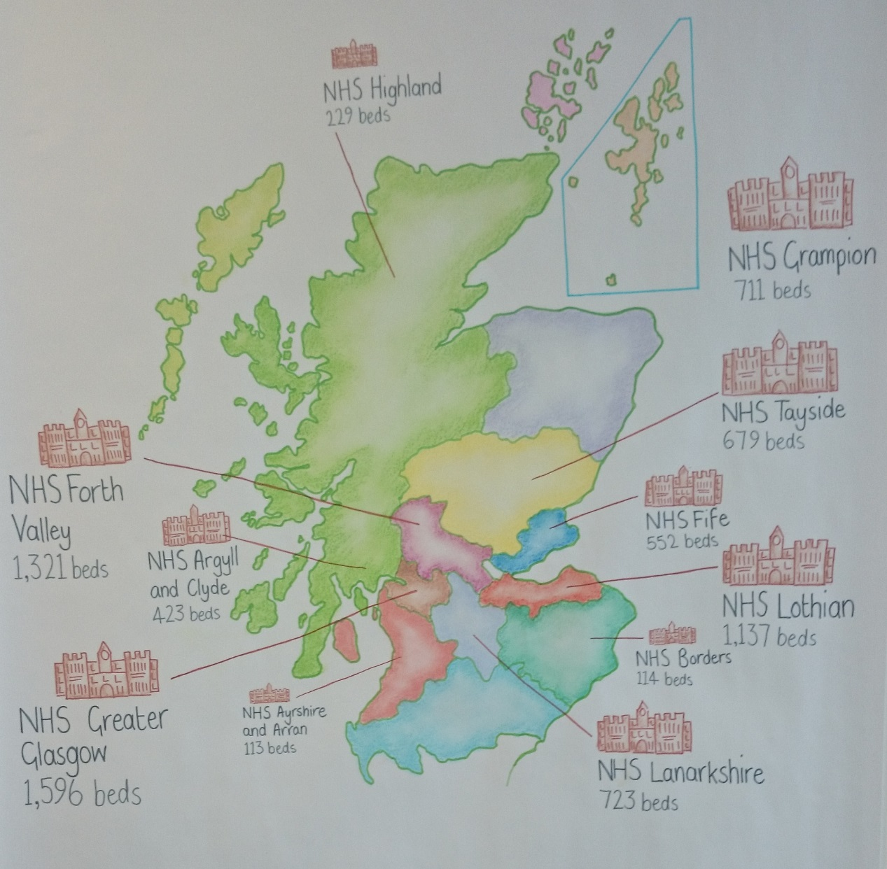
Beds in Learning Disability Hospitals by Health Board in 1976

Slide 13


In our report to the Scottish Government we recommended that further work should be carried out to try and work out how many people with learning disabilities are likely to be eligible to take part in the NCF
SCLD was given a small amount of funding to carry out some more research

Slide 14

NCF Part 2
Estimate the number of children placed in long stay learning disability hospitals in Scotland between 1930 and 2005
Estimate the number of people with learning disabilities in Scotland eligible to speak to the NCF

Slide 15


Thank you for listening!
Would anyone like to ask a question?

