Slide 1
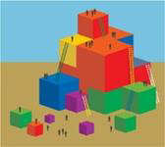
Building yarrow’s future together
Presentation by Brian Turley, Ayaz Nisar & Diana Cadogan
Notes:
Ayaz
Hello everyone
It is good to be here
My name is….. and this is Brian and this is Diana.
We would like to tell you about our project Building Futures

Slide 2
Building Yarrow’s Future Together
Yarrow is 25 this year.
Yarrow supports people with
learning disabilities in West
London
We are planning our future. We call this work “Building Futures”.
We are involving lots of people who user services, their families, staff and others.
Notes:
Diana to ask Brian – why do you think this work is so important?

Slide 3
Building Futures
We have been using a system called Appreciative Inquiry.
Asking people to tell us their best stories of Yarrow
Learning from this to get even better at supporting people.
“You get what you focus on”
Notes:
Diana to tell story of canoeing down a river, instructor says don’t hit the rock, all you can do is think about the rock – and guess what, you hit it!
If he said aim for open water, the rock wouldn’t be on your mind – and guess what, you miss the rock!
So by the same token – we say, lets look at the good stuff, what we do really well, lets really talk about it, find out why it went so well, that way we can do more of the good stuff, hence the saying – you get what you focus on
We wanted to use a different more creative approach to planning. Traditional models can focus heavily on what’s going wrong. on fixing problems and on financial constraints. This is a more creative and valuing approach, one which allows us to focus on our great practise, it builds motivation and enables more great work to flourish, it involves lots of people designing the future together and this way creates capacity and builds engagement.

Slide 4

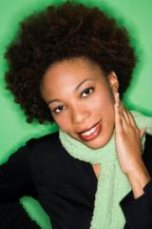
4 D’s
There are four stages
Discovery –gather real stories of when Yarrow has been at its best and what made this happen work
Dreaming – dream together about what a really great future will look like

Slide 5
4 D’s
Designing – thinking about what needs to change in Yarrow to make our dreams come alive
Destiny – planning together to take action

Slide 6
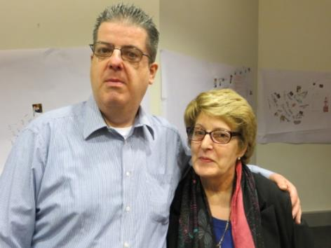
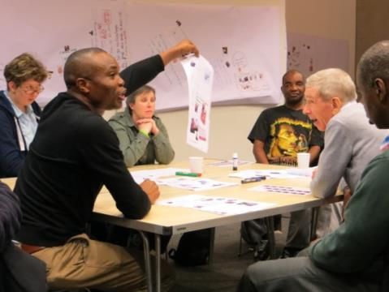
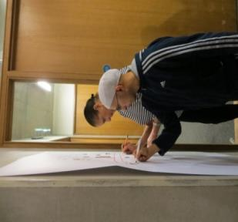
Getting started
We started by holding two great days, one with the people we support and one with families
Notes:
Diana
We had two people helping us.
Paul Davies how understands Appreciative Inquiry
Cathy Claydon a speech and language therapist who is helping us to find ways to include people who use our services in everything we do.
The family day was a great opportunity to work with families in a different way, getting them involved in thinking about what Yarrow does really well and imagining a better future. It is the start of a new relationship with families

Slide 7

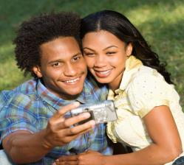
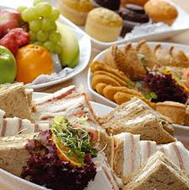
Service user day 15 January 2014
Bring your story to our ‘Building Futures’ Day
Bring an object..
Or a photo..
Or a story.. about your best
or most important thing.
Notes:
Diana
This is part of the poster we sent to people inviting them to come
So people could tell their stories we asked them to bring along something to help them tell their story of their best or most important thing
Diana ask Brian what he thought about the event
I remember Paul was very good at explaining what we were going to do.
He wanted us to generate lots of conversations, talk to each other, chat
Cathy was very good. She told us to bring something important with us.
I brought my panic alarm. Its very important to me
Ayaz – I bought a picture of a cricket player and information about a gardening project I did

Slide 8
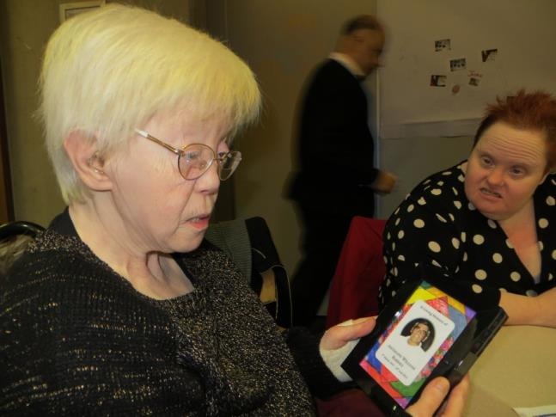
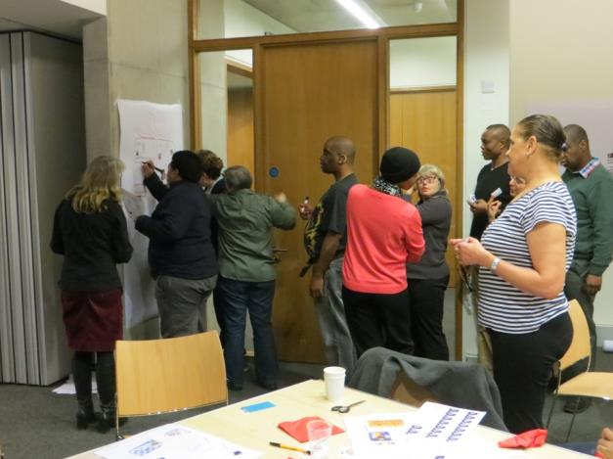
What we discovered
We heard some great stories about peoples lives and the support they get from Yarrow
Notes:
This is some of the work I did – Ayaz and Brian show posters on wall

Slide 9
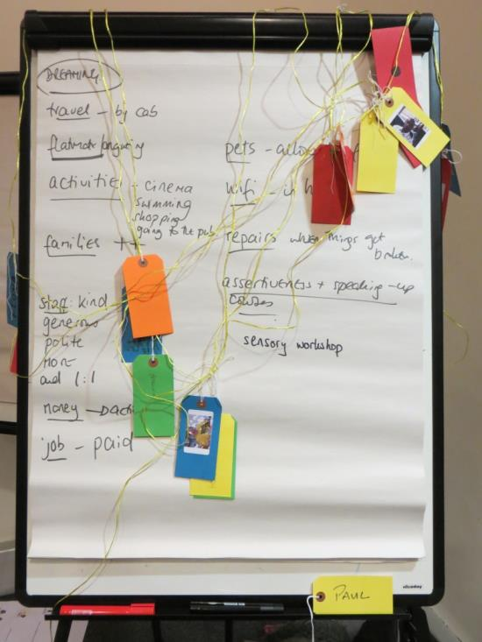
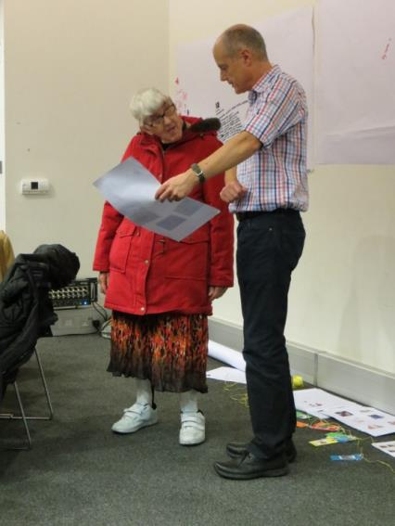
What we discovered
We found out about people’s dreams
and wishes for the future
and we made new friends
Notes:
We all put a photograph of ourselves on a label and one by one tied it onto a on long piece of string to show who was there and that we were all working together – we called it the thread of inquiry
Its shows that we are all working together and how many people are involved
We will be adding names and labels to the thread at the next big event
People shared similar dreams and we grouped these together into themes, they included:
Wanting technology
Wanting to choose their staff and having kind staff to support them
More travel
More activities

Slide 10
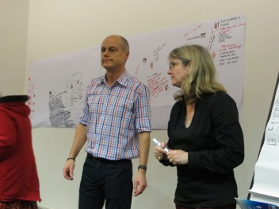
Our Team
Next we set up a team to lead the work
It was made up of service users, family
members, staff and managers
We worked together thinking about
what makes a good team
Together we wrote three statements to guide the next stages of our work
We learnt how to interview people to find out more great stories of Yarrow and about people’s dreams
Notes:
Brian
There was a good atmosphere, a good feeling in the room, bringing people together to tackle issues now, not later, communicating, building self esteem and confidence

Slide 11
Gathering stories
We interviewed lots of people –
service users, families, staff and
commissioners
We wrote up what they
said on posters
We met as a team to look at
what people were saying and to
plan for the summer event

Slide 12
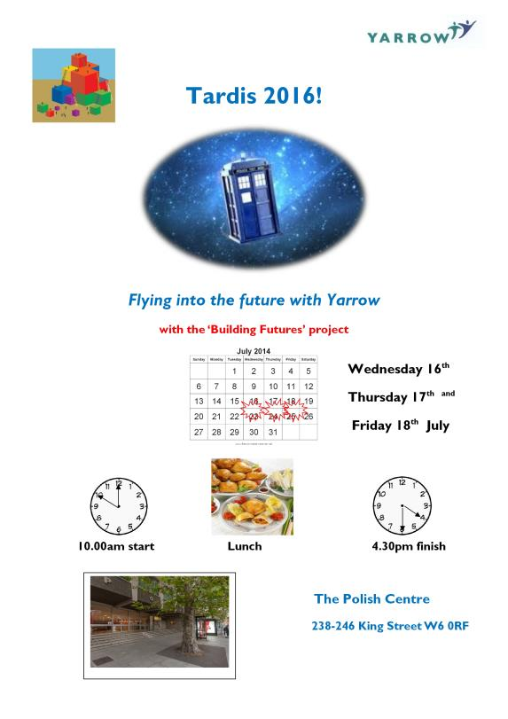
Flying into the future
Notes:
This is the poster advertising our summer event. Dr Who idea from service users

Slide 13
Tardis 2016
Over 100 people – service users, family and staff are meeting this week for three days
We will share more great stories
Dream more about how we want life to be
Decide what needs to change
Draw up action plans to make those changes
We have an artist to record what we do over the three days

Slide 14
Involving everyone
To make sure people who use service are really involved we have asked people to do some work before the event
We have written an accessible workbook
for the three days
Designed activities
which everyone can enjoy
At the end of the three days the Moment by Moment Theatre Group will put on a show for us all

Slide 15
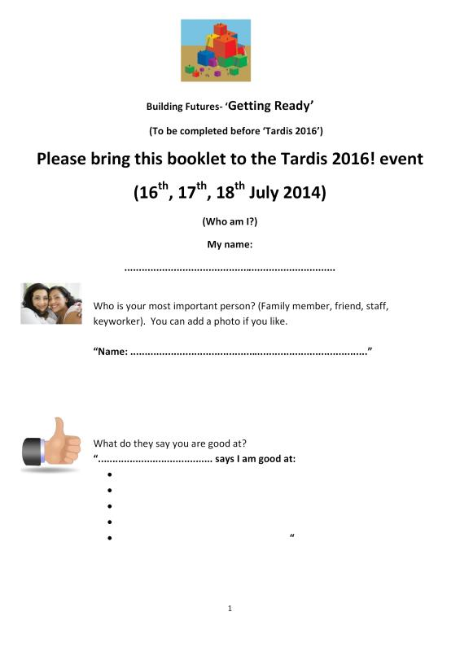
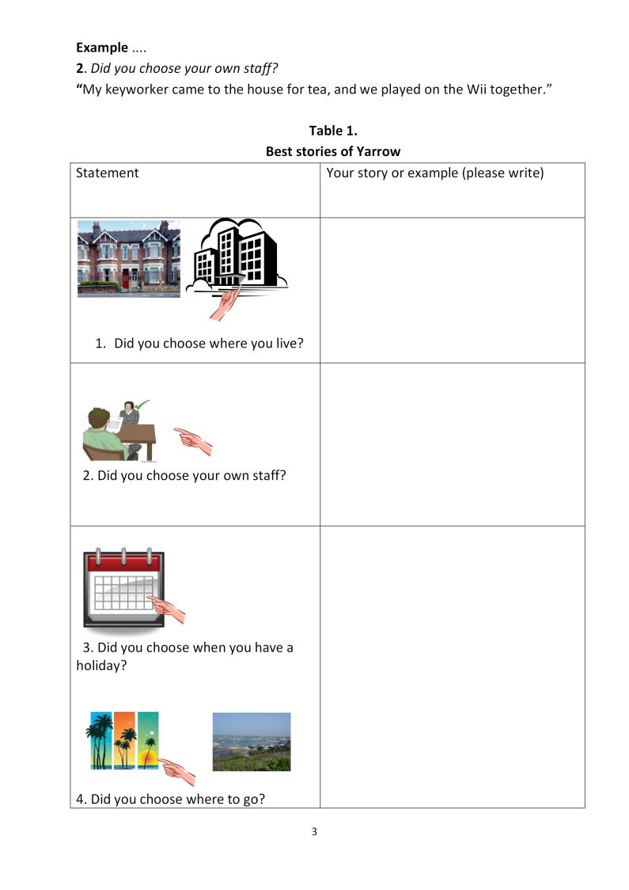
Getting Ready Booklet
Notes:
This is part of the getting ready book Cathy helped us design

Slide 16
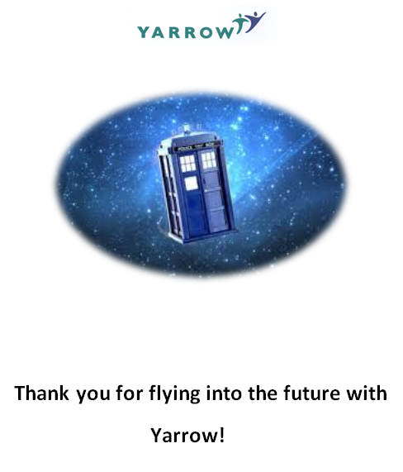
What next?
After Tardis 2016 we will
start the real work of
putting our plans into
action
Building Yarrow’s
future together

Slide 17
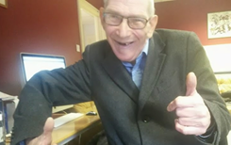
Remembering Peter Kemp
Soho by Peter Kemp
I got up in the morning and I was yawning,
I put my clothes on and had my breakfast,
And left the house quiet as a mouse,
I went to Soho.
I caught the bus, the 94, to Piccadilly like I'd done before,
then I walked to Soho square, I always have a good time there,
I went to Soho
I went past the strip clubs and all the sex shops,
I walk past some prostitutes, but I don't stop,
I went to Soho.
I go to a coffee shop and I get a coffee,
They charge £2 and it is very frothy,
I say hello to the people there,
At the coffee shop in Soho square,
I sit outside and have a smoke,
I am a most contented bloke,
I went to Soho
Then I go home, the way I came,
And next week I'll do it all again.
Notes:
Many of the changes that came about over the last 25 years were reflected in the life of Peter Kemp, whom many of you knew. Peter was part of the Building Futures team but very sadly died a few weeks ago. He came to Yarrow from a long-stay institution where he had little choice or control over his life. At Yarrow, Peter took control of his life. He did and enjoyed the ordinary things in life, a bus ride, a coffee, making friends and in the words of his poem ‘I went to Soho’ became ‘a most contented bloke’. A copy of the poem can be found at the end of this presentation.
With the support, commitment, dedication and skills of Yarrow’s staff, Peter successfully established a new life with a very large circle of friends, ran a film club at The Gate and wrote a regular music blog with a following of 47,000. We are dedicating our work on Building Futures to Peter Kemp

