Slide 1


Online Journal Club - why?
ICT competence / confidence
Subject knowledge / confidence
Finding / analysing content
Critical thinking
Ownership of learning
Community
Employability skills

Slide 2


Fun
Safe
Optional
Outside of formal study
Own identity
Supportive
Informative but no ‘teaching’
No recordings
Open to any student, wherever they were
Online
Journal
Club
Issue – no budget!

Slide 3
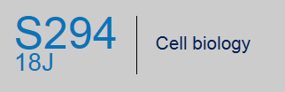

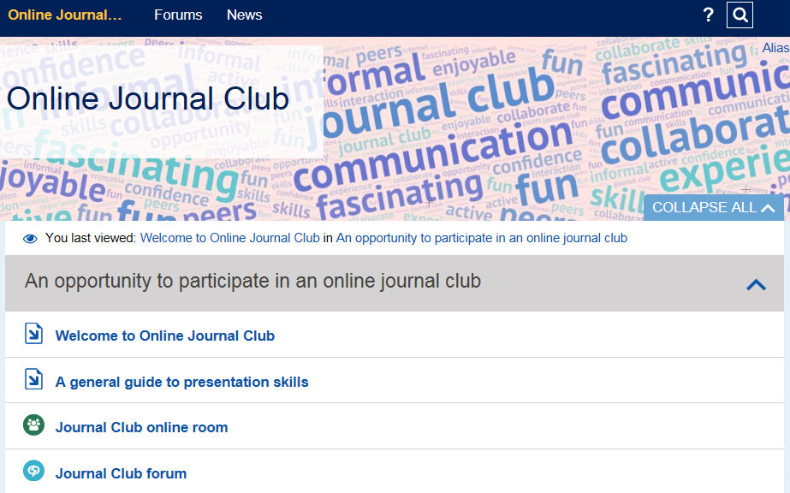
Online Journal Club - where?
Guidance
Tips
Templates
Forum
Online room
Online Journal Club - when?
Between modules
During presentation

Slide 4

Online Journal Club - how?
Guidance
Tips
Templates
Forum
Online room
Student groups
Same module
Same pathway
Same level
Cross level
Cross-faculty
Journal Club Models
Item of news
Item of news (+ ref)
Original article
‘full’ or ‘part’ presentation
Reward
Experience
Microbadge

Slide 5

The OJC website
https://learn1.open.ac.uk/course/view.php?id=100179

Slide 6


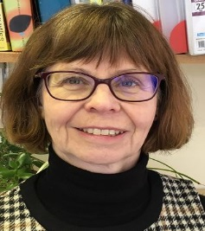
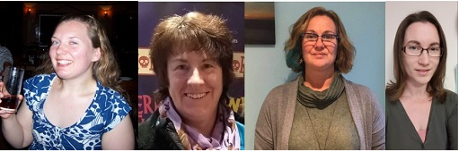
Online Journal Clubs:
The view from the coalface AL perspective
Fiona Moorman ST and AL
Karen New
ST and AL
Hazel Church Curriculum manager and website guru
Meet the team
AL OJC facilitators. From L-R; Heather Fraser, Jo Culross, Kate Fox and Trish Aldred
Notes:
Four ALs involved in the S294 Early Start pilot also moderated the associated OJC sessions.
Jo Culross, Heather Fraser and Trish Aldred and Kate Fox.
ALs then took over the running and moderating of OJC from 18J module start.
Two ALs per club.
Administration.
Administration involved replying to applications of interest, supporting and advising on suitable topics and style, sending reminders and collation/modification of slides.

Slide 7
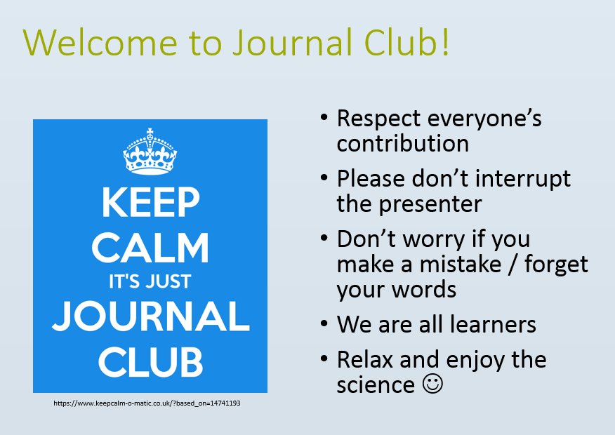
The first rule of journal club:
Do talk about journal club
The second rule of journal club:
What happens in Journal Club,
stays in Journal Club
Notes:
Five clubs ran between January and April 2019 (11 students).
ALs introduced a few housekeeping slides then handed over to students. Student slides were previously uploaded so “ready to go”.
Sessions were student-led with only limited questions/input from ALs.
Post-presentation, students were asked if they were happy for their slides to be posted in the OJC forum and encouraged to fill in the feedback questionnaire.

Slide 8
Fantastic enthusiasm and knowledge from students with a wide scope of topics covered including:
    Electric Fields Elicit Ballooning in Spiders
    Researchers create first stem cells using CRISPR genome activation
    Tiny tunnels inside garnets appear to be the result of boring microorganisms
    Selfish gene acts as both poison and antidote to eliminate competition
    Newly discovered neurons which may be unique to humans
    Fatal Familial Insomnia
    The Wild Side of Plant Microbiomes
    Fat-blocking effect of nanofibers discovered
Notes:
AL feedback has been overwhelmingly positive.
Initial AL concerns and nerves at being “out of our comfort zone” and worries about AC reliability, questions from students on areas of science out with our expertise, student shyness, technical issues, etc.

Slide 9
Major AL benefits include
  Facilitated students’ ownership of their learning.
  Changed teaching practice to a “say less, listen more” approach in own tutorials.
  Fired us up about recent science news stories and we enjoyed learning new things too. Prompted us to think about ways of incorporating new science into existing tutorials.
  Hugely rewarding to see student's confidence blossom and their love of science grow. Infectious enthusiasm.

Slide 10

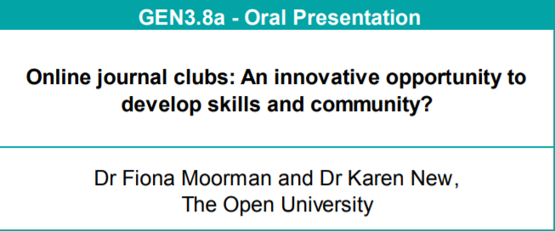
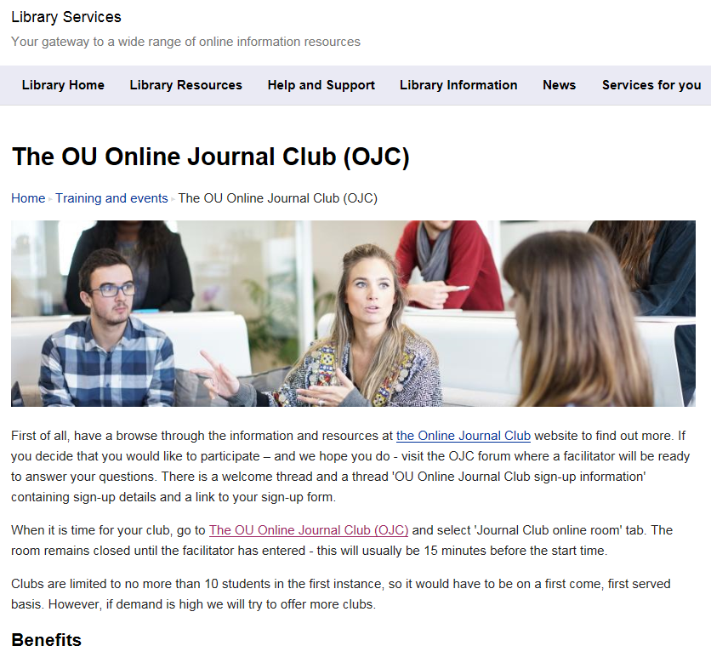
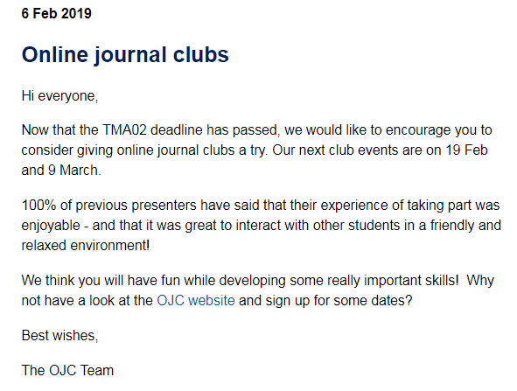


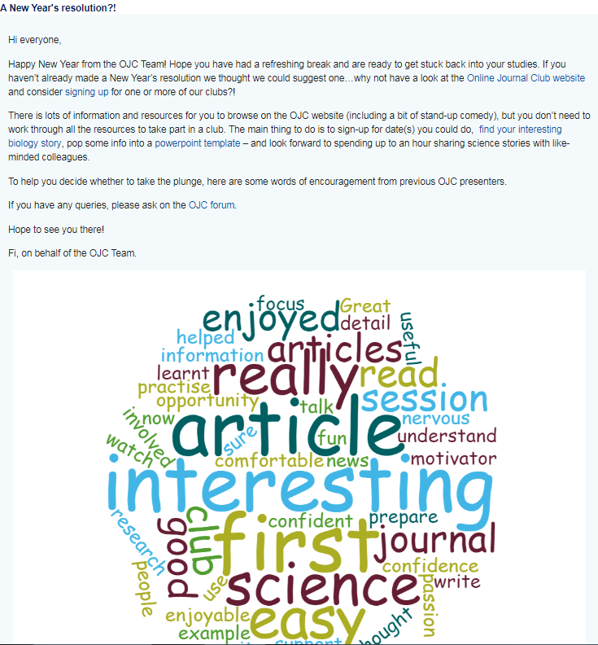
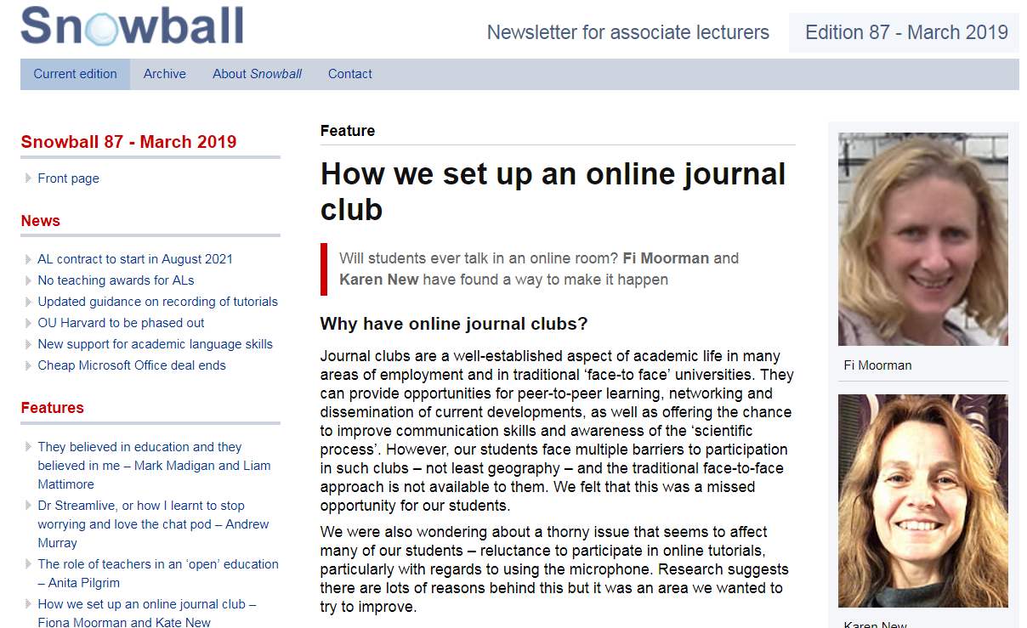
Notes:
To students: As news item on module websites, within forums, on buddy forums to let buddies know, haven’t really ‘done’ social media yet, but it’s on our radar as this is a great vehicle for getting the word out!
To ALs: Kate and I ran a session as part of an online ALSD day in Jan, Karen and I were asked to write an article for Snowball
To wider community – we talk about OJC at every opportunity (everyone here will have probably been collared by Karen and I at some state, and AdvanceHEA have accepted our proposal to give an Oral presentation at the Teaching and Learning conference in July; people are asking about OJC: Learning Technologist at Swansea Medical School interested in running online journal clubs as part of a distance learning MSc in Medical Education September start.

Slide 11
The student perspective (JISC survey)
Notes:
These clubs were offered to L2 B and H students from mid Jan- early April, outside module; feedback from 11 students who used OJC website resources to prepare and deliver
Starting point: just over a third never used mics in AC before; over half had never given online presentations before

Slide 12
The student perspective (JISC survey)
Notes:
These clubs were offered to L2 B and H students from mid Jan- early April, outside module; feedback from 11 students who used OJC website resources to prepare and deliver
Starting point: just over a third never used mics in AC before; over half had never given online presentations before

Slide 13
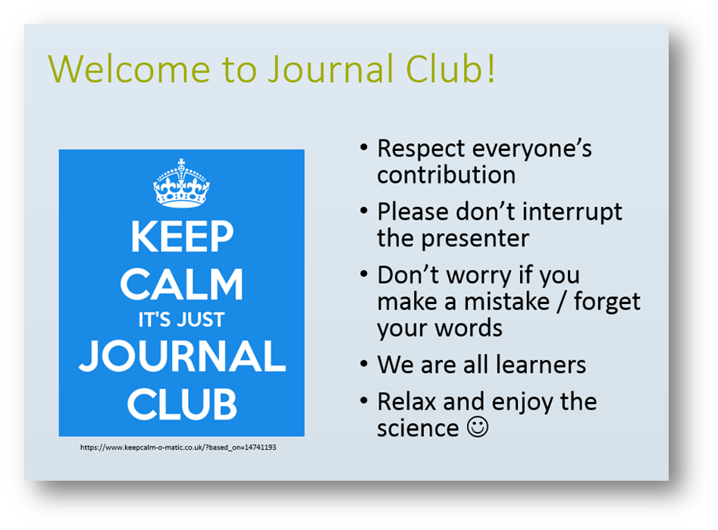
Any questions?

