Slide 1
Storytelling in computing education
Matthew Nelson
9th eSTEeM Annual Conference April 2020
Notes:
We tell fictional stories as a significant part of teaching in two of our Computing modules. Why do we do this?
Does it work?
What do students think?
In this presentation I look at feedback to see how stories are received by students.

Slide 2
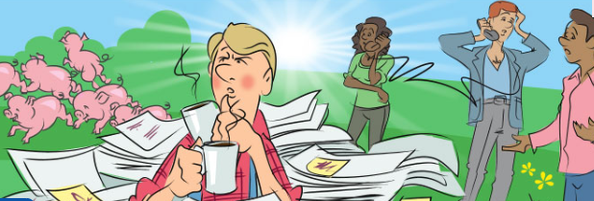
TM254, Managing IT: the why, the what and the how
The story: “Ben’s Farm”
Notes:
Ben runs a nature reserve but does not have a clue about managing its IT services.
Ben shows our students how not to do it.
His friend Georgina shows him the way.
What starts as Ben’s folly ends up as an exemplar of good IT service management practice

Slide 3
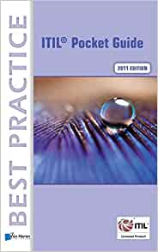
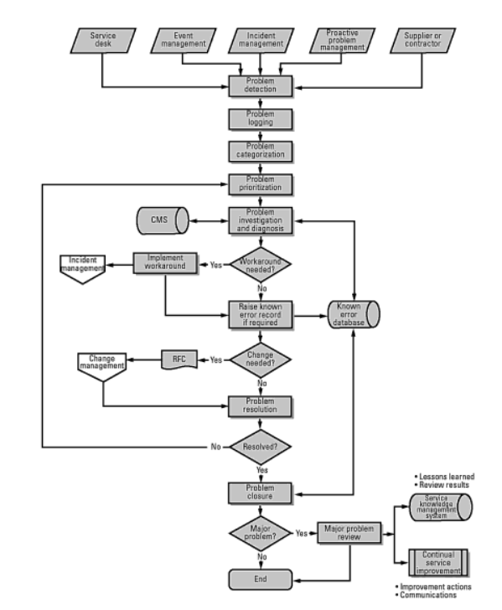
in contrast to …
“The full ITIL framework, found in 2000 pages, condensed into just 200 pocket-sized pages! ”
Notes:
This is the set book used on the predecessor module and considered very dense and dry.
It is comprehensive and of good quality, but full of acronyms and what students complain is “jargon”.
But on TM254 we aim to foster an understanding of underlying principles of best practice …

Slide 4
TM112: Introduction to computing and information technology 2
The story: “Data on your computer: A private investigation!”
Notes:
The cast: Rupert, private investigator and OU Level 1 computing student. That’s his Rolodex. He needs to get with it.
His client, Gloria, has a Masters in digital data security,
Together they solve a case, while Gloria teaches Rupert about data on computers, and digital forensics.

Slide 5
Why these stories?
Instructor perspective:
Teach what you’re teaching vs wrap it in a narrative
Ability to construct a case study
One story can contain many case studies, each teaching something different
Notes:
We create an artificial case study. This can be made to include all the lessons we want understood.
This is also a gentle introduction to students in the academic use of case studies.
Students are asked to apply their understanding of principles to problems within the story to identify root causes and create solutions.

Slide 6
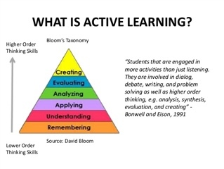
Why these stories?
Student perspective:
Active vs passive learning
Notes:
This user-involvement is a form of active learning.
Engagement and motivation
Connection vs disconnection
Humanising and connecting, making relevant
Image:
https://ion.icaew.com/academia/f/forum/5025/active-learning

Slide 7
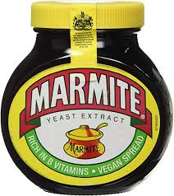
Reception
Notes:
Some students really like the narrative approach: others really don’t.
There is plenty of Seam feedback and forum posts which are strongly on one side or the other.
The sharp dichotomy of opinion is very striking

Slide 8
Private investigation
SEam positive
The story was excellent and I actually learned a lot while I was reading the story. It's an excellent way to learn and I would hope this kind of study material is used more in the future.
Notes:
Pause for audience to read slide
There were many comments like this one. Encouraging to see. Given this, why would we question our approach?

Slide 9
Private investigation
SEam negative
This was an interesting experiment in how to deliver the material in an interesting way. Unfortunately, as I’m not twelve I found this laborious to read.
I hope the rest of the modules I cover are written more conventionally.
Notes:
Pause for audience to read slide
There is an element of surprise in some reactions. They didn’t expect this in a University course
They go on to say: “Please also end the patronising "story telling" narrative. This detracts from the academic text.”

Slide 10
Ben’s farm
SEam positive
For something as incredibly dry as project and service management, this course was surprisingly engaging. I did genuinely enjoy "Ben’s farm" and the slightly sarcastic comments about their potential romantic involvement did produce some actual laughter from me.
Notes:
If you can get somebody to laugh while reading about IT Service Management you have done something remarkable.
BUT …

Slide 11
Ben’s farm
SEam negative
I found it very difficult to keep my interest and focus in the mundane tasks around the farm. When you pay over £1500 you don’t really expect to be reading about the quasi romantic overtures of a farmer and his disgruntled employees or their penchant for coffee.
Notes:
Pause for audience to read slide
The student goes on to say:
“This was extremely inappropriate, yes provide me with examples but don’t write a novel detailing a poor business.
There are real world examples we could look at.”

Slide 12
Private Investigation
Forum reactions
Seriously, this is a complete waste of time to parse. As a literary critique it just isn't very good as a story, and I'm not taking a fine arts degree. I just need the information required to learn. Where can I find it?
Notes:
Pause for audience to read slide
But most students who posted in response to this posting completely disagreed.
Interesting that in survey feedback assertions cannot be challenged: in a forum they can be.

Slide 13
Ben’s Farm
Forum reactions
Unfortunately service management is one of those subjects that is inherently dry and nigh-on impossible to make interesting while discussing the basics.
I have to admit I kept looking forward to Ben's Farm examples as it made it bearable.
Notes:
Pause for audience to read slide
Bearable is a triumph!
Often a forum thread that starts with a moan ends up being a series of moans. Not with storytelling threads

Slide 14
Questions and conclusions
Why do some students really like stories?
Why do others really not like them?
Notes:
The following postings are representative of the opposing views
“It put across all of the information in an interesting way which could be related to a real world scenario.”
On the other hand
“The benefits to bare bones clear styling is it lets you structure the information yourself in the learning style you prefer”

Slide 15
Conclusion
Should we be using teaching techniques that we know many students do not like?
Use multiple versions and let the students decide?
matthew.nelson@open.ac.uk
Notes:
Forum post:
“People learn in different ways so this may have been helpful for others and not as great for some.”
OU teaching is fundamentally linear. Is it feasible to present multiple versions and to let students choose the approach that suits them best, while still delivering all of the learning outcomes.
Are there any other stories out there? How successful are they? Let me know.

