Slide 1
Decentralised Qualifications on the Blockchain
Dr Alexander Mikroyannidis, The Open University, UK

Slide 2
Motivation
The centralised education model is no longer sustainable:
  Learning happens increasingly outside the brick-and-mortar lecture halls of schools, colleges, and universities on online platforms, within communities of like-minded individuals, or by contributing to projects and initiatives in the real-world.
  Learning is far more international than it used to be: key education players open campuses abroad, while students travel to different countries to improve their employability prospects.
  In the networked, digitally empowered world of the 21st century, education providers often do not have remit or the means and capacity to cover the range of activities learners engage with, which attest their achievements, knowledge, and skills.

Slide 3
Vision
We envision an education model in which the awarding and validation of qualifications no longer occur exclusively under the management of an education institution or an employer.
Individual students, teachers, and peers take more ownership of the learning experience and its outcomes without compromising on safety, security, and accessibility.

Slide 4
What is a blockchain?
A cryptographically secure, shared, distributed ledger.
Each block aggregates a timestamped batch of transactions and is identified by a cryptographic signature.
These blocks are all back-linked so that the chain can be traced all the way back to the very first block created.
As such, the blockchain contains an un-editable record of all transactions.
Source: http://hackeducation.com/2016/04/07/blockchain-education-guide

Slide 5
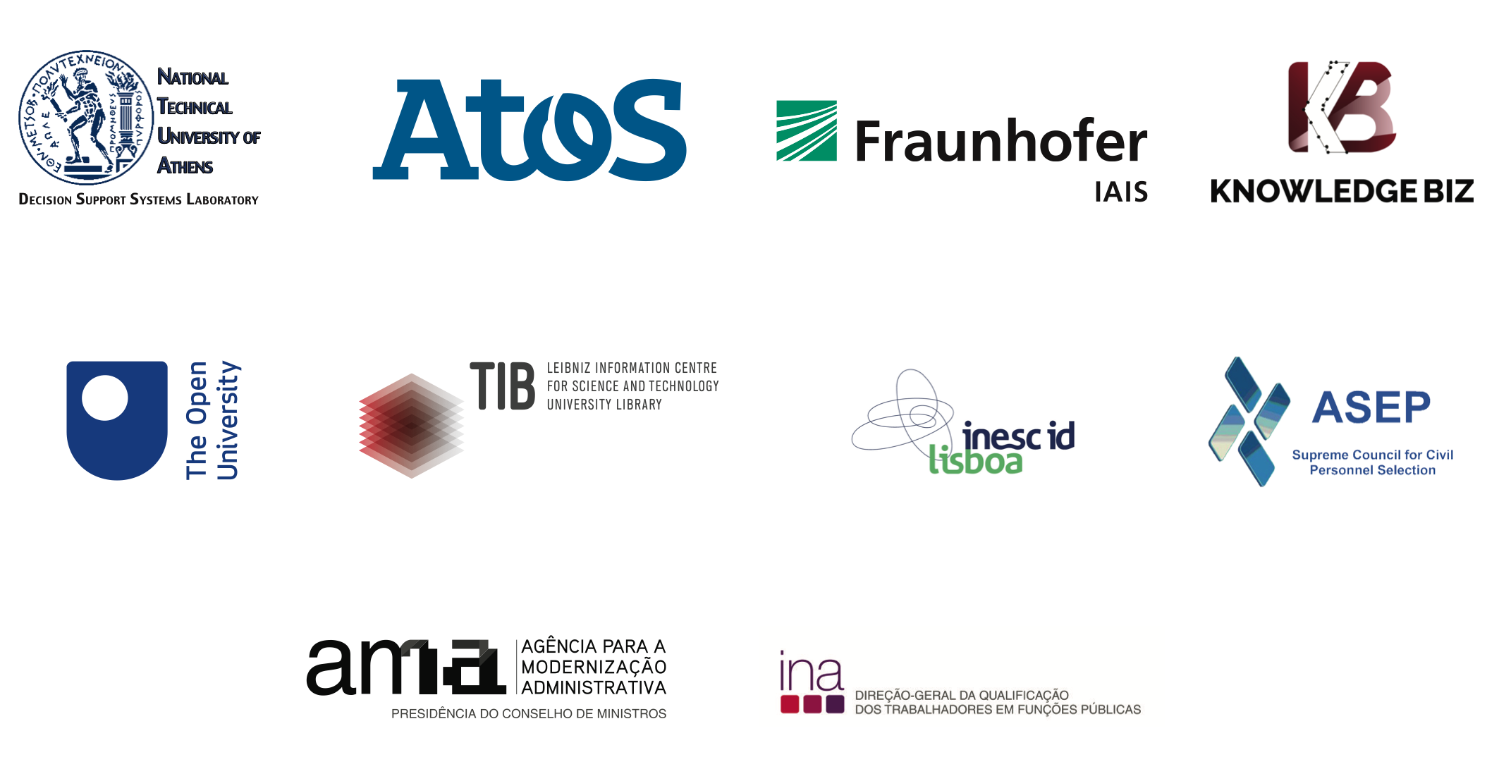
QualiChain
H2020 research and innovation project investigating the verification and management of decentralised qualifications on the blockchain.

Slide 6
Project objectives
Creation, piloting and evaluation of decentralised solutions for storing, sharing and verifying education and employment qualifications.
Assessment of the technical, political, socioeconomic, legal and cultural impact of decentralised solutions on education.
Targeting four key areas through pilots in:
  Lifelong learning
  Smart curriculum design
  Staffing the public sector
  Providing HR consultancy and competency management services

Slide 7
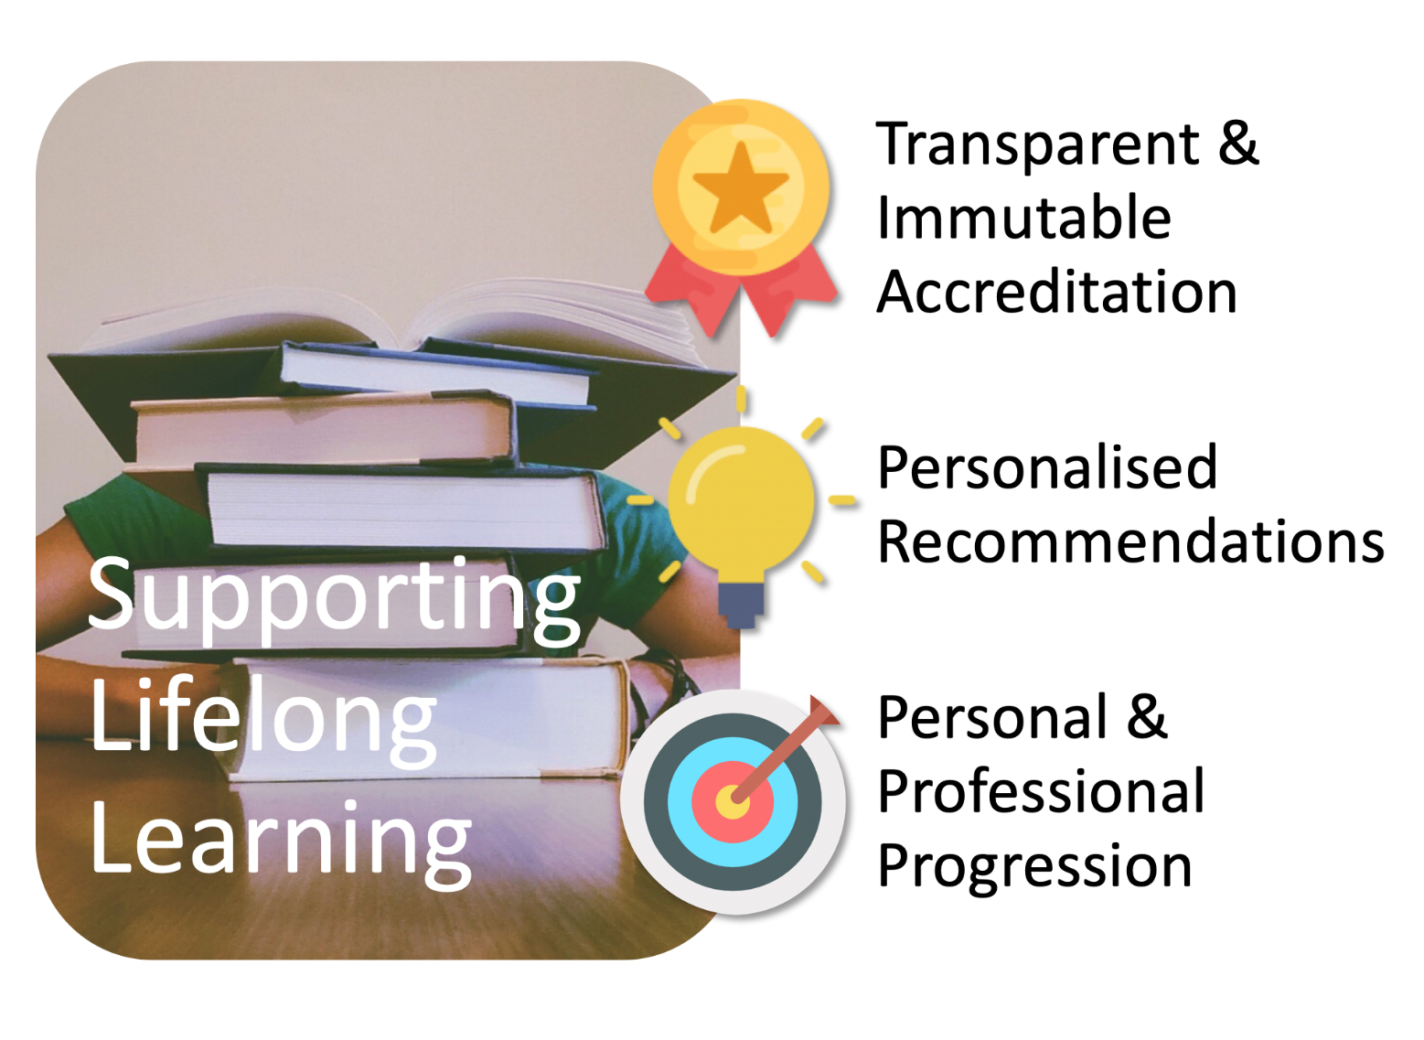
The lifelong learning pilot

Slide 8
Pilot objectives
Targeting both formal and informal learning: We will not restrict this pilot to university (formal) education only, but will be investigating how to support informal learning too.
Targeting both academic degrees and other forms of educational accreditation: We will not restrict this pilot to university degrees only, but will also target other forms of accreditation.
Supporting the learning journey and career trajectory of learners: Instead of just focusing on the equivalence of academic degrees among universities, we will be aiming to support the whole learning journey of lifelong learners.

Slide 9

Stakeholders (1/2)
Lifelong learners. They pursue learning throughout their lifetime, for either personal or professional reasons. They may study to develop new skills that they need in their professional life, for example to advance their career by finding a new job or by being promoted in their current job. They may also study to acquire skills and knowledge for personal reasons, for example as a hobby of theirs. Lifelong learners may engage either formal or informal education, or both.

Slide 10

Stakeholders (2/2)
Educational institutions. These are institutions that provide education or training services, either paid ones or free. Examples of such institutions are preschools, primary schools, secondary schools, as well as further and higher education institutions. The offerings of educational institutions can vary from conventional offline degrees to online free or paid courses, such as Massive Open Online Courses (MOOCs) or Open Educational Resources (OERs).

Slide 11
Use case
Lifelong learners earn Smart Badges stored on the Blockchain, thus ensuring the validity of the awarded accreditation and eliminating the risk of fabricated qualifications.
Smart Badges include data about the key skills that learners have acquired.
Learners receive personalised recommendations about job offers that match their skills. They also receive recommendations about what to study next.

Slide 12
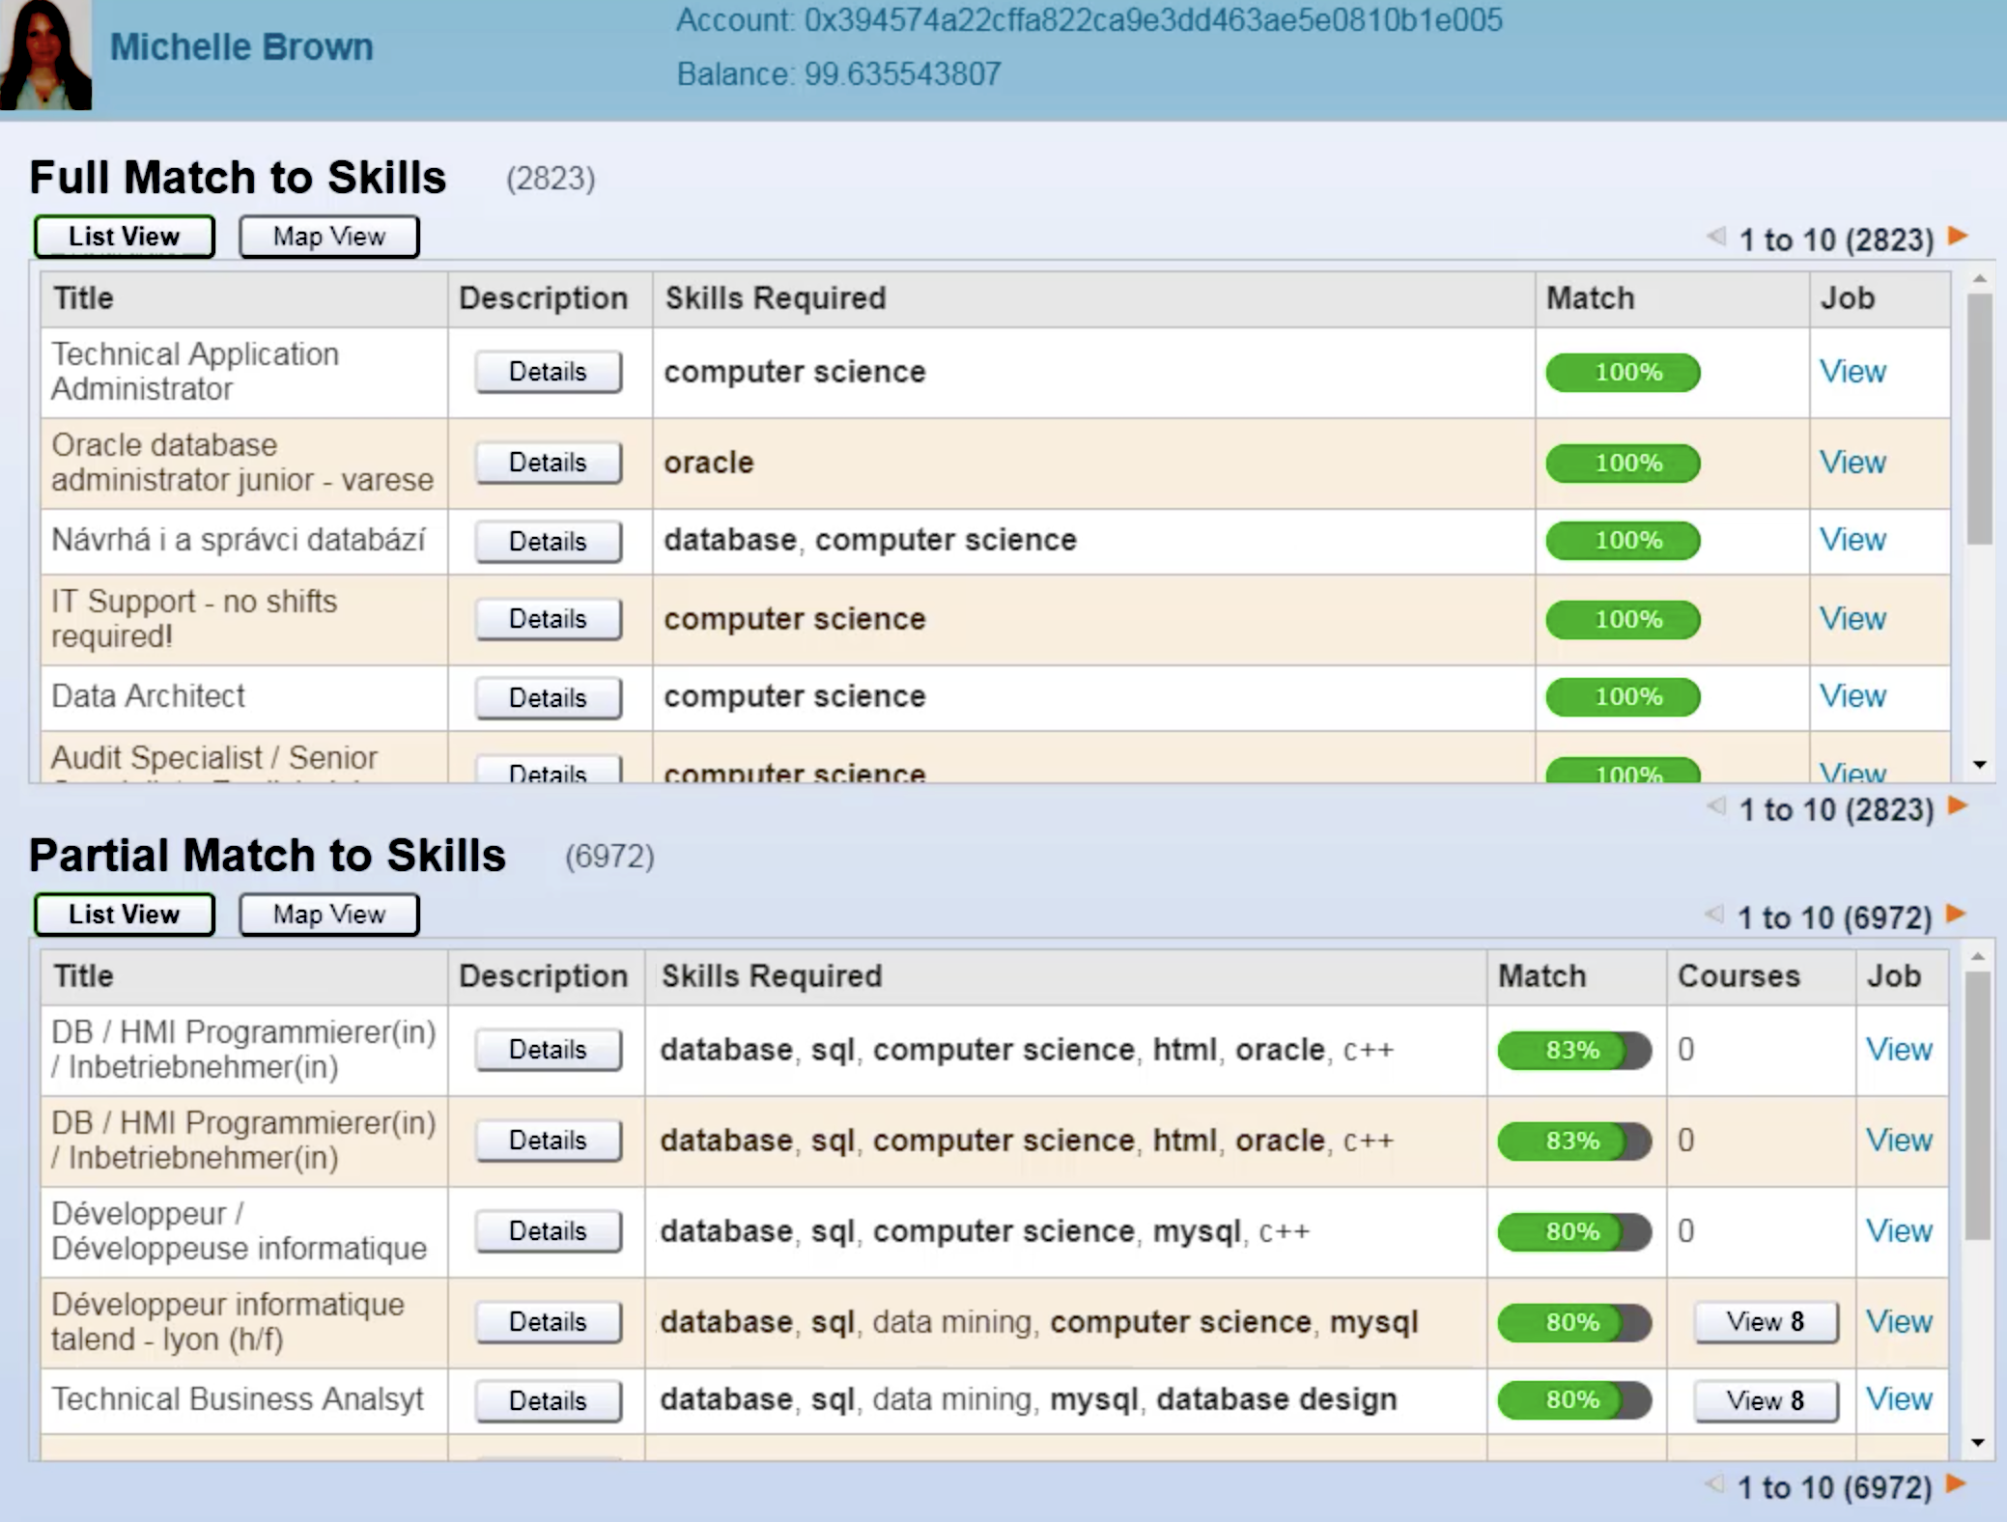
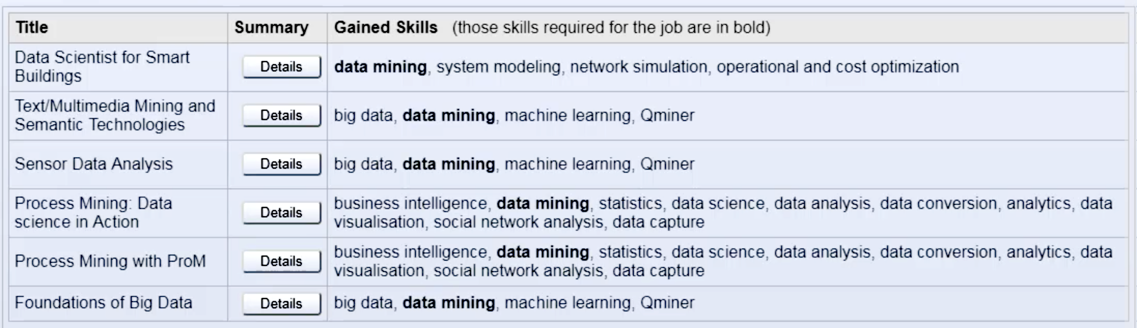
Learning recommenders

Slide 13

Consultation workshops
We have conducted a series of consultation workshops, in order to elicit requirements from groups of learners, educators, researchers and practitioners.
During these workshops, we have consulted with participants in order to better understand the lifelong learning challenges they face and their proposed solutions.

Slide 14
Findings
Validation of Formal & Informal Qualifications
Lifelong Learning Pathways & Micro-credentials
Career
Counselling
Data Ownership and Privacy
ePortfolios should aggregate formal and informal qualifications validated by employers and educational institutions.
Learners should receive guidance in building lifelong learning pathways and acquiring micro-credentials in order to achieve their learning goals.
Job seekers should be provided with a comprehensive overview of the job market and the latest market trends.
Learners/job seekers should own their digital identity and their ePortfolio data and should be able to control third-party access to it.

Slide 15
Thank you for your participation! https://qualichain-project.eu

