Slide 1
Individual student support sessions; where are we now? Considering awareness, usage and effectiveness of individual student support sessions
Fi Moorman and Karen New
Notes:
Welcome and introductions

Slide 2
Is individual student support important?
Can you think of an instance of how 1-2-1 support helped you to achieve a goal?
https://pxhere.com/en/photo/1513463
Notes:
Fi - Hopefully some will share example and will bring out aspects such as reassuring, confidence building, personalised, felt liked they cared, took an interest, mentoring, etc. etc. Type in chat pod.

Slide 3
Our students
Different awareness/expectation of institutional support available
Diverse availability (e.g. full time student, part-time student, work/family/caring commitments)
By definition, study at a distance
Study at variable intensity (e.g. single/multi-module; overlapping/single presentations)
Diverse individual characteristics (e.g. motivation, aspirations, personality, ability)
Diverse demographics (e.g. age, ethnicity, gender, socioeconomic background, previous educational experiences, disabilities)
Notes:
Karen (to slide 9 inclusive)

Slide 4
Wider Higher Education environment
Research suggests students appreciate higher levels of pastoral and academic support (Schlusmans, K. (2018); McKie, A. (2018))
Neves and Hillman (2017) found that 36% of all respondents cite too little interaction with University staff as the reason for a negative university experience.
Many conventional universities are latterly recognising that individual tutor-student contact is important (e.g. https://www.sheffield.ac.uk/lets/pp/support/tutors).
Gabi and Sharpe (2019) argue that we might change the discourse from a focus on retention to one on persistence; and that persistence results from a complex interplay between personal and environmental factors, where the institution – tutors – is key
This message is also reflected in the highly positive feedback from our students about the personalised feedback on their assignment that they receive from their tutor
Notes:
Karen – brief chat re HE context.
Which faculty do you think offer the most ISSS per year?

Slide 5
Is individual student support important?
Notes:
Which faculty out of ISSS sessions offer the most ISSS per year? For context there are ~25K, 20K, 18K and 12K FTE students for FASS, STEM, WELS and FBS, respectively

Slide 6
Is individual student support important?

Slide 7
Is individual student support important?

Slide 8
Is individual student support important?

Slide 9
Is individual student support important?
STEM B&J Modules | Numbers of ISSS requests
SDK100 (J&B) | 32
SDK228 | 27
TM111 | 27
MST124 (J&B) | 21
MU123 | 20
U116 (J and B) | 18
S111 (J&B) | 17
TM112 | 15
T212 | 13
TM129 | 13
S317 | 12
M250 | 12
T192 | 12
S295 | 11
S112 | 9
M140 (J&B) | 9
S294 | 8
M208 | 8
M269 | 7
MST125 (J&B) | 7
SK320 | 7
Notes:
Karen:
A rough and ready look at data for STEM students for 19B and 19J students as of Jan2020.
Note – this is just a snapshot to give an indication of ISSS requests by modules, only covers 19B and 19J up until Jan 2020, so skewed

Slide 10
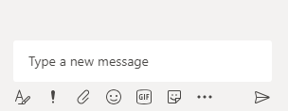
What are the main reasons ISSS are offered?
Type your thoughts here
Notes:
Fi
Give 2 mins for people to types their thoughts

Slide 11
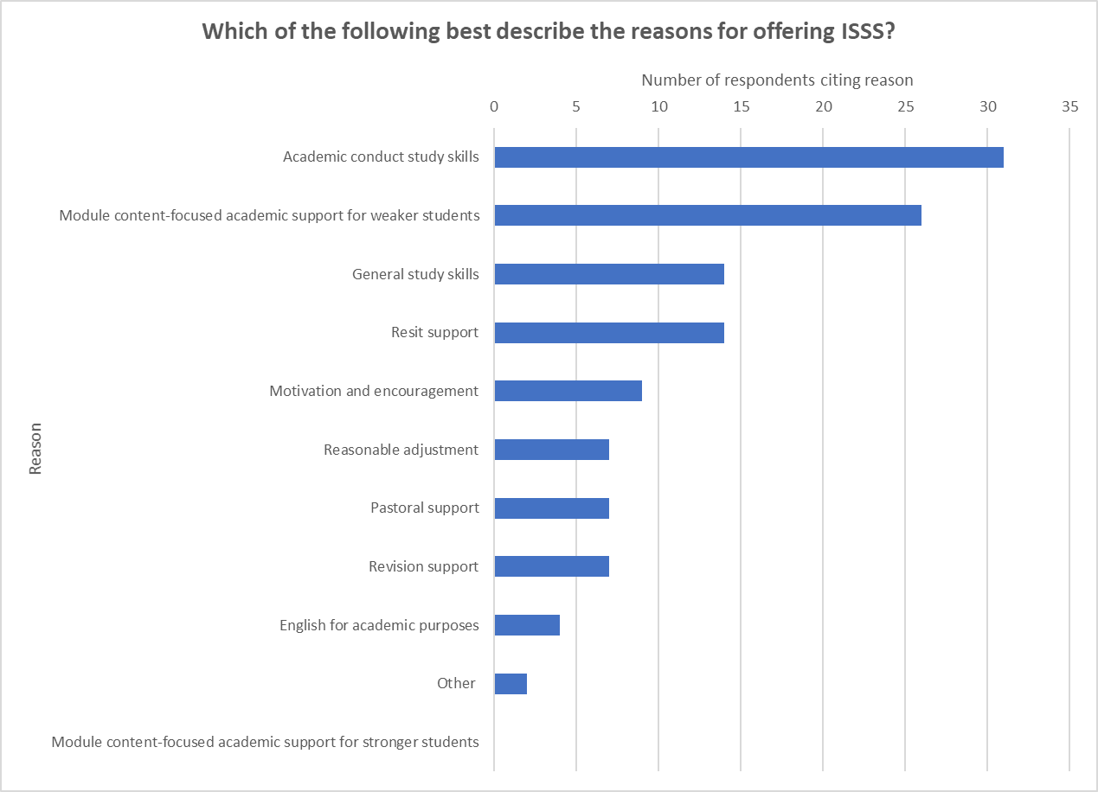
What are the main reasons ISSS are offered?
Survey responses from 45 ALs tutoring LHCS modules
Notes:
Fi Survey data based upon responses from 45 ALs

Slide 12
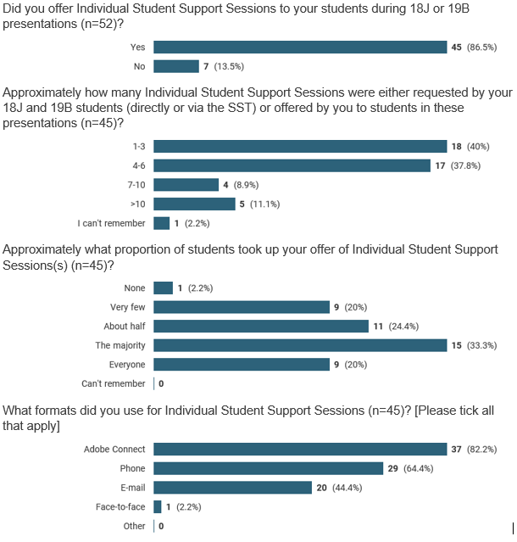
How many ISSS offered / accepted and how provided?
Notes:
Fi
Quick peek at some survey data about uptake and format of ISSS (Fi)
Some tutors feel they are offering quite a lot of ISSS, but this doesn’t seem to be reflected in the VOICE data showing numbers of SRs associated with ISSS

Slide 13
Effective use of ISSS: breakout room discussion
What makes ISSS intervention(s) less or more effective?
How do we judge this?
Breakout Room One
Breakout Room Two
Breakout Room Three
Type your thoughts here
Please nominate someone to share 1 less effective and one more effective approach and how did you decide?
Notes:
Karen

Slide 14
What makes an ISSS effective?
Realistic, clear objectives and purposes
Positive and supportive session
Advance preparation by tutor & student
Follow-up
Focused on defined aspect (e.g. a specific study skill)
Notes:
Fi Survey suggestions from our ALs – did these align with your thoughts?

Slide 15
Effective use of ISSS: resource packs for STEM ALs to adapt for ISSS
Do you think these could be useful?
What could we include?
Time management
Maths for biologists
Effective note taking
Online study
Responding to feedback
?
https://pxhere.com/en/photo/1165445
Notes:
Karen
Large group discussion

Slide 16
Time Management Skills
ISSS Support Pack (to be adapted for each session)
Notes:
Karen (to 21 inclusive)

Slide 17
Action plans – talking points
My goal
What do I need to do to achieve it?
How can I achieve it?
What resources will I need?
When can I take action?

Slide 18
Study time calculator
Activities | Mon | Tues | Wed | Thu | Fri | Sat | Sun | Weekly Totals
Work hours
Travelling time
Quality family time
TV/Reading
Socialising
Housework/ Gardening
Shopping
Exercise/Health
Eating
Sleeping
Hours in the day | 24 | 24 | 24 | 24 | 24 | 24 | 24 | 168
Total committed hours
Time available for study

Slide 19
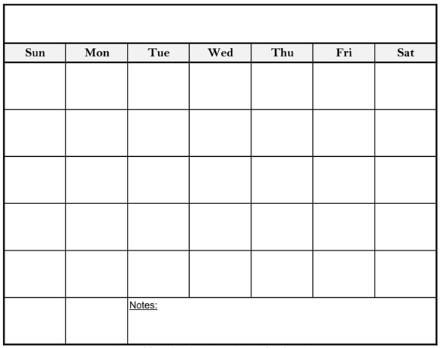
The coming weeks…

Slide 20
Step by step
Find a reason to enjoy each task
Continually consider ways to free up time
Set deadlines for each task
Concentrate on just one thing at a time

Slide 21
Learn from past experiences…
What happened?
What were you thinking / feeling at the time?
What was good / bad about the experience?
What challenged you?
What else could you have done?
Reflective cycle

Slide 22
Let’s get creative – ideas for use of ISSS resource
Make the support proactive – identify ‘at risk’ students before they fail and offer ISSS
Build more 1-2-1 student support time into AL contract
Advertise to students so they know what could be available and feel less stigmatised
Offer bespoke email /short phone support over extended period(s)
Offer multiple sessions, and / or split the ‘session’ into chunks offered at different times
Make it more ‘joined up’ so that ALs can see what ISSS have been provided previously
Offer individual support at pre-determined times (e.g. module start, midway and near exam)
Mechanism for student/ tutor to provide feedback about their session (closing the loop)
https://commons.wikimedia.org/wiki/File:Light_bulb_(yellow)_icon.svg
Notes:
Fi - Data from AL survey

Slide 23
Individual student support: where next?
Take away packs for ALs to customise?
Plan to capture student views on individual student support
https://pixabay.com/photos/support-letters-scrabble-help-2355701/
Notes:
Fi

Slide 24
References
Gabi, J and Sharpe, S (2019) “Against the odds: an investigation into student persistence in UK higher education”, Studies in Higher Education, pp1-17 https://www.tandfonline.com/doi/full/10.1080/03075079.2019.1626364?scroll=top&needAccess=true
McKie, A. (2018) ‘On call: how much support should academics give students?’ Times Higher Education [Online]. Available at https://www.timeshighereducation.com/features/on-call-how-much-support-should-academics-give-students (accessed 22 January 2019)
MacLaughlin, J., Chamberlin, L., Buck, J. (2017) Supporting Student Success: ‘The role of an Academic Progress Tutor’ [Online] Available at https://intranet9.open.ac.uk/collaboration/Scholarship-Exchange/documents/Supporting%20student%20success%20-%20the%20Academic%20Progress%20Tutor.pdf (accessed 22 January 2019)
Neves, J and Hillman, N (2017) ‘Student Academic Experience Survey’ Higher Education Policy Institute 96. [Online] Available at https://www.hepi.ac.uk/2017/06/07/2017-student-academic-experience-survey/ (accessed 22 January 2019)
Schlusmans, K., van den Munckhof, R., Nielissen, G. (2018) ‘Tutoring and support in open online education – a students’ view’. [Online]. Available at https://intranet9.open.ac.uk/collaboration/Scholarship-Exchange/Wiki/Document.aspx?DocumentID=2124 (accessed 10 January 2019)

