Slide 1
eSTEeM
Addressing Disparities in Student Success: enhancing BAME students' achievement
Phil Gravestock p.gravestock@wlv.ac.uk

Slide 2
University of Wolverhampton
West Midlands, post-1992 University
180 years old
18 Schools housed in three faculties
University of Opportunity
Diverse student body
c.21,000 students over three campuses
47% BAME students
54% of full-time undergraduates aged over 21
19% of students from POLAR 1
68% of students first in family into HE
75% of students from a 25 mile radius

Slide 3
Wolverhampton’s Journey
Dhanda (2010)
DiSA (2010-12)
WhatWorks?
(2012-16)
Understanding Misconduct (2016)
Vice Chancellor's Strategic Projects
Students Pre-expectations of HE (2015-16)
Strategic Enhancement Project: R & A (2015)
University Belongingness Study (2015-16)
HEA Collaborative Project (2015-16)
Catalyst: Value-added (2017-19)
Dhanda (2010) > DiSA (2010-12) > What Works? (2012-16); Strategic Enhancement Project: R&A (2015); Students Pre-expectations of HE (2015-16); University Belonginngess Survey (2015-16).
What Works? > Understanding Misconduct (2016); HEA Collaborative Project (2015-16); Vice-Chancellor’s Strategic Projects
HEA Collaborative Project > Catalyst: Added Value (2017-19)
Catalyst: DRIVER (2017-19)
Catalyst: DRIVER (2017-19)
Notes:
Over the past decade, the University of Wolverhampton has been working on a number of projects relating to attainment and the award gap.

Slide 4
DiSA Outcomes
Relational Factors
Aspects of Pedagogy
A jigsaw showing four interlinking factors that affect attainment and belonging: relational factors; aspects of pedagogy; psycho-social processes; and social and cultural capital (after Cousin & Cureton, 2012).
Psycho-social Processes
Social and cultural capital
(Cousin & Cureton, 2012)
Notes:
Cousin and Cureton (2012) identified four factors that impact upon student attainment:
Relational factors: i.e. factors relating to the way in which students connect with their peers, their lecturers and their department and university. Connected to the concept of belongingness
Aspects of pedagogy: i.e. inclusivity of the learning environment, focusing mainly on the curriculum. The focus for many students and members of staff is the accessibility of assessments and the associated learning support
Social and cultural capital: i.e. students’ knowledge to help them negotiate and understand the physical and social structures of the HE environment, including the use of language and terminology. Can also include students’ understanding of the difference between FE and HE.
Psycho-social processes: i.e. the psychological and sociological processes that have the potential to influence student success, but which can lead to marginalisation if not challenged. Can include the development of students’ academic identity and the fear of stereotype threat. May impact upon students’ sense of belonging

Slide 5
Belonging
Relational Factors
Sense of Belonging
Relational Factors
Sense of Belonging
Notes:
The development of a sense of belonging was highlighted as a key issue through the What Works? project.
Also highlighted as a key issue in the UUK / NUS (2019) #closingthegap report:
BELONGING (p.18)
“A strong theme in the literature is the importance of inclusion and belonging. NUS (2011) found that when BAME students were asked why they were ‘less likely’ to be satisfied with their experience and less likely to get a first or upper second, respondents repeatedly cited feelings of discomfort, isolation and a sense of not belonging. HEFCE and the Paul Hamlyn Foundation ran a programme on student retention and success (Thomas, 2012) which found that a sense of belonging is crucial to retention and success. This looked at seven programmes being delivered collaboratively across 22 institutions. The evaluation identified belonging as an important factor and concluded that ‘academic programmes and high-quality student-centred learning and teaching must be a primary focus for effective student retention and success’ (Thomas, 2012, p.6).”

Slide 6
Belonging: findings
Perceived belongingness differs by ethnic group
Students from minority backgrounds perceive the belongingness differently to their white counterparts
Ethnicity by level suggests that Level 5 students of Asian origin are particularly at risk
Belongingness increases with age for white students; however, this is not true for other ethnicities
Perceived belongingness differs by ethnic group
Students from minority backgrounds perceive the belongingness differently to their white counterparts
Ethnicity by level suggests that Level 5 students of Asian origin are particularly at risk
Belongingness increases with age for white students; however, this is not true for other ethnicities
Notes:
The ‘What Works?’ project identified a number of findings relating to students’ sense of belonging.

Slide 7
Belonging: part of the family
“Part of the family”
Students discussed being ‘part of the family’ in relation to their university life. Some levels of belonging were stronger than others, with peers being strongest followed by: course; university; and then university buildings.
Notes:
Students discussed being ‘part of the family’ in relation to their university life. Some levels of belonging were stronger than others, with peers being strongest followed by: course; university; and then university buildings.

Slide 8
Activities
Aspects of Pedagogy
What can we do?
Development of inclusive curricula from the start
Link to improved assessment strategies
Key action areas:
Development of inclusive curricula
Review of assessment practices

Slide 9
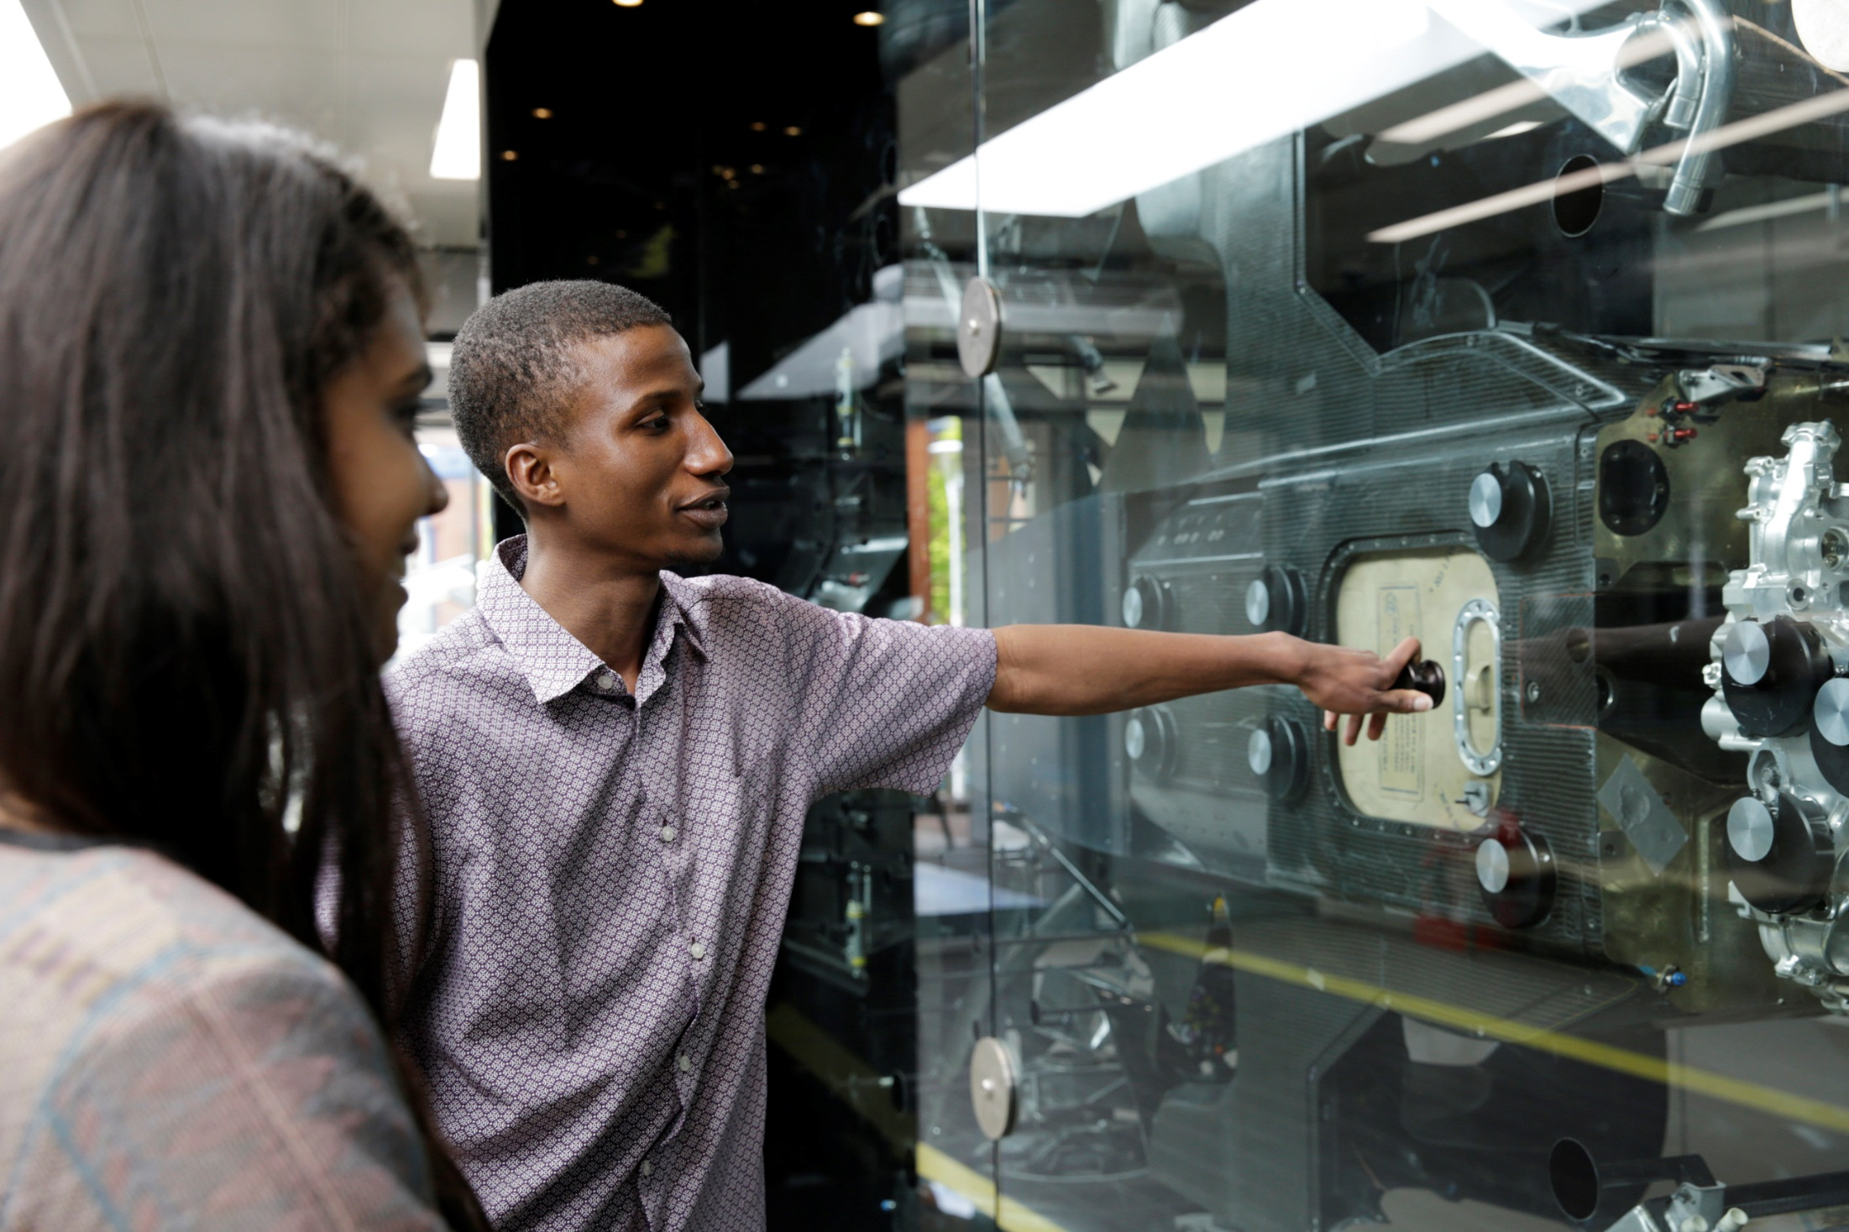
What our BAME students are telling us
Students report that they:
spend more time interpreting the brief than doing the assignment
turn to their peers for advice
struggle with assignment anxiety
Students:
believe that there are hidden questions/ requirement in the assignments set
approach staff for help, looking for the ‘magic key’
Students:
believe that there are hidden questions / requirements in the assignments set
approach staff for help, looking for the ‘magic key’
Students report that they:
spend more time interpreting the brief than doing the assignment
turn to their peers for advice
struggle with assignment anxiety
Notes:
Howell-Richardson (2012) notes that “assessments point create a ‘pedagogic battlefield between students & lecturers’”.
(Howell-Richardson, C. (2012) Challenges in Academic Writing’ Project. Unpublished research data. Coventry University: Centre for Academic Writing)

Slide 10
What Works? Recommendations
Clear (and concise) assessment briefs
Assessment unpacking – variations of student-led approaches
Course level assessment café during revision week

Slide 11
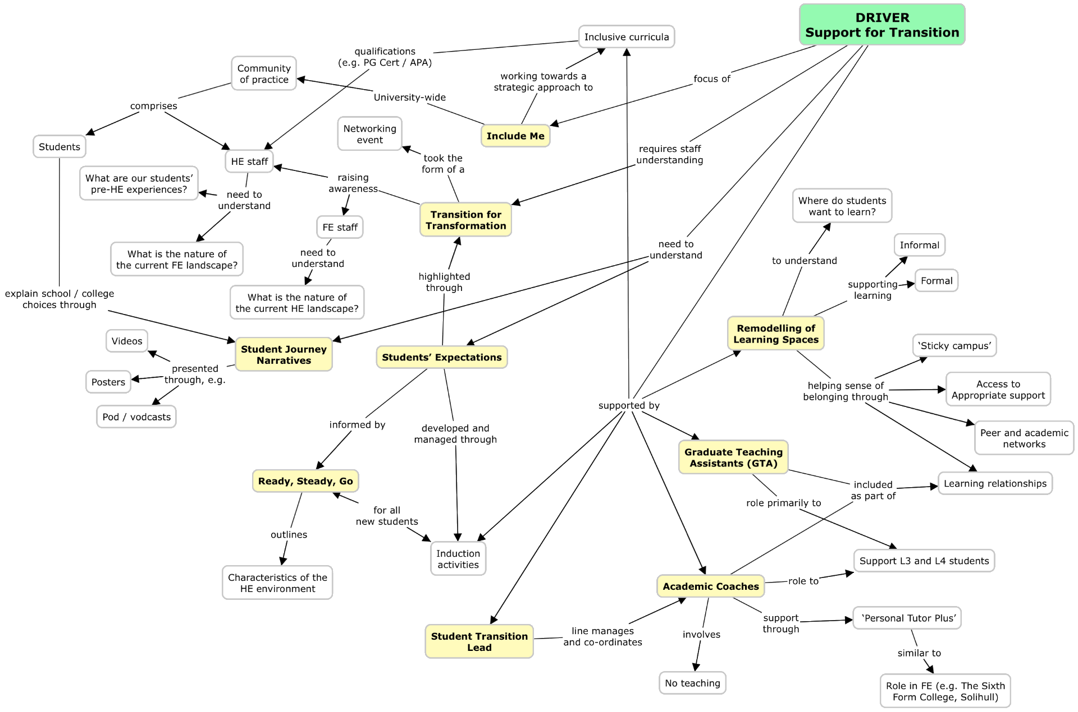
DRIVER project
Social and Cultural Capital
A concept map showing the activities undertaken by the University of Wolverhampton for the DRIVER project, and the links between these activities. The key activities are: remodelling of learning spaces; Graduate Teaching Assistants (GTAs); Academic Coaches; Student Transition Lead; Ready, Steady, Go; students’ expectations; student journey narratives; Transition for Transformation; and Include Me.

Slide 12
Universal Educational Design
Supporting students’:
Understanding (of higher education, the curriculum, etc.)
The slide shows a Venn diagram displaying the three proposed elements of an inclusive curriculum with three intersecting circles. The three elements are supporting students’ understanding of the curriculum; engagement with the curriculum; and demonstration of knowledge, skills and achievements. The centre, where all three circles overlap, represents a truly inclusive curriculum.
Inclusive curriculum
Engagement (with the curriculum, university, etc.)
Demonstration (of knowledge, skills, achievements)

Slide 13
Universal Educational Design: DRIVER projects
Students’ Expectations
Ready, Steady, Go
Understanding
GTAs
Academic Coaches
Student Transition Lead
Elements of the DRIVER project mapped onto the UED diagram.
Understanding: students’ expectations; Ready, Steady, Go
Understanding / Engagement: GTAs; Academic Coaches; Student Transition Lead
Engagement: remodeling of learning spaces
Understanding / Demonstration: assessment unpacking
Centre: Include Me
Assessment unpacking
Engagement
Demonstration
Remodelling of learning spaces
Include Me

Slide 14
Universal Educational Design: finished diagram
Understanding
The slide shows a Venn diagram displaying the three proposed elements of an inclusive curriculum with three intersecting circles. The three elements are supporting students’ understanding of the curriculum; engagement with the curriculum; and demonstration of knowledge, skills and achievements. The centre, where all three circles overlap, represents a truly inclusive curriculum.
Engagement
Demonstration

Slide 15
Universal Educational Design: eSTEeM presentations 1
What are the careers education, information, advice and guidance needs of Open University Level 1 Computing and Communication students?
David Conway
The Change in Student Engagement with Personalised Support: An Evaluation at the Mid-way Point of an eSTEeM-funded Project
Cathryn Peoples
Understanding
Understanding and Engagement elements of the UED model, with relevant eSTEeM presentations indicated.
Promoting Good Mathematical Communication as a key Employability and Transferable Skill in Level 1 Service Maths
Andrew Potter et al.
Student perceptions and development of employability skills in level 1 science
Fiona Aiken and Chris Hutton
Engagement
Maximising online tutorial attendance of a high population level 1 module
Susan Pawley
Generating graphical content for teaching: a simple and cheap way to produce diagrams/symbol rich content for forum postings and for live streaming in Adobe Connect
Nick Chatterton et al.
Can a new OU Study App enhance the learning experience of students on S350, an online only module?
Catherine Halliwell et al.

Slide 16
Universal Educational Design: eSTEeM presentations 2
Large-scale game-based activity for delivering experience of communication within teams
Matthew Nelson and David Bowers
A systematic review of pair programming for learners of programming at a distance
Adeola Adeliyi et al.
Blended Tutorials in Mathematics - Simultaneous Face-to-Face and Online Learning Events
Andrew Potter and Colin Blundell
Engagement element of the UED model, with relevant eSTEeM presentations indicated.
The role of large informal online workshops to engage and enthuse students studying SDK228 an interdisciplinary level 2 module
Janette Wallace and Isabella Henman
Engagement
OpenSTEM Africa: Strengthening science education in Ghana
Kerry Murphy et al.
The Mathematics and Statistics Study Site: Facts, figures and further plans
Rachel Hilliam et al.

Slide 17
Universal Educational Design: eSTEeM presentations 3
Understanding
Single Component Assessment Examination and Exam Feedback: the S112 experience
Jim Iley and Nick Adams
Understanding and Demonstration elements of the UED model, with relevant eSTEeM presentations indicated.
Demonstration
Can an asynchronous student conference in Open Studio develop students’ critical evaluation skills?
Catherine Halliwell and Jenny Duckworth

Slide 18
Universal Educational Design: staff diagram
Supporting staff to:
understand their students (e.g. characteristics, requirements and experiences)
A variation of the UED diagram showing how staff can be supported to:
Understand their students – including requirements and experiences
Recognise how their students are / can be engaged
Support students to demonstrate achievement of learning outcomes
recognise how their students are / can be engaged
design inclusive methodologies for students to demonstrate achievement

Slide 19
Universal Educational Design: staff eSTEeM presentations 1
Decentralised Qualifications on the Blockchain
Alexander Mikroyannidis
Developing “use value mindsets” to enhance undergraduates’ perceptions of learning mathematics in a first-year service mathematics environment
Gerry Golding and Andrew Potter
Giving practical support to MSc students in the Global South
Stephen Burnley and Sinead O'Connor-Gotra
understand their students (e.g. characteristics, requirements and experiences)
Understanding element of the Staff UED model, with relevant eSTEeM presentations indicated.
Factors influencing female participation in Physical Science Postgraduate Research Programmes
Anne-Marie Gallen et al.
Online Team Investigations in Science (OTIS) – The student view of online team-working in astrophysics and space science
Mark Jones et al.
‘More Learning Designers are Needed’: Identifying the instructional design competencies required for the successful implementation of the UK Open University learning design approach in three Chinese Open Universities.
Tom Olney et al.
Who are our apprentices?
Leonor Barroca and Matthew Walkley
Learning analytics - let's get real!
Steve Walker et al.
Perceptions, Expectations and Experience of Group Tuition: towards a shared understanding amongst stakeholders (part II: the student perspective)
Anne-Marie Gallen et al.
Using Real Time Student Feedback (RTSF) as an Emotion Awareness and Regulation Tool in an Assessed, Online, Collaborative Project
Jake Hilliard et al.

Slide 20
Universal Educational Design: staff eSTEeM presentations 2
understand their students (e.g. characteristics, requirements and experiences)
Exploring the use of Labcasts to Support Associate Lecturers
Venetia Brown et al.
Understanding and Engagement elements of the Staff UED model, with relevant eSTEeM presentations indicated.
Accessibility and inclusion in tuition: examples of individualised support
Rachel Slater et al.
recognise how their students are / can be engaged
Understanding and mitigating students’ difficulties in undertaking complex practical activities on their computers
Patrick Wong et al.
How Jupyter Notebooks enhance learning and teaching on TM351
Sharon Dawes et al.
STEM ISSS - where are we now? Evaluating awareness, usage and effectiveness of individual student support sessions
Fiona Moorman and Karen New
An AL led eSTEeM action research project to support students and tutors: challenges and opportunities
Shirley Evans et al.
Building a community of STEM ALs –extension of the STEM-ByALs-ForALs programme to include more social learning opportunities
Janet Haresnape et al.

Slide 21
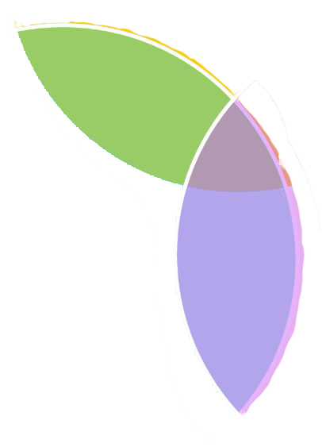
Universal Educational Design: staff eSTEeM presentations 3
TMA Extensions: How are they used and what is their impact on student success?
Catherine Halliwell and Cath Brown
understand their students (e.g. characteristics, requirements and experiences)
Understanding and Demonstration elements of the UED model, with relevant eSTEeM presentations indicated.
Evaluating the accessibility of an alternative format of module materials in Maths & Stats
Chris Hughes et al.
Curriculum innovation – transforming postgraduate learning systems for a world in turbulence
Rupesh Shah et al.
design inclusive methodologies for students to demonstrate achievement
Putting Innovation into Practice – Enhancing the STEM curriculum through scholarship
Trevor Collins et al.
Addressing Inequitable Outcomes for Black Students at The OU Workshop
Wendy Fowle et al.

Slide 22
VA Metric
Entry qualifications
& subjects of study
5 years sector attainment data
Expected % of cohort attainment
Probability of attaining 1st or 2:1
Aggregation of probability
Calculation of the value-added (VA) metric:
5 years sector attainment data
Entry qualifications and subjects of study
Probability of attaining 1st or 2:1
Aggregation of probability
Expected % of cohort attainment
If attainment > 1, attainment has exceeded expectation
If attainment = 1, attainment has met expectation
If attainment < 1, attainment has not met expectation
VA = 1
Attainment=
Expectation
VA = >1
Attainment>
Expectation
VA = <1
Expectation
Attainment<

Slide 23
University Level
VA scores at a university level for the academic years 2012/13, 2013/14 and 2014/15. White students are shown with VA scores > 1 (i.e. exceeded expectation) and BME students are shown with VA scores < 1 (i.e. did not meet expectation).
Population: 1,549
1st / 2:1 Expected: 69%
1st / 2:1 Actual: 63%
VA score: 0.91
Population: 1,301
1st / 2:1 Expected: 72%
1st / 2:1 Actual: 79%
VA score: 1.11

Slide 24
School Level
VA scores for School and course level. Both show white students with VA scores > 1 and BME students with VA scores < 1. The thickness of the line represents the number of students in the calculation (thicker line = more students). This shows that the numbers of BME students exceeds white students in all cases.
Course Level

Slide 25
Conclusions
A student’s sense of belonging may wax and wane throughout the period of their studies
Develop staff to be able to design multiple approaches to support students’:
Understanding (including terminology, expectations, etc.)
Engagement
Demonstration
Try not make assumptions about students’ experiences, expectations, motivations, etc. Determine ways to find out this information
Small changes can make a big difference

Slide 26
Thank you p.gravestock@wlv.ac.uk

Slide 27
References
Cousin, G. & Cureton, D. (2012) Disparities in student attainment (DiSA), York; Higher Education Academy. Available at: https://www.heacademy.ac.uk/ system/files/projects/worlverhampton_2010_disa_final_report.pdf
Cureton, D. & Gravestock, P. (2019) ‘We Belong’: differential sense of belonging and its meaning for different ethnicity groups in higher education, Compass: Journal of Learning and Teaching, 12(1). DOI: https://doi.org/10.21100/compass.v12i1.942
Cureton, D. and Gravestock, P. (2018) Supporting students’ learning: the power of the student-teacher relationship. In: M. Shah and J. McKay, eds., Achieving Equity and Quality in Higher Education: global perspectives in an era of widening participation. Cham, Switzerland: Palgrave Macmillan, pp.51-71
UUK / NUS (2019) Black, Asian and Minority Ethnic Student Attainment at UK Universities: #Closingthegap. Available at: https://www.universitiesuk.ac.uk/ policy-and-analysis/reports/Pages/bame-student-attainment-uk-universities-closing-the-gap.aspx

