Slide 1
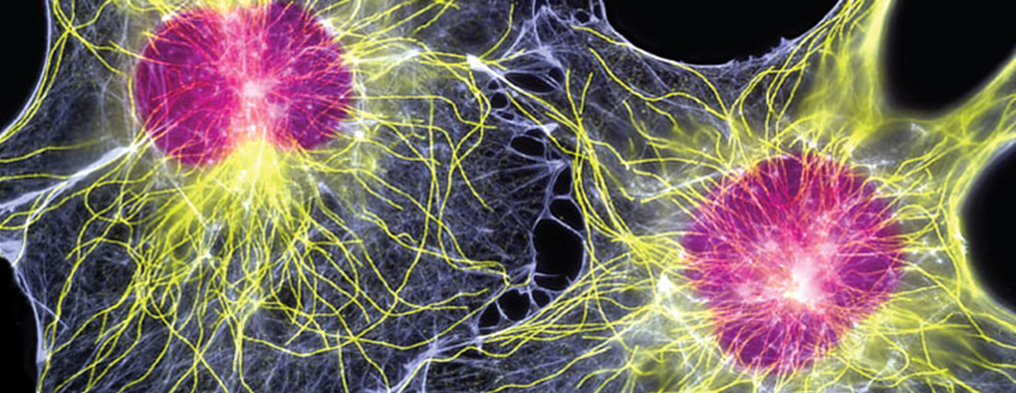

S294 Early Start: what has it achieved?
S294 Cell Biology
Jane Loughlin, Katja Rietdorf, Diane Butler, Kate Fox, Joy Wilson

Slide 2
What was the S294 Early Start?
Aimed to:
help students consolidate their prior study and gain confidence
give students chance to reflect on, and potentially adjust, their study plans
From early July to early Sept – registered students had access to the website with:
Forums moderated by ALs
Online tutorials on core topics and skills
‘AYRF S294?’ drop-in
Preparatory resources – Module Guide, ‘AYRF S294?’, ‘Core concepts from level 1 study’ etc
Module materials (online version of books, activities and quizzes)
Journal Club opportunity
Could not access TMAs
After the ES: ES forums and tutorials were available as read / view-only

Slide 3
Evaluation
Student engagement:
Forum activity
Tutorial attendance / views
Survey of students in 18J and 19J (n=91)
Semi-structured interview for 18J participants (n=6)
TMA submission and module completion rates
Impact:
Module results
Notes:
Engagement:
Analytics on student access to forum, plus categorisation of posts according to purpose / content – social chat or subject-related
For both forum and tutorial engagement, distinguished between those accessing during the ES period and those accessing after.
Impact:
Survey
Identical survey was run in 18J and 19J – targeted all students, not just those who participated but with specific questions on the support offered for those who did participate
Wanted to know what they made use of – interested in not just the ES activities and support, but also Preparatory materials, and to what extent they engaged with the main module materials
6 students agreed to follow-up interviews – Coded using Nvivo software
Looked at TMA submission and sitting exam as well as module results

Slide 4
Who takes up the Early Start?
Participation
18 J
19 J
39.4%
28.5%
60.6%
71.5%
N=807 students
N=729 students
Taking part in ES
:= viewed or created a post in the ES Forum
Not taking part in ES
:= not active on the ES Forum
Based on all students registered at Module Start
Notes:
Definition of ES participation was that they viewed or created a post on the ES Forum during the duration of the ES. (Don’t mention but for our memory: More detailed analysis of the engagement was done, but will not be presented here. Students not taking part were not distinguished into those registered during the ES period, or registering after the end of the ES period.)
Mention that data are presented separately for the 18J and 19J presentation when results differed, and combined when they were similar (to reduce the amount of graphs presented in this short presentation).
Some data based on all students registered at Module start, most for Reg25 only. Always shown in the bottom right hand corner in the relevant slides.
Participation was higher in 18J than in 19J. Not yet analysed for 20J.

Slide 5
Who takes up the Early Start?
Participation
Taking part in ES
Study Intensity
18 J
19 J
Not taking part in ES
18 & 19 J
39.4%
28.5%
60.6%
71.5%
N=807 students
N=729 students
Based on all students registered at Module Start
Notes:
Study intensity was not different between students participating or not in both presentations and was around 70 credits on average.
Date are mean ± SD, unpaired T=Test

Slide 6
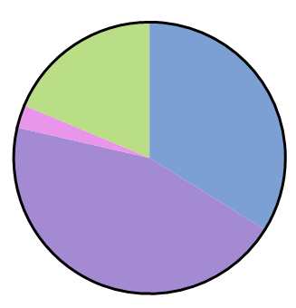
Who takes up the Early Start?
Participation
Taking part in ES
Study Intensity
18 J
19 J
Not taking part in ES
18 & 19 J
39.4%
28.5%
60.6%
71.5%
N=807 students
N=729 students
Qualifications
18 & 19 J: All students
18 & 19 J: ES participants
Based on all students registered at Module Start
Notes:
Majority of students are Q71 and Q64. Proportion of students overall and those taking part in the ES is similar.
I counted the first qualification listed in the list I received. I.e. if a student has listed Q64 in the first column of the CIRCE data, and R58 in the second, they count as Q64. Plenty have both, Q64 and R58 listed, but this was not quantified or taken into account.

Slide 7
Who takes up the Early Start?
Previous Performance
18 J
19 J
Taking part in ES
Not taking part in ES
Taking part in ES
Not taking part in ES
Based on all students registered at Reg25
Notes:
Previous performance was analysed on data from Martin Hlosta and is the average of Module Result from previously finished Modules. Together with the current Study Intensity, it is seen as the best predictor for future performance.
In 18J, students taking part has a significantly higher previous performance compared to those who do not take part (66.2 ± 18.9 vs. 53.9 ±24.2).
In 19J, there was no significant difference between students taking part and not (59.7 ± 23.5 vs. 57.5 ± 26.2)
Interpretation: Maybe word about the ES being there had spread for 19J and encouraged some ‘less keen’ students to also participate in the ES (remember that the uptake was~10% lower)
Unpaired T-test, Mean +_ SD

Slide 8
Engagement with ES resources / activities during the ES (n=62):
Notes:
Of the 62 survey respondents who had visited the S294 website during the Early Start period:
58% attended or watched a tutorial and 34% attended or watched all 5 tutorials
~85% accessed the forum.
~ 1/3 accessing at least once a week.

Slide 9
Notes:
In the survey, we asked ES participants to indicate how useful they found the various aspects of the Early Start, using a Likert scale.
The open bars indicate % of respondents who did not access or participate in a particular activity and the other bars indicate how students who did use them rated their usefulness.
Engagement with forum and tutorials was highest, but for all the activities, where students did engage, a majority rated them very useful.

Slide 10
Use of module materials during the ES
Of those students who accessed the ES website:
70% started to study the books
39% attempted related activities
32% attempted related self-assessment questions (SAQs)
Notes:
The survey also asked about use of the module materials.
S294 has 3 printed books which are sent out a few weeks before module start but students could access online versions during the Early Start and the activities and self-assessment questions.
Among those 62 survey respondents who visited the website during the ES period, 70% said that they had started to study the books during the ES…….
Analysis of open comments from the survey, where these were provided, showed that most got at least 2 or 3 chapters into Book 1, though there was one student who indicated that they had read all three books.
There was also some engagement with the main module activities and the self-assessment questions.

Slide 11
How and to what extent did students feel they benefited from the Early Start?
Notes:
Looking at the Early Start overall, we asked ES participants to indicate whether, and to what extent, they agreed with a number of statements about potential benefits of the early start.
There was strong agreement for statements about preparation, judging how much work was involved, and fairly strong agreement for statements on improving confidence, reducing stress and knock-on benefits for those studying other modules.
Fewer students were interested in the opportunity to meet other students in advance, interact with tutors or engage with the Journal Club.

Slide 12
Themes that emerged from interviews and open responses
Some students appreciated the extra time because they had health issues
Students saw it primarily as an opportunity to get ahead rather than prepare / consolidate prior learning
Some students felt pressure to engage – worried that would be disadvantaged / get behind
Some students appreciate continuity of study – don’t want too much downtime between modules
Danger of being lulled myself into a false sense of security and being too relaxed
Notes:
Qualitative analysis of the interview transcripts and open comments revealed some key themes that highlight other potential benefits of the Early Start and how students used the Early Start,
but also highlighted some potential drawbacks.
A few students indicated that the extra time was particularly beneficial as they had health issues or were anticipating a birth during the presentation.

Slide 13
Were students who engaged with the ES more likely to be retained?
TMA01 submission
18 J
19 J
Taking part in ES
Not taking part in ES
Taking part in ES
Not taking part in ES
Based on all students registered at Reg25
Notes:
In the following slides, results are presented separately for 18J and 19J as the pandemic caused 19J to be untypical for Module results (higher on average), and these graphs shown contribute to the interpretation of the Module results.
Students who participated in the ES have a higher submission rate for TMA01
18J: 5.8% higher (92.7 vs. 86.9%)
19J: 8% higher (84.7 vs. 76.7%)
Analysis: Chi-square analysis of submission per group with multiple comparison correction.
* indicates minimum statistical difference level (<0.05)

Slide 14
Were students who engaged with the ES more likely to be retained?
TMA01 submission
18 J
19 J
Taking part in ES
Not taking part in ES
Taking part in ES
Not taking part in ES
Module completion
Based on all students registered at Reg25
Notes:
Students who participated in the ES showed a trend for higher completion rate in 18J and had a significantly higher completion rate in 19J.
18J: 6.5% higher (72.1 vs. 65.6%)
19J: 11% higher (69.3 vs. 58.3%)
Analysis: Chi-square analysis of submission per group with multiple comparison correction.
* indicates minimum statistical difference level (<0.05)
18J showed a significant difference if only students who were registered during the ES period were analysed.

Slide 15
Does participating in the ES affect the Module Results?
Module Result
18 J
19 J
Taking part in ES
Not taking part in ES
Taking part in ES
Not taking part in ES
Remember:
Lower number = better outcome ☺
Based on all students registered at Reg25
Notes:
Mention that this needs to be considered separately from 19J as different result distribution in remote exam
Remember that a lower number is a better result
18J: Significantly better results (2.7 ± 1.2 vs. 3.2 ± 1.3) – remember: stronger students taking part. But more detailed analysis indicates that also students with a weaker predicted result did benefit.
19J: Trend for better results (2.2 ± 1.0 vs. 2.4 ± 1.1)
Interesting that this is despite students taking part not being stronger on average. More detailed inspection of the results distribution provides more evidence for this.
Unpaired T-test, mean ± SD

Slide 16
Judging the effect of the ES: Predicted vs. actual results in 19J
All students
Taking part
Not taking part
Based on all students registered at Reg25 who completed and had a predicted result
Notes:
19J – remote exam: so actually results were better than predicted (typically S294 has lower results than the predicted ones and the orange curve is shifted to the right).
When separating data for students taking part in the ES and not taking part, we see that for both, more students than predicted received a 1st . However, the proportion of those is higher for students taking part (you see a bigger part of the green curve than the blue one). Also, more students than predicted who participated in the ES received a 2nd, whilst fewer of the non-participants received a 2nd. This trend to an better result continues for the lower results, grades 3-5, seen as a bigger gap between the green actual results and the grey predicted results curve, whilst actual and predicted results are pretty similar for grades 3-5 for the non-participating students.

Slide 17
Conclusions
Early Start was very popular with students
Students used it primarily to get ahead rather than consolidate or prepare
All aspects of support were valued highly by those students who participated in them (participation highest in tutorials and forum)
Some students felt pressure to engage
Retention (TMA01 submission and completion) is higher for students participating in the ES
Students who participated in the Early Start in 18J had a statistically better module results
In 19J the distribution of Module results was shifted towards better than predicted results for students who participated in the ES and there was a trend for better module results.

Slide 18
Acknowledgements
S294 Early Start Tutors (Kate Fox, Trish Aldred, Heather Fraser, Jo Culross)
Kate Fox (AL consultant on the project)
Joy Wilson (CM)
eSTEeM
Students who agreed to interviews
Those who have supplied performance data
Carole Calvert for advice on setting up the Early Start

