Slide 1
Intro Slide Title 1
Evaluating the effectiveness of printed materials as an alternative to online resources in Environmental Science
Fiona Aiken and Chris Hutton
Senior Lecturers in Environmental Science
19 April 2023

Slide 2
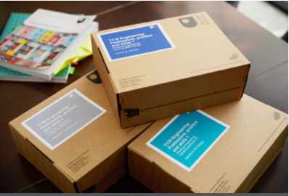
Contents
Introduction
Background
Objectives
Literature
Methods
Results and Discussion
Quantitative data
Focus group data
Student questionnaire data
Student Voice
Interim Conclusions and Recommendations
Acknowledgements
References

Slide 3
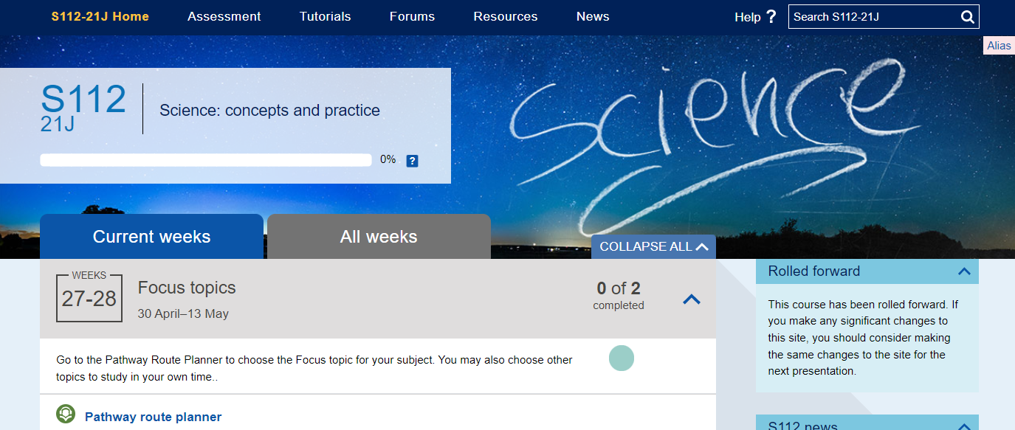
Introduction
Background
Teaching materials for Environmental and Earth science are delivered online
No textbooks
Online materials may present accessibility barriers
Additional requirements
Secure Environments
Limited / poor internet access
In these cases, a printed version of the online materials is provided

Slide 4
Introduction
Our project
This presentation summarises findings of objective 1 and 2.
Objectives…
Evaluate the current use and efficacy of print packs for students and their Associate Lecturers (ALs)
Design an intervention and train AL champions to improve print pack use
Re-evaluate use and efficacy of print packs post-intervention
Note on literature…
Strong focus on disability
Very little on print as an accessible alternative to online materials

Slide 5
Introduction
The literature
The Open University is the largest HE provider for students with disabilities (36,400 declared a disability in 2020/2021 (The Open University, 2021a).
There is a large amount of literature on disability in relation to HE in general. e.g. Seale (2014), Moriña (2017)
Collins et al (2019) focuses on inclusion and links to employability: there is a move away from ‘reasonable adjustments’ to inclusive education for all’ but there remains a focus on adjustments for individual students.
Online formats, particularly asynchronous, give greater flexibility to disabled students having more difficulty concentrating / staying on task (Terras et al., 2015)
Studying online means students can engage with peers and academics regardless of difficulties e.g. with vision or mobility (Seale, 2014).
The OU strives to make online modules as accessible as possible but recognises that some elements might not be fully accessible, e.g. online experiments / interactive activities (The Open University, 2021b).
Adjustments provided as standard include figure descriptions, audio / video transcripts and closed caption subtitles (Slater et al., 2015).
Students in Secure Environments (SiSE) and members of armed forces on operational duty have no or limited internet access, so may not be able to study online.

Slide 6
Methods
Research instruments used to evaluate print pack use and efficiency
Associate Lecturer Focus Group
(SiSE theme)
Student Support Team Focus Group
(Non-SiSE theme)
Quantitative Data
(OU data)
Student survey
(Non-SiSE)
Literature review
All University ethical approvals obtained prior to starting.
SiSE = Students in Secure Environments

Slide 7
Results and Discussion
Quantitative data - baseline
S112 - Science: concepts and practice
Comparison of previous two years data
Focus on first assignment submission and score
Least affected by pandemic
SiSE perform better than whole cohort
Print pack users lower than whole cohort
Many have complex additional needs
 | SiSE | Print pack | All
2019-20 | 11 | 35 | 1536
2020-21 | 14 | 21 | 1731

Slide 8
Results and Discussion
Focus Groups
Both
- Late delivery
- Poor organisation
SST (Print pack users)
- Blended use
- Few complaints
- Viable work-arounds
ALs (SiSE)
- Blended use often impossible
- Poor interactivity
- Lack of AL info and support
AL = Associate Lecturer
SST = Student Support Team
SiSE = Students in Secure Environments

Slide 9
Results and Discussion
Student questionnaire – initial highlights
Sample of eligible print-pack users (not SiSE)
Response rate of 30 % (n = 13)
Most rely heavily on print packs as an adjustment for disability
Most blend with online resources
Interactive content
Media
Tutorials
Main advantage: improving accessibility (e.g. visually impaired, difficulty sitting at desk)
Improvements: timely delivery, better organisation / format

Slide 10
…ensuring they arrive slightly earlier than the study weeks they cover (rather than later!)…
Student Voice
Quotes from the student questionnaire
Cannot use a screen for reading large amounts of text so would be unable to sufficiently complete the modules without the printed materials
Being disabled I struggle to sit at a desk for long periods due to chronic pain so I use the printed packs to study whilst lying down

Slide 11
Interim conclusions and recommendations
Positives
Very valuable in blended context
Enable study when no online access
Improvements /
Recommendations
Timely delivery / better organisation
More support for students & ALs
Better interactive adaptations
Current and
next steps
ALs working as champions in 22J on S112 and S206
Post-intervention evaluation

Slide 12
AL Print Pack Champions
Interim findings…
Students who have access to module website are better supported by print packs than SiSE who rely entirely on print packs
Sticky threads on tutor forums used to engage tutors at module start – some initial activity, then quiet
Tutors found access to print pack resources on SharePoint helpful on S112
Physical copies of print pack delivered to champions for evaluation – better organisation and introduction recommended (e.g. covering letter with advice on which documents to prioritise; explanatory titles and cross-links between resources)

Slide 13
Acknowledgements
Dr Jane Kendall-Nicholas and Dr Kim Vickers – AL print pack champions
Dr Jenny Duckworth – literature searching / review
Associate Lecturers and Student Support Team colleagues participating in focus groups
Student reviewers for questionnaire design
eSTEeM – The OU Centre For STEM Pedagagy – for funding

Slide 14
References
Collins, A., Azmat, F. & Rentschler, R. (2019). ‘Bringing everyone on the same journey’: revisiting inclusion in higher education. Studies in Higher Education, 44(8), 1475-1487. https://doi.org/10.1080/03075079.2018.1450852
Moriña, A. (2017). Inclusive education in higher education: challenges and opportunities. European Journal of Special Needs Education, 32(1), 3-17. https://doi.org/10.1080/08856257.2016.1254964
Seale, J.K. (2014) E-Learning and Disability in Higher Education: Accessibility Research and Practice (2nd Edn), Abingdon, Routledge.
Slater, R., Pearson, V.K, Warren, J. P. and Forbes, T. (2015). Institutional change for improving accessibility in the design and delivery of distance learning – the role of faculty accessibility specialists at The Open University. Open Learning, 30(1), 6-20. https://doi.org/10.1080/02680513.2015.1013528
Terras, K., Leggio, J. & Phillips, A. (2015). Disability accommodations in online courses: The graduate student experience. Journal of Postsecondary Education & Disability, 28(3), 329-340.
The Open University (2021a). Facts and Figures. https://www.open.ac.uk/about/main/strategy-and-policies/facts-and-figures
The Open University (2021b). Accessibility statement for the Open University. https://www.open.ac.uk/about/main/strategy-and-policies/policies-and-statements/website-accessibility-open-university

Slide 15
Slide Title 30
Thank you
Questions?
Fiona.Aiken@open.ac.uk
Christopher.Hutton@open.ac.uk

Slide 16
Slide Title 31

