Slide 1
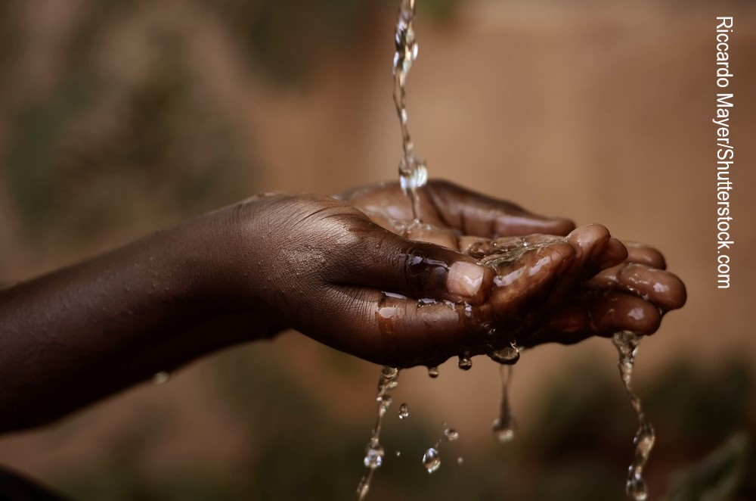
OpenWASH evaluation
Pam Furniss Senior Lecturer in Environmental Systems
Engineering & Innovation, STEM Faculty, The Open University, UK
October 2018

Slide 2
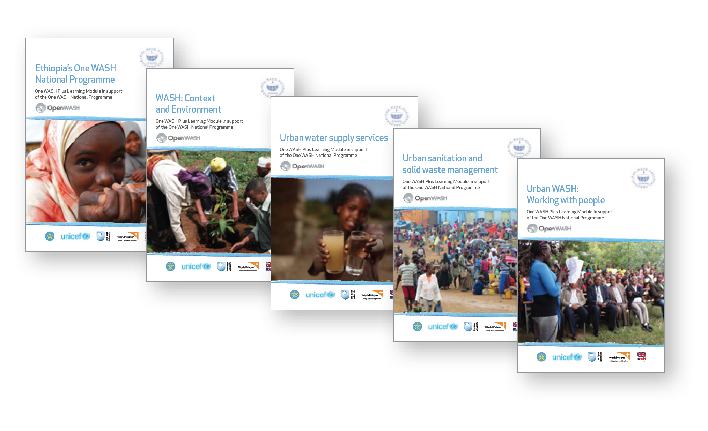
What is OpenWASH?
High quality learning resources for the water, sanitation and hygiene (WASH) sector in Ethiopia
Five modules and Trainers’ Handbook (2016) plus new module Count me in! Inclusive WASH in Ethiopia (2018)
Modules intended for print and also freely available online http://www.open.edu/openlearncreate/openwash

Slide 3
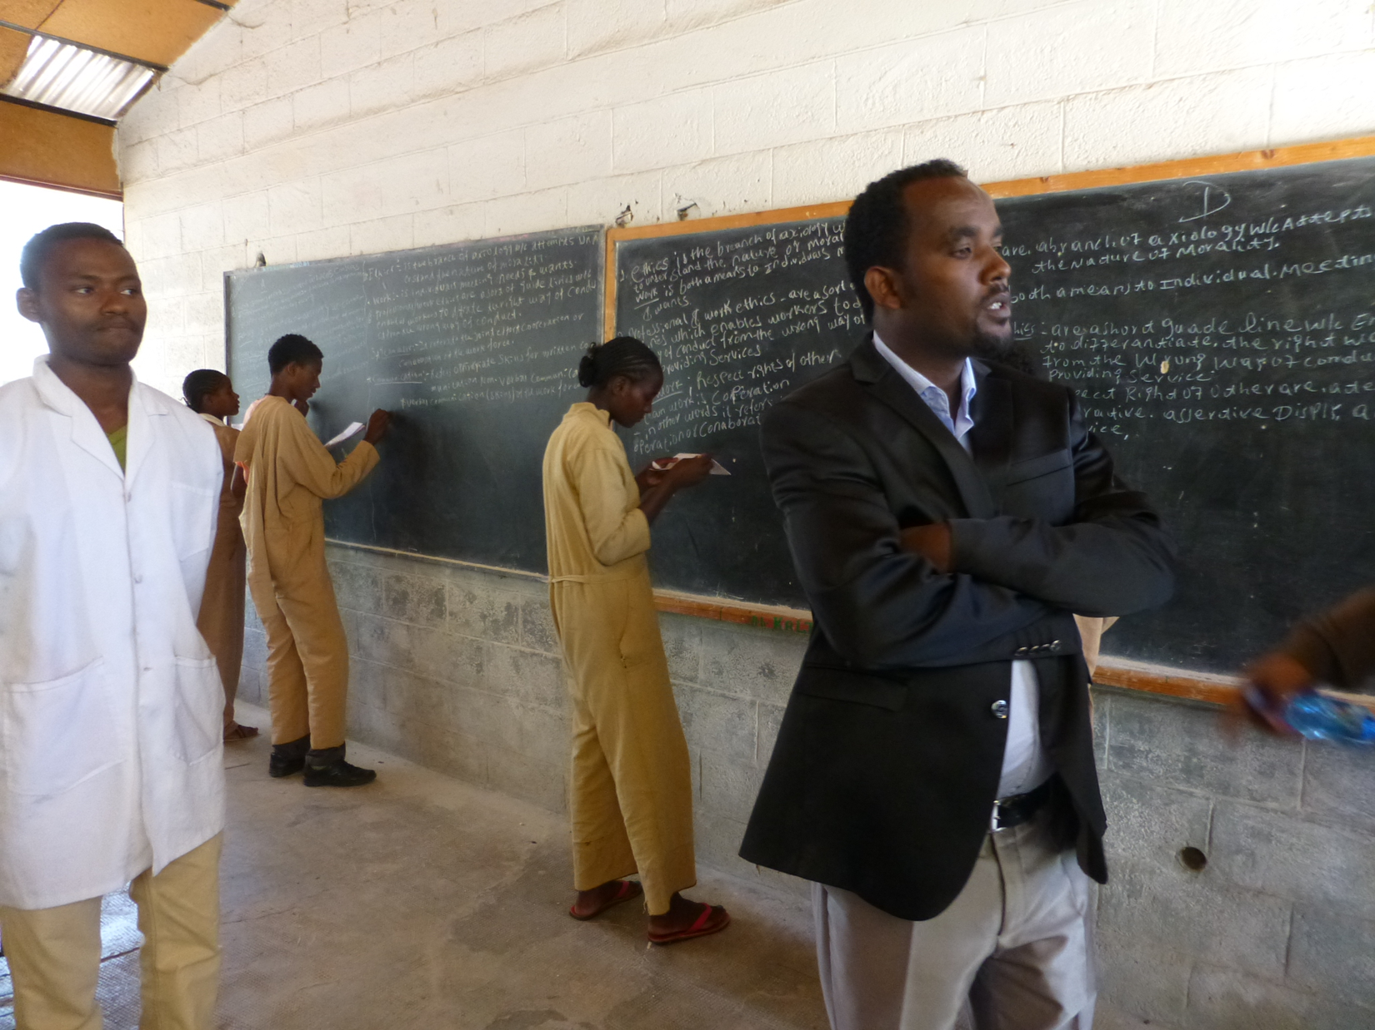
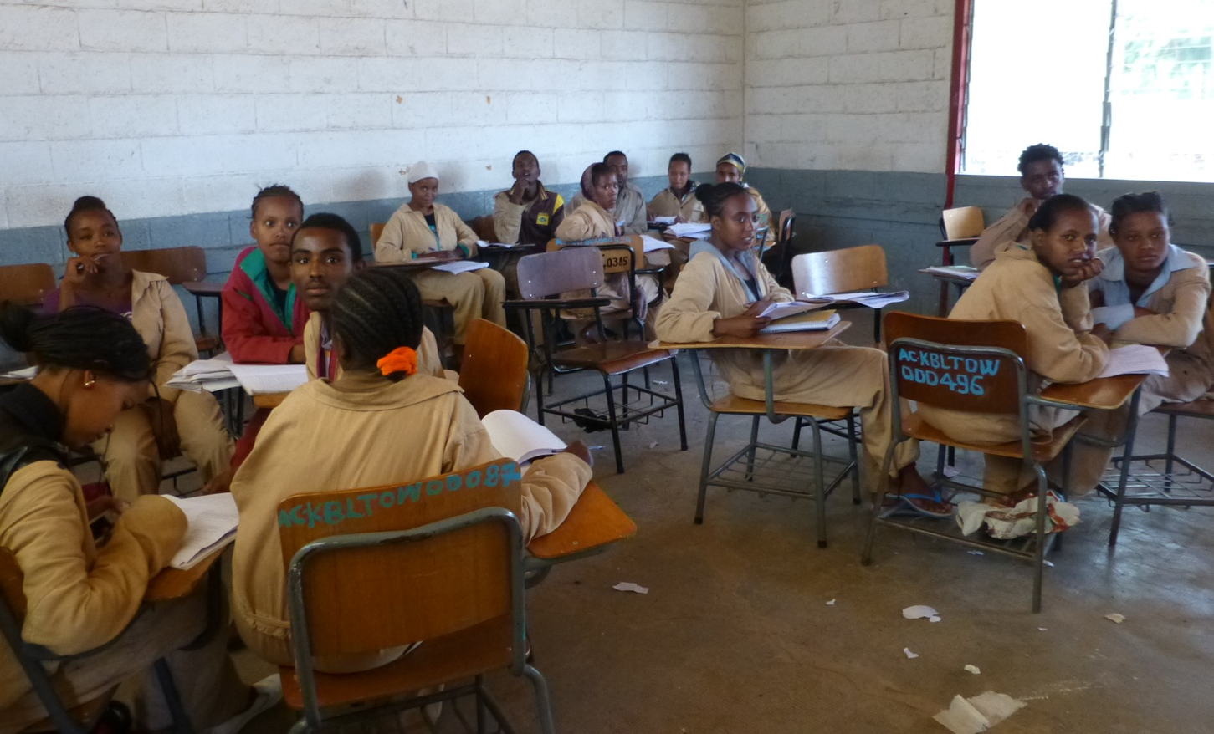
The story so far
Modules have been piloted in TVET and Health Science colleges
Also used for short training courses and professional development
> 1100 students (July 2017)
What happened next?
Evaluation project
Visit the colleges and other users for interviews, surveys with staff and students
Assess outcomes and impact of project so far
Identify future opportunities (and constraints) for wider use, update and adaptation

