Slide 1
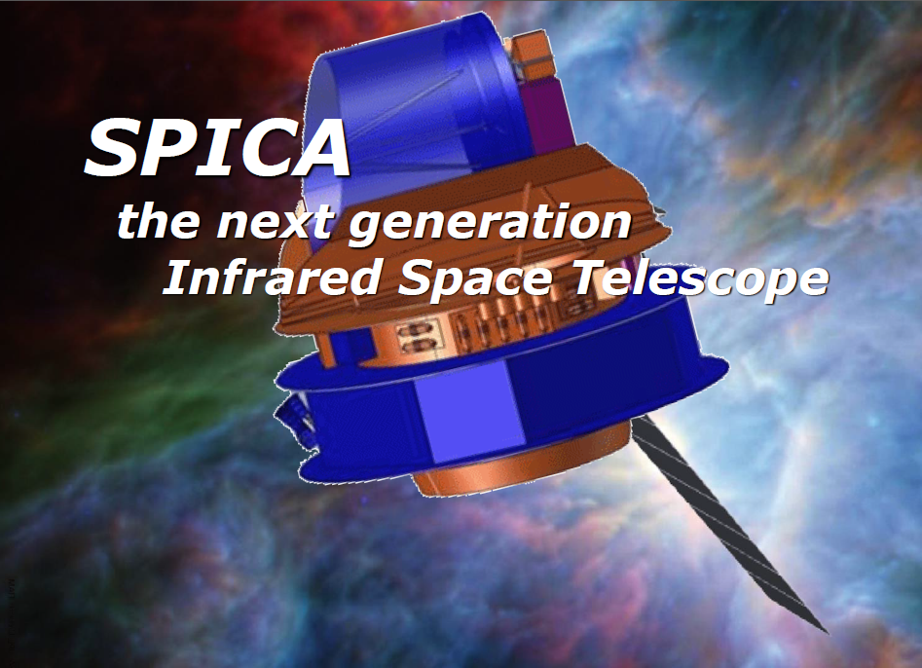
UK SPICA Science Meeting, RAS, 22 Jan. 2016
Introduction
Matt Griffin, Cardiff University

Slide 2
Meeting Objectives
Provide an update on SPICA status and
plans
Assess SPICA scientific capabilities and
priorities for the UK community
Clarify opportunities/mechanisms for UK
community engagement with the SPICA
team, the SPICA M5 proposal, and beyond
Plan for future promotion of SPICA within
the UK

Slide 3
Agenda
10:30 Introduction Matt Griffin
10:50 SPICA and M5 Peter Roelfsema
11:10 SPICA in Japan Takashi Onaka
11:20 UK technical participation Matt Griffin
11:40 SPICA science overview Dave Clements
12:00 Galactic science Derek Ward-Thompson
Mark Wyatt
Mikako Matsuura
Jane Greaves
Helen Fraser
13:10 Lunch

Slide 4
Agenda
13:10 Lunch
14:10 Nearby galaxies Floris van der Tak
Cristina Popescu
Izaskun Jimenez-Serra
15:10 Distant galaxies Cedric Lacey
Michal Michalowski
Carlotta Gruppioni
Mat Page
Mattia Negrello
16:30 Detectors Stafford Withington
16:50 Discussion and wrap-up

Slide 5
SPICA in the UK
UK participation in SPICA initiated by Bruce Swinyard
in 2004
SPICA-SAFARI consortium UK-led initially, then
transferred to Netherlands in 2009
No direct UK funding for SPICA since then but ESA
CTP programme for related detector development
UK SPICA team made submission to AAP and 2012
STFC Programmatic review. Based on
- UK ability to make essential technical contribution
- Strong science case
- Planetary system formation and evolution
- Stars and the lifecycle of dust and gas
- Nearby Universe
- Galaxy evolution and cosmological surveys

Slide 6
SPICA in the UK
UK participation in SPICA initiated by Bruce Swinyard
in 2004
SPICA-SAFARI consortium UK-led initially, then
transferred to Netherlands in 2009
No direct UK funding for SPICA since then but ESA
CTP programme for related detector development
UK SPICA team made submission to AAP and 2012
STFC Programmatic review. Based on
- UK ability to make essential technical contribution
- Strong science case
- Planetary system formation and evolution
- Stars and the lifecycle of dust and gas
- Nearby Universe
- Galaxy evolution and cosmological surveys

Slide 7
SPICA in the UK
Reasonable outcome
  Rated g-2 in PR (as good as can be expected for a
  proposed future mission)
  Favourable recognition in the 2012 AAP report
SPICA and SAFARI have evolved since then
- 2.5-m telescope
- SAFARI grating spectrometer instead of FTS
- Now planned as a joint European-Japanese mission
- M5 rather than M4
But still as exciting as ever scientifically, and case
for UK technical involvement is as strong as before
SPICA not on UKSA radar today, but UKSA is amenable
to supporting ESA M missions

Slide 8
Possible M5 Schedule
ESA call for proposals Apr. 2016
Deadline for proposal submission Aug./Sept. 2016
Selection of missions for Phase-A study Early 2017
Selection of mission for implementation ~ End 2018
Launch ~ 2029

Slide 9
Next Steps
No prospect of UKSA funding unless/until
  SPICA is selected for Phase-A study by ESA
  UKSA receives strong formal advice from STFC
  that SPICA is scientifically a high priority mission
  for the UK community
Assist with strong M5 proposal
Build support within the UK scientific community
for SPICA and engagement with the SAFARI
Consortium
Ensure that STFC register SPICA as an important
mission

Slide 10
UK SPICA Science Meeting, RAS, 22 Jan. 2016
Potential UK Contributions
to SAFARI
Matt Griffin, Cardiff University

Slide 11
Potential UK Technical Participation
Based on Herschel experience and strong detector
development programmes, UK can make key
CoI-level contribution to SAFARI
Following handover of PI-ship in 2009, technical
participation was prioritised:
  Contribution to detectors
  Ground Segment
  Filters and quasi-optical components
Change from FTS to grating spectrometer
  No impact on priorities
  Poses different challenges for the detectors

Slide 12
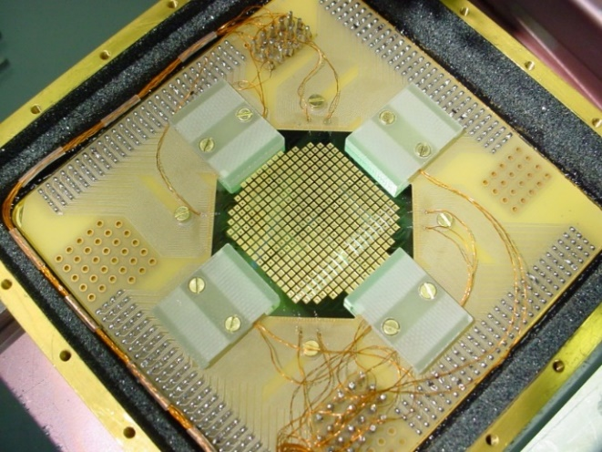
Detectors
See talk by Stafford later
Affordability of detectors for
SAFARI likely to require contributions
from several countries
  UK
  USA
  Netherlands
Exact division of responsibilities TBC
UK role will be major and highest priority
because
  Return on many years of STFC
  investment in superconducting
  detector development
  High-profile contribution, unique and key to mission
  success
  Conducive to strong voice and influence in the
  international consortium

Slide 13
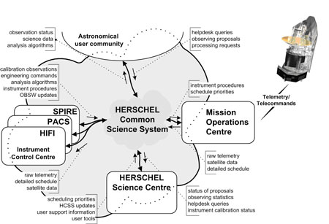
Ground Segment: Herschel Example

Slide 14
Ground Segment
Herschel (and Planck) experience
  Early, coordinated, sustained investment in ground
  segment pays dividends
    High data quality → scientific productivity
    Thorough national-level understanding of system and instrument behaviour promotes strong community engagement in science planning and implementation
  Potential UK contributions
    Detector data pipelines and calibration
    Support of ground and in-orbit testing
    Definition, simulation, optimisation of observing
    modes
    High level of UK expertise in these areas from
    Herschel
Substantial investment in SAFARI detectors could not
be fully justified without GS contribution

Slide 15
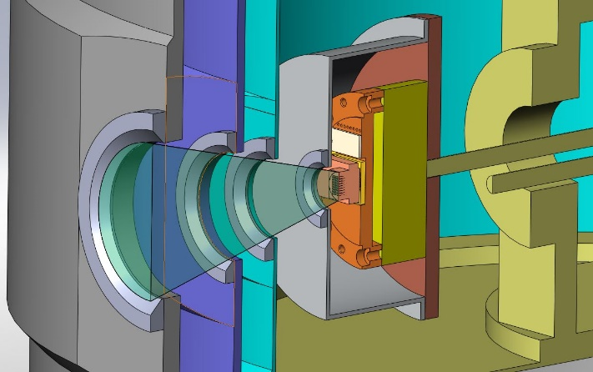
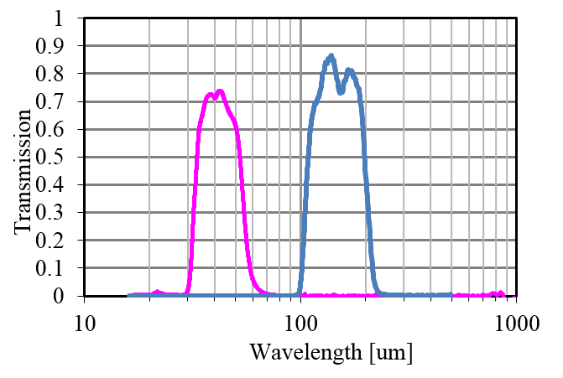
Filters and Quasi-Optical Components
Essential for SAFARI
- Band selection
- Thermal optimisation
UK is effectively sole supplier
through Cardiff group technology
Third priority for UK funding
at this stage as discussion
underway with Sweden about
collaborative provision

Slide 16
Guaranteed Time
SPICA guaranteed time arrangements still to be
defined/agreed
Not likely to be as high a proportion of mission time
as for Herschel
Proposed UK approach to GT
  Regardless of the absolute amount or the SAFARI
  Consortium rules for GT, the UK proportion will
  be opened up to all UK institutions
  A UK SPICA Science Team will be formed to define
  and manage that process
  No special rights for institutions making technical
  contributions to SAFARI

