Slide 1
IT Service Desk Jon Steggles Team Leader 2nd Line Service Desk

Slide 2
IT Service Desk
IT Service Desk
The Services and Support Team comprises of the following teams:
1st Line
This team is the first point of contact between the IT organization and the business for all incident reports and service requests.
2nd Line
Second Line deal with the queries submitted via the self service portal and Incidents that first-line support escalate.
Service Administration
Account creation and administration al all user accounts at the University
Audio Visual
Management of meeting rooms and The lecture theatres on campus, filming and Streaming live events

Slide 3
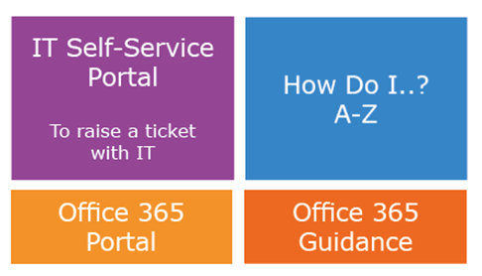
IT Service Desk
IT Service Desk
All Graduate student IT support requests are handled by the Service Desk
Hours: 9.00am – 5.00pm Monday – Friday
Telephone: 01908 (6) 54321
Linked from the IT intranet using these buttons:
Type ‘askit’ into your web browser

Slide 4
IT Service Desk
When should I contact IT over the phone directly?
Only contact the IT Service Desk directly on 01908 (6)54321 if your issue is stopping you from working.
Important Steps To Take If You Encounter IT Issues
​​If you encounter one of the commonly seen issues below, please first use the helpful resources and guides found in our How Do I? Guides.
Self-Service portal
Details on the Staff Self-Service portal how to raise tickets and the difference between an Incident and a Service Request can be found on this resource page:
https://openuniv.sharepoint.com/sites/intranet-it/Pages/shes-got-ticket-raise.aspx
The Self-Service portal can be found via this link:
https://askit.open.ac.uk

Slide 5
IT Service Desk
Please raise Incident Requests (IRs) via 'Report an incident’ on the self service platform if something broken or not working properly
Service requests should be raised when additional software is required, please see the software centre for all free to air software. Anything that requires a licence will need to have approval from a supervisor.
For all new post grad research students raising tickets, calling or emailing the Service Desk in the month of October please enter URGENT PGRS in the title or let the Service desk know you are new to the university so the Service Desk can prioritise the tickets and ensure they are assigned to the correct team if needed.
Existing students are asked to raise tickets as normal.
If emailing out of hours or from overseas, the email address for IT Service Desk is IT-Service-Desk@open.ac.uk , please include a with contact number and state what the problem is include any OU asset numbers in the email. As above for all new students please include URGENT PGRS int the title for the month of may.

Slide 6
IT Service Desk
OU Account unlock/Windows password change
Please use this guidance on OU Account unlock or Windows password change:
https://openuniv.sharepoint.com/sites/intranet-it/Pages/password-reset.aspx
This link can be used to perform an OU Account unlock or Windows password reset via a smart mobile or tablet
https://pwreset.open.ac.uk/PasswordReset/
If this site does not work, then please call for assistance.

Slide 7
IT Service Desk
Hardware
The University provides HP Optimised Windows 10 laptops.
Desktop devices can be requested with a business case and will need to be approved by a supervisor.
All devices are deployed with a managed O/S with Microsoft office 365.
All Hardware is faculty procured, if you require any additional hardware please speak to a supervisor for approval.
Devices are secured with Bitlocker encryption to secure data.
Semi Autonomous permissions and Autonomous devices can be granted Information on both can be found here: https://openuniv.sharepoint.com/sites/intranet-it/Pages/managed-autonomous-and-semi-autonomous.aspx

Slide 8
IT Service Desk
BitLocker Self-Reset
To reset your Bitlocker encryption code please follow the steps here:
https://openuniv.sharepoint.com/sites/intranet-it/Pages/changing-bitlocker-password.aspx
Please take note of this web page and save this to you smart mobile or tablet where possible:
https://bitlocker-service.open.ac.uk

Slide 9
IT Service Desk
Office 365
Go to http://portal.office.com
Log in with OUCU@open.ac.uk and your normal OU password
From here you have access to your emails, OneDrive, Yammer, your calendar and online Office apps - Word, PowerPoint, Excel and OneNote. See: Advice on Office 365 portal
When you login to the portal, you have links to install Microsoft Office 365 for free onto up to 5 computers/mobile devices and also if you click on Microsoft Teams from the home page, you can download the Desktop client for your personal machine.
Learn By App: Office 365
The IT pages on the intranet have a central repository with information & in-depth guidance on the Office 365 suite of software.
https://openuniv.sharepoint.com/sites/itmgt/o365/SitePages/Learn%20by%20App.aspx.

Slide 10
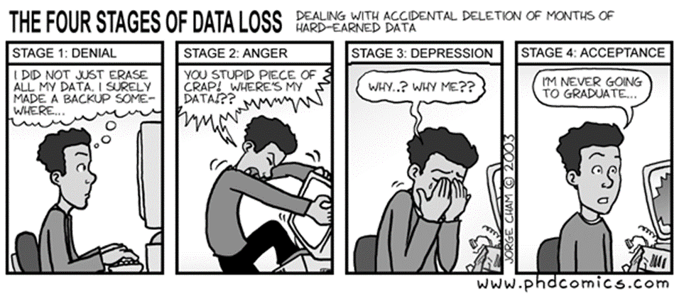
IT Service Desk
One Drive
OneDrive is a place to save your files online (similar to Dropbox).
Total storage per person is ​​1T with a size limit per file of 10GB and file are encrypted at rest and ​in transit.
https://openuniv.sharepoint.com/sites/itmgt/o365/SitePages/OneDrive.aspx
Please ensure your Research is Securely Backed up at all times, Data Loss can be avoided!

Slide 11
IT Service Desk
Software
Some software has already been packaged and is available either for you to install yourself through your Application Catalogue, or for you to request via a Service Request in IT Self-Service.
The Open University Maintains a Catalogue of 1200+ applications.
Other software may require your faculty to purchase a licence and must be requested through your supervisor.
This information can be found in the Software Catalogue via the IT Intranet.
https://openuniv.sharepoint.com/sites/intranet-it/Pages/software.aspx

